Slide 1
Mental Health: It’s everyone’s business
Sophie O’Keefe,
PD Manager,
English Australia

Slide 2
Who is English Australia?
Peak body member association
for the ELICOS sector
www.englishaustralia.com.au
Notes:
Brief introduction to who English Australia is to situate the presentation contextualy.

Slide 3
Presentation Overview
Common issues in ELICOS student mental health
Challenges in providing student mental health support
How teachers can make a difference
Frameworks for talking to distressed students

Slide 4
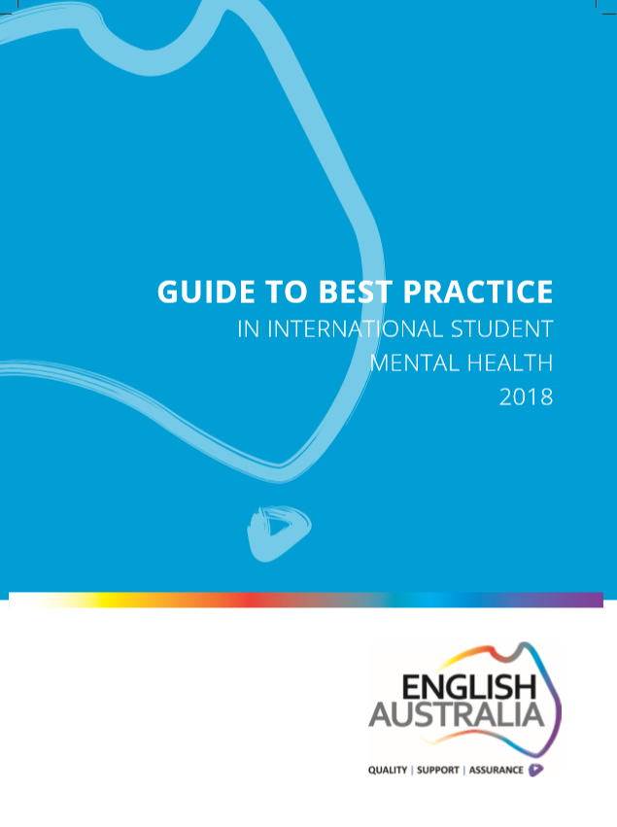
Guide to Best Practice in International Student Mental Health
www.englishaustralia.com.au/professional-development/best-practice-guides
Thanks to our Guide funding partners
Notes:
Snapshot: ELICOS mental health landscape
Key features of effective mental health policies & procedures
Guide to available MH services and resources
Real examples and case studies throughout
4

Slide 5
Mental Health survey
In the past 2 years, which mental health issues have students at your institution experienced?
Feelings of extreme highs & lows
Substance abuse
Self-harm or risk of self-harm
Debilitating acculturative stress
Eating disorders
Drastic change in behaviour
Psychosis
Post-traumatic stress
Paranoia
Anxiety 89 %
Depression 81 %
Extreme worry 73 %
Grief-related stress 68%
Social withdrawal 52%
Panic attacks 52%
Suicidal thoughts 39%
Internet/gaming addiction 38%
Domestic violence 38%
37%
30%
29%
25%
25%
21%
18%
15%
13%
Guide to Best Practice in International Student Mental Health (2018)
Notes:
Note: At English Australia mental health Forums, many professionals cited ‘insomnia’ as a huge issue
Why is it useful to have this data?
-Can inform staff training focuses and connection to outsourced services.
-As Ts, what to be aware of. Ss can reach out in different ways.
Audience Qs:
Do any of these surprise you?
Are there any others not included here?

Slide 6
Challenges for education providers
What are the main challenges your institution faces in providing support to students experiencing mental health difficulties?
Notes:
I will ask people to think about this for 30 seconds.

Slide 7
Top challenges for ELICOS centres
Stigma & students not seeking help
Lack of staff expertise & training
High demand for counselling & limited
human resources
Identifying students early
Non-disclosure of issues before arrival
Budget constraints
Notes:
Person nominated as std counsellor was often DoS, Head teacher, student services staff. Many of these people have undertaken short training courses, such a MH First Aid.
3. Stigma related to different cultural paradigms of dealing with mental health and comments indicate also that Ss are fearful that disclosure may mean they are sent home.
4. Access to counselling staff in a timely way – wait periods; and smaller colleges are stretched for human resources (takes up a lot of time)
5. It’s extremely difficult to talk about emotions in another language, esp when you are distressed. A lot of colleges use staff members who are not trained interpreters to help but this can be problematic.
6. Although many colleges have great services for Ss, they are still struggling to get Ss to use them.

Slide 8
Training for all staff
Assists with:
Breaking down barriers
Early intervention
Whole-of-organisation approach
Reducing staff stress levels

Slide 9
Training for all staff
Clear reporting lines are important. If I knew these, I would feel so much more confident when faced with a student with mental health issues.
I would like to know more about how to deal with critical cases, in that first meeting when I often feel overwhelmed myself.
I don’t know exactly how much I should be doing to help students with mental health issues. Where should I draw the line?
ELICOS teacher quotes
Notes:
Ask participants to comment on if any of these comments resonate with them.

Slide 10
Training for all staff
Training in:
Mental health protocols –
what to do & limits
Critical incident procedures
Identifying issues
Having difficult conversations
E.g. Mental Health First Aid
or ‘Accidental Counsellor’
Notes:
So, what could this training look like?
Examples of best practice:
-Macquarie Uni twice a year seminars
-NVTS PD sessions focus on a single common issue such as anxiety and panic attacks
-Adelaide University ELC – the counselling service train staff to use its ‘assisting students in distress flowchart.’

Slide 11
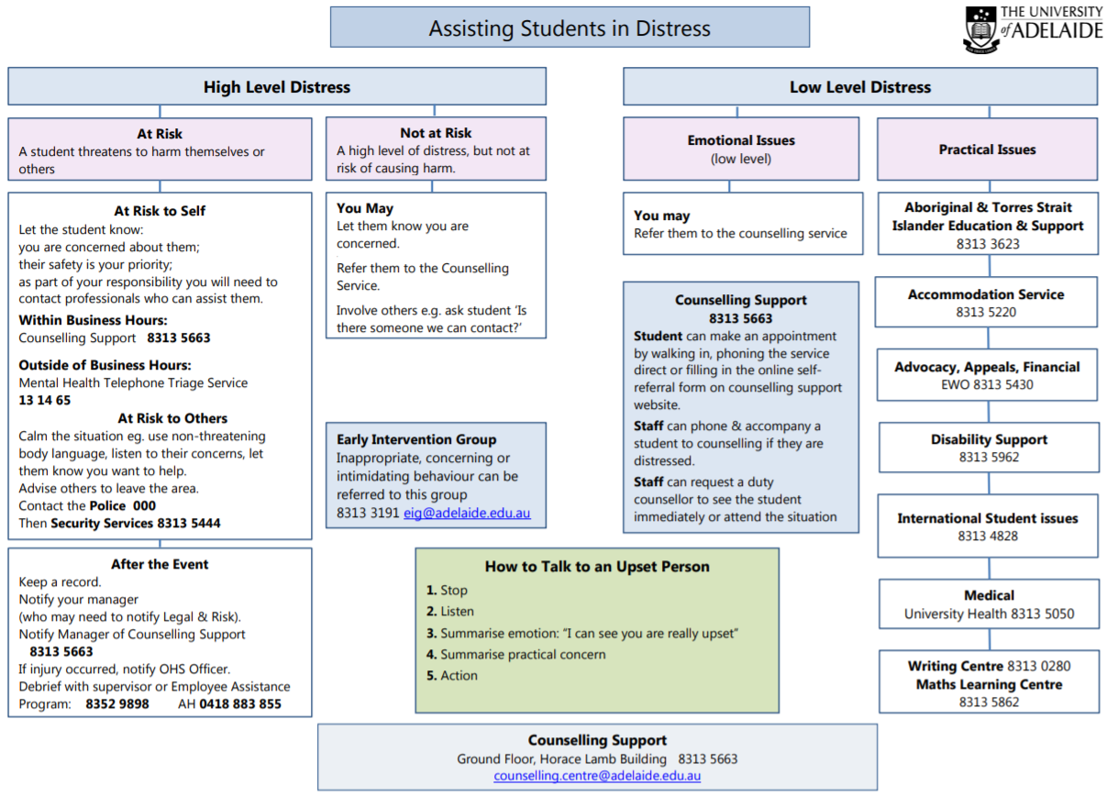
Notes:
This is a Flowchart used by teachers at Uni of Adelaide ELC (they are trained in its use by the Counselling Service). Use visible procedural flowcharts.

Slide 12
Accidental Counsellor training
www.humanconnections.com.au

Slide 13
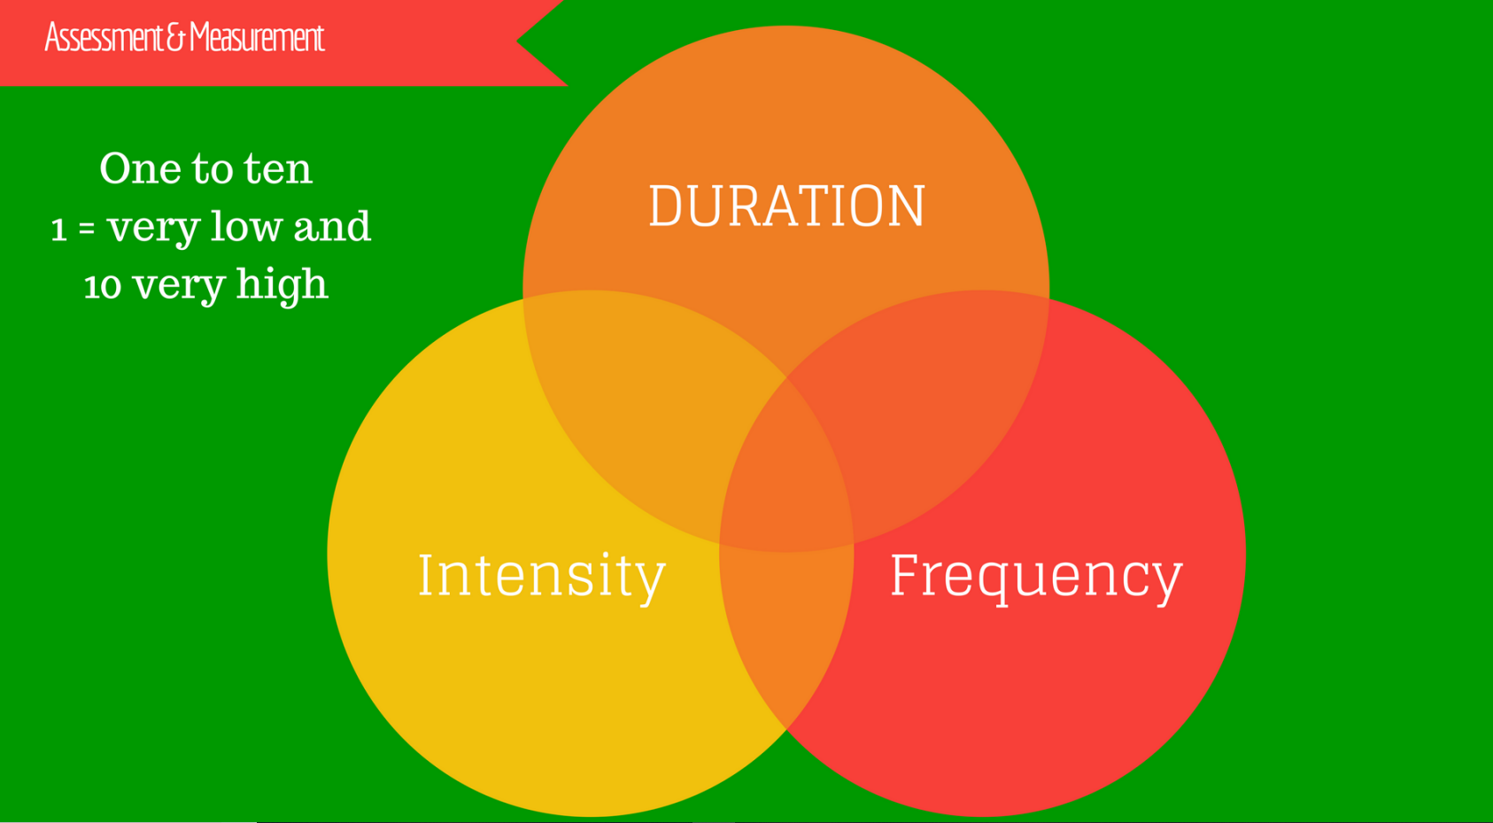
Assessing severity
Notes:
Used to assess seriousness of what std is experiencing
Passing mood fluctuation versus I cant get out of bed and I don’t know why. Capital D versus small d depression.
High intensity 8/10 is severe.
Several times a week is enough to consider getting a team involved.
Duration - for how long does it last (30 mins) and for how long has this been going on for (happening for past 2 months)?
Frequency – how often is this happening?
Intensity – use scaling Q

Slide 14
Assessing severity
You have a private conversation with your student who has failed an assessment.
They tell you how anxious they’re feeling about their study progress, mention they have not been sleeping well and say they have difficulty completing assignments because they are never good enough.
They also say: ‘If I don’t pass this course, I cannot go home to my family.’
Use the Duration – Frequency – Intensity model to assess this student’s level of distress.

Slide 15
Establishing boundaries
You ask one of your students to stay back after class to have a chat. You’re concerned because they’ve been sleeping in class and are disengaged with their study.
During the conversation, you decide to recommend your school’s counselling service.
The student is adamant they do not want to talk to a counsellor. They only want to talk to you, the person they know and trust.
What would you do in this situation?

Slide 16
Establishing boundaries
The Accidental Counsellor: www.humanconnections.com.au
Notes:
You need to assess your duty of care to the std versus confidentiality.
If Ss says I don’t want to speak to them, I want to speak to you: you can say
– you deserve for this to get better and for this to happen you and I need to have a good team around us. This is better than saying: it’s not appropriate for me to discuss this with you.
You have told me you’re really distressed and I’m going to have to tell a few people here at the school that I’m worried about you – homestay, teacher, counsellor.
Reassure them of confidentiality
Ask audience: have you ever had a std who was resistant to seeing the counsellor? How did you deal with this? Or, if you haven’t, what do you think would be a good way to deal with this?
Talk about your ‘’friend’’
Walk std to counselling service and introduce them and/or make an appointment with them
Check back in with them afterwards to see if they went
Talk about confidentiality
Describe what will happen behind the closed door of the counsellor’s office – demystify the process and the language
Your role – Check back in with the student – you were the person they trusted to open up to in the first place and so you play an important role.
Contract (or agreement) – Let’s talk about this again

Slide 17
Mental Health Special Interest Group
If you work for an English Australia member college, join the Mental Health SIG:
https://www.englishaustralia.com.au/professional-development/special-interest-groups

Slide 18
Where to from here?
1. What training in the area of mental health would you find useful?
2. Does you institution have any effective practices for supporting students’ mental health?

Slide 19
References
Orygen, The National Centre of Excellence in Youth Mental Health. ‘Under the radar. The mental health of Australian university students’ (2017). Melbourne.
Reavley, NJ, Ross, A, Jorm, AF and Killacke, E (2011) Introduction to Guidelines for Tertiary Educational Institutions to assist them in Supporting Students with Mental Health Problems, JANZSSA, 38, October 2011, 22-33.
The Accidental Counsellor Training : Human Connections
The Guide to Best Practice in International Student Mental Health (2018), English Australia
University of Adelaide Counselling Service: counselling.centre@adelaide.edu.au

Slide 20
sophieokeefe@englishaustralia.com.au

