Slide 1
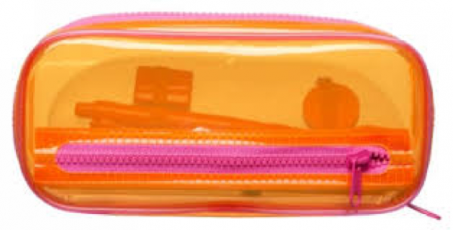
What’s in Your
Pencil Case?
By Sarah Chamberlain
s.chamberlain@cqu.edu.au
pencilcasechallenge.com
UECA PDFest Sydney 2019

Slide 2
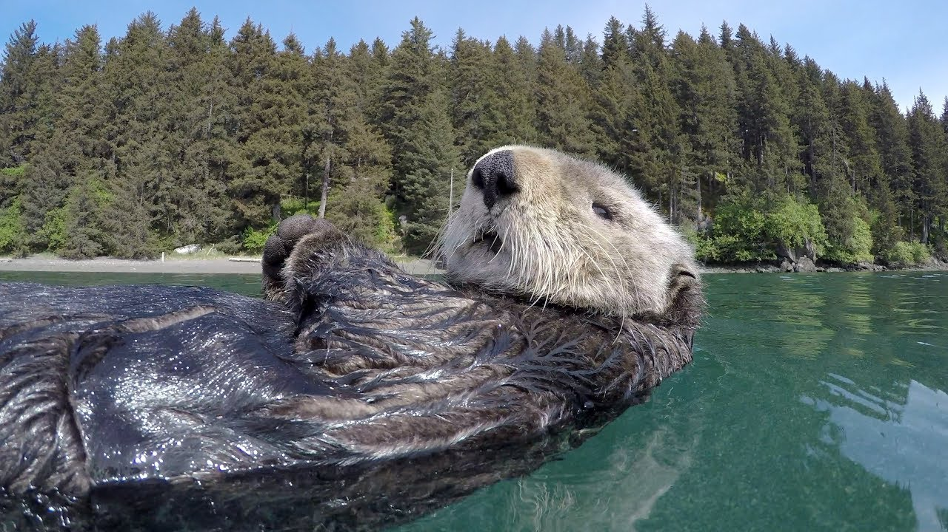
Today's Session
#minimalresources
#peerobservation
#lastminuteteaching
pencilcasechallenge.com

Slide 3
Lesson Planning
How much time do you spend preparing your lessons each week?
How might you reduce this time whilst maintaining quality of teaching?
pencilcasechallenge.com

Slide 4
The Pencil Case Challenge
30
You have 20-30 minutes to prepare a lesson
Grab an object from your bag, pencil case or desk
What would you do with this object?
pencilcasechallenge.com

Slide 5
Hypothesis & Method
30
Context & Hypothesis: Newly-graduated teachers preparing to
begin relief teaching asked me how to prepare a 4- to 5-hour
lesson in just 30 minutes
Method: Participants, experienced teachers from the ELT community, were asked to help answer the question via interview, and given the challenge of grabbing one nearby object to use in their lesson

Slide 6
Participants discussed their chosen object and offered deep insight into teaching methodology, teaching with minimal resources and how to make the most of class preparation time
Research Results
Key themes:
- Emerging language
- Students as a resource
- Creating movement and interaction

Slide 7
A teacher who does not need resources is a teacher who…
Has the required skills and knowledge to deal with the students’ emerging language
#10 Lucas Chiusoli, International House

Slide 8
Fluency practice
Exploring vocabulary
Connecting ideas & themes
My Object:
Hot Topics Cards
Interview #2 - Vesna Stefanov

Slide 9
In your prep time, find an article or a TED Talk that you can really pull apart
Interview #9
Helen Barr
- News Article

Slide 10
#7 Sarah Sutton
VUEnglish
#1 Gena Rhoades

Slide 11
#7 Sarah Sutton
Write an OPEN question you’d like to ask any person (not a specific person) in the room.
1. What……..?
2. Where…..?
3. Who….?
4. When…?
Find a partner and ask your question.
Swap your Post-It Note with your partner.
Find a new partner and repeat.
pencilcasechallenge.com

Slide 12
Extending Learning
What extension tasks could you set after the Post-it Note activity for:
Pre-intermediate students?
Advanced students?
pencilcasechallenge.com

Slide 13
Your Challenge...
One object, 15 minutes to prepare
What would you do with this object?
Go further – what extension activities can you facilitate after using the object?
pencilcasechallenge.com

Slide 14
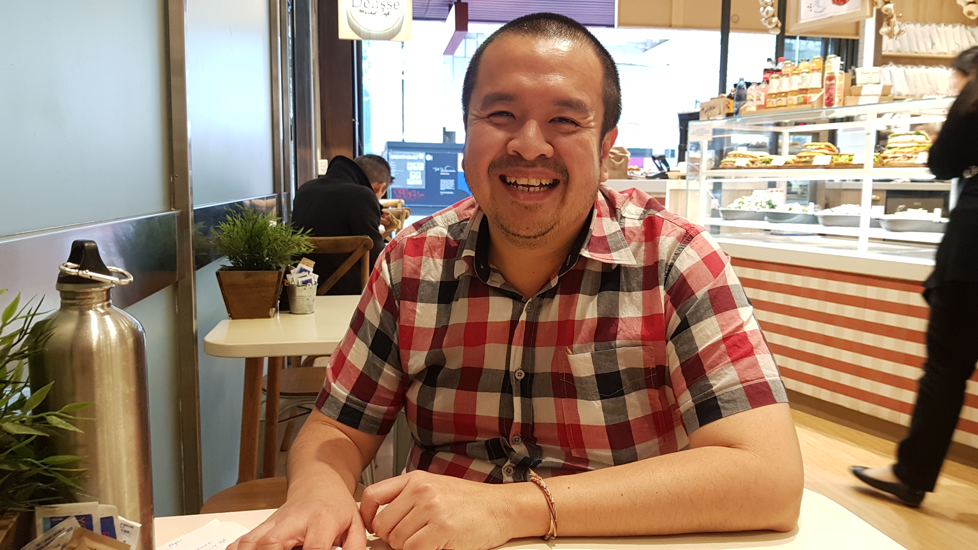
Music player – Spotify, YouTube, iTunes
#16 Yuli Lukito
Monash College

Slide 15
#14 Van Copp
UNSW
Tennis ball – questioning, drilling

Slide 16
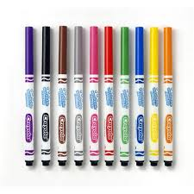
#4 Thuy Dinh
Monash College

Slide 17
Stick poster paper on wall
Give topic - brainstorm vocab (grps)
Give question – write answers (individually)
Discuss/compare in groups
Presentation to the class
#4 Thuy Dinh
Monash College

Slide 18
Our instructions and our activities are more important (than the materials)... clear instructions, clear aims, and then enhance the interactions among the students. Activate reflection rather than resources.
#4 Thuy Dinh
Monash College

Slide 19
Session Take-aways
Set time limits on your prep – let the class emerge
Print less, reduce paper wastage
Look inside yourself and your students for rich answers/ ideas
Think about developing a more-is-less methodology – extend extend extend!
pencilcasechallenge.com

Slide 20
Where & why to join the project
pencilcasechallenge.com/join
Share your ideas with the wider ELT community
Support new teachers
Contribute to the field
Celebrate your own skills and knowledge
pencilcasechallenge.com

