Slide 1
Think Again! Innovating Task Based Design for Direct Entry Courses
Presented by
Brooke Donnelly, Carolyn Matthews, Paola Clews
The Centre for English Teaching

Slide 2
THINK AGAIN:
INNOVATING TASK BASED DESIGN FOR DIRECT ENTRY COURSES

Slide 3
Overview
1. Context Carolyn Matthews
2. Principles of Task Based Design Brooke Donnelly
3. Principles in Action-Applied Example Paola Clews
4. Q&A

Slide 4
How do we do learning? Conversational Framework: Diana Laurillard
Teacher concepts
Learner concepts
Peer concepts
Acquiring
Inquiring
Discussing
Producing
Modulate
Modulate
Generate
Generate
Learning environment
Learner practice
Peer practice
Practising
Collaborating
Diana Laurillard: “Teaching as a design Science : Can we unlock the power of technology”: Abertay University 2014: https://www.youtube.com/watch?v=eh9254T2ZYg
Notes:
Diana Laurillard’s Conversational Framework
Notion of Teachers trying to impact on the “Private World” of the student ( Colin Beard)
Suggests that we learn through a sequence of actions that include conversations
Acquire knowledge from a teacher
Leads to Inquiring or research
Practising new skills and ideas
Discussing ideas with peers and enriching and learning new concepts
Collaborating with peers to construct or build knowledge ( Seymour Papert)
When designed tasks and integrating technology we need to integrate these actions to enrich the learning experience and technology enables all the above actions so it is a powerful medium for learning

Slide 5
Approach: Design Thinking
Learning Solutions Mag March 16 2018
Notes:
The reimagining of the curriculum involved rethinking how tasks could be delivered if technology was included in the scaffolding of the task.. This involved developing protoypes, trialling them , reviewing them and making adjustments.
The process was not only about discovering how we could change pedagogy to include technology and deepen student engagement but also a journey of changing teacher attitudes and beliefs about the benefits of using technology to teach language.
In reimagining past tasks the aim was to experiment & explore, problem solve during the pilot stage and seek and apply feedback from students and teachers. Quite time intensive but well worth it.
Therefore a process of prototyping and piloting and seeking and applying feedback became key to the momentum of the endeavour.
The approach takes commitment and is both vision and feedback driven ​
​
The realisation of the process also requires a high degree of teamwork and synergy​
​
Generally accepted view among all teachers and managers that we are “continuously improving​”

Slide 6
Blended Learning
Method
+
Modalities
+
Ratio of F2F & Digital Environments
Graham Allen Ure (2003 p.4 )
Notes:
The integration of technology and a commitment to enhancing multimodal learning creates a plethora of opportunities to enrich the language learning experience so it is important that from the process of reimagining evolves a deliberately articulated preferred blend or pattern of engagement with digital tools and modes of learning so that the learning processes are somewhat predictable for students ( and teachers) providing a stable base for the development of the architecture of the learning experience as a whole.
The complexity of Blended Learning is highlighted in its definition. Graham Allen Ure’s suggest that BL is a combination of methods, modalities as well as a ratio of learningF2F and in Digital environments
So the blend of technologies and the features they afford generate new ways in which language learning opportunities can be realised and therein lies the opportunity to innovate! It is up to the teacher and /or course co-ordinator as designer to decide how to match the affordances of technology with the particular objectives of a skill to be developed.
Tasks then need to be developed and designed across both digital and physical​ learning spaces incorporating as much social or peer centred learning as possible.
In addition how the pattern for blending emerges might be influenced by the outcomes you are trying to achieve in your course. For example CETs pattern for blending takes into account how the students will use CANVAS ( LMS) to study at university as that is the target environment we are preparing them for. However at this stage that is still a bit of a mystery as they themselves are still experimenting.
Blended learning also means a shifting teaching culture: Movement or detachment from "the book" to "Canvas pages” and “links” “tabs", introduction of videos as a mass communication tool have changed the nature of the classroom and the teachers role in it. The classroom itself has expanded into space or digital space. The decentralisation of the teacher to facilitator and guide and invasion of the teaching space by learning designers sending messages to students about tasks to complete etc meant that the teacher was no longer alone in the classroom instead there was a team working on a class. Teaching itself then becomes a collaborative endeavour which includes, designers, video teachers, course leaders. This means that Blended learning does necessitate a culture shift for teachers.
​
Digital tools such as google docs and discussion boards add a new dimension to group collaboration creating an opportunity for deep engagement with the task through synchronous and asynchronous peer collaboration, feedback from peers, modelling of interaction and in addition production of group artefacts using digital tools that in terms of vygotsky “construct” meaning from group interaction validating it and motivating the group.
. The recycling of particular digital tools embedded in the curriculum across the graduated courses develops a digital fluency competency as well as a the activities associated with the digital tools a collaboration competency and a critical literacy competency as the language of discussion, debate, interrogation and persuasion emerge underpinning the development of language of critical literacy.​ In this way the concept of competency is layered including not only language but also appropriate use of communication tools, awareness of the social rules of engagement in digital space
​
The deep engagement with themes and related sub themes provided the context for students to develop sufficient depth of understanding that enables the development of critical and reflective skills . These skills are developed because of both the personalised activities delivered through the digital or online learning environment as well as the active interactions facilitated through in class activities. These activities are usually sequenced and scaffolded tasks leading to for example to an Assessment event .

Slide 7
DEC at CET
Entry
DEC 36
DEC 25
DEC 15
DEC 10
Outcomes for Uni Entry
Spiral Curriculum
Task Design repeated; increase in difficulty; target Standard increases in difficulty.
Social Learning
Collaborative, Interactive, Autonomous, Empowerment
Blended Curriculum
Task Design across Digital (LMS), Physical (Classroom) and
Social spaces (Digital or Physical): Multimodal
Adaptive Learning
Learning/Feedback loops, Learning/Feedback loops
Learning Process
Input & Skill development; Practise + Feedback; Performance Assessment Task - Result +Feedback
One Scale
A common rubric: Clarity in terms of progress
Notes:
Structure of DEC course
Underlying Design principles: Overall aim was to achieve a consistency in design across the courses but not compromise the originality of each course, the distinctive purpose of each course and the separate outcomes each course aimed to achieve. The thematic structure and content and purpose of each course preserved each courses character.
Past: DEC 36 & 25 were considered foundational courses taught using a General English framework: Now the courses are graded EAP courses developing foundational academic English skills and competencies that lead to the final DEC 10 level. Students completing DEC 10 are aiming for a range of English Entry Requirements defined by admissions as ranging from Overall 6.5 up to 8.0. So there is no articulated Exit level.
The course design aimed to achieve a bespoke learning experience where students developed academic language skills and competencies in a graduated pattern centred on the principle of task based language learning which included technology as a way of enriching the personalised and interactive and social aspects of learning. The use of an LMS was seen as an opportunity to develop language experiences across a new space and to develop interactive protocols using new digital tools. The digital dimension was essentially a new mode of communication where new registers of social rules of interaction applied and which is relevant to the academic environment students need to engage in at university .
The spiral curriculum design aimed to develop digital literacy by designed tasks where students could learn how to use the tools to learn academically: ie how to have an academic discussion asynchronously on a discussion board. Digital tools such as collaborative or joint construction and deconstruction was also developed and repeats across the courses. So whike the content and themes change the digital tools that are being used to achieve the communicative task remain the same ensuring students develop a working understanding of how to use these tools for example for group collaboration. Also repetitous use of these tools across the courses , over time decreases the need for support for using the tools foregrounding the language development aspects of the task and also puts technology in its place ie augmenting the communicative act.
Overall Design of curriculum means tasks are repeated or recycled ie language skills and academic skills are developed across courses but depth in terms of themes studied and associated extensive and intensive reading & listening increases in complexity and expectations in terms of output or assessment tasks become increasingly complex.
6. Blended Delivery: The rhythm of how to deliver a language lesson across mediums took some time to emerge. However once “new” pattern of learning emerged and teachers embraced the reality and existence of the LMS as another teaching tool and teaching space the magic began to happen. the LMS became more than just a repository of resources but it is potentially a space for students to collaborate, practise their English, work with peers and engage in targeted language development. There is a shift then in classroom culture and teacher role that emerges. No longer is the teacher the sole source of input and feedback. Suddenly input and feedback is far more dynamic because there are more modes ie multimodes through which this can be achieved. We have only started to develop these patterns of teaching but this is an exciting area.
7. One element of Blended learning which is intrinsically motivating for students is the sense of both security and autonomy the LMS provides s. Once they have learned the habitual patterns of interaction they are able to develop independent patterns of learning that also include peer led interactions and learning

Slide 8
TASK BASED LEARNING
Pre-Task
LMS/Digital
Aquiring/Constructing Language& Skill
Peer interaction
Task
Classroom/Digital
Practising/
Performing
Post-Task
LMS/Digital
Feedback
Refllection/Transfer
Ellis 2009, Laurillard 2012
Notes:
Now move down to Task based learning itself:​
TBL
Intrinsically motivating
Consistent with a learner focus
Contributes to imporvement of communicative fluency
Offers input of target language
Opportunity for “natural language”
Stresses meaning over form
(Ellis 2009)
&
Tasks should provide rich input that makes the task real and authentic
Focus on error in context
Give corrective feedback
Encourage collaborative learning
Promote language output (Gonzalez-Lloret)
Evolution of task design
The design of tasks changed with the concept of "flipping" content so that pre-task skill development was often prepared at home and teachers would begin lessons at the activity stage in class. So the timetable is a crucial tool for communication and standardising delivery​
​
​
Timetable included learning tasks to be completed in a predefined sequence of activities that builds competency towards the asssessment event or performance stage of the learning process
​
Also areas of intensive development where students could self select resources. So students have CHOICES in their learning.
Interact with peers and learn socially
Engage with resources on the LMS
Engage with adaptive learning modules
Seek feedback from their teacher
The existence of choice empowers the self-directed learning of the student.
The other observation that becomes evident is that the digital space now provides continuity of learning for the student and a sense of belonging-the classroom is no longer the sole space for learning . The classroom or F2F component is now a smaller but still a very significant component of the learning experience as a whole. The point is the learning environment seems to have shifted. What the implications of this are for the future remains to be seen.
In the context of the curriculum, it is the reimaging of the task which is key to unlocking a new curriculum.

Slide 9
UoC: Participate in an Academic Discussion
Academic Discussion
Connecting key points from sources and synthesising them to express own argument
Read
-Attitude
-Argument
-Position
Listen
-input
-Strategies for conversation
Writing
-Fluency
-Language Structures
Digital Literacy
-Fluency of interaction augmented by digital tool
Group Conversation
-- intelligibiility, fluency, pronuncition accuracy
Turn taking, pause
-Value of feedback
-Value of contribution
-Peer led
Academic Voice
& Critical Literacy
-Intertextuality
-Appraisal, Negotistiion persuasion
-Integrated References
Critical Literacy:
The ability to evaluate a text and see beyond the explicit message to the implicit messages including bias, political and social meanings.
Digital Literacy:
“The capabilities which fit someone for living learning & working in a digital society”
(JISC, UK)
Notes:
Note to self: The task itself hasn’t changed ie participate in an academic discussion but “how” the task is achieved integrating technology , the level of engagement and use ofdigital tools (what) to scaffold the task has changed modifying the task (why?)to achieve a deeper language learning experience ie SAMR Model Puentedura
Also requires a level of student digital fluency to use the tools. ( fluency –what to use + how to use + why touse)
Digital tools such as google docs and discussion boards add a new dimension to group collaboration creating an opportunity for deep engagement with the task through synchronous and asynchronous peer collaboration, feedback from peers, modelling of interaction and in addition production of group artefacts using digital tools that in terms of papert’s “construct” meaning from group interaction validating it and motivating the group.
. The recycling of particular digital tools embedded in the curriculum across the graduated courses develops a digital fluency competency.
The activities associated with using the digital tools generate a collaboration competency and the deep engagegement with the conversations generated because of task engagement develop a critical literacy competency developing language of discussion, debate, interrogation and persuasion emerge underpinning the development of language of critical literacy.​ In this way the concept of competency is layered including not only language but also appropriate use of communication tools, awareness of the social rules of engagement in digital space and a key target skill criticality.
​
The deep engagement with themes and related sub themes provides the context for students to develop sufficient depth of understanding that enables the development of critical and reflective skills . These skills are developed because of both the personalised activities delivered through the digital or online learning environment as well as the active interactions facilitated through in class activities. These activities are usually sequenced and scaffolded tasks leading to for example to an Assessment event .
So these are the concepts underpinning the reimagining of the design of our DEC curriculum which is still in the stage of refinement and consolidation. It is however Task design that is at the core of the reimgining and we now turn to what we think are the principles that underpin reimaging task design.

Slide 10
Principles of Task Based Design
Notes:
I’d now like to introduce Brooke Donnelly who will elaborate on the Principles of Task Design and underpinning pedagogy followed by Paola Clews who will discuss an applied example of this .

Slide 11
Digital tools – learning by design
A task should:
Focus on meaningful communication
Generate collaboration
Draw upon authentic language use in a set of real-world tasks
(Gonzales- Lloret, 2017)
Digital tools in the curriculum should:
Equip students with multimodal literacy practices
More effectively scaffold language learning
Notes:
So broadly, our aim with reimagine / rethink the curriculum is to widen the scope of our courses to include these expanded competencies of critical and digital literacies. These expanded competencies are in addition to, and indeed as a complement to, the focus on language and academic skills outcomes that we have more traditionally had. So at a practical level, this has meant reconceptualising task design across the curriculum to incorporate these expanded competencies without just adding more. And essentially this has meant reconceptualizing how digitial tools are used systematically in our direct entry programs so that we are enriching and adding value to our tasksk and learning sequences and not just adding more.
And SO What I’m going to do is to talk you at a more practical level through 3 principles we have formulated for task design in order to guide how we design digital tools into tasks how digital tools can be used to scaffold tasks. For a coherent curriculum, these tools need to be designed systematically and purposefully into tasks and learning sequences in order to expand and improve learning outcomes.
This of course is an iterative process and one that is ongoing and while we are really talking here at the level of an integrated curriculum across a number of programs or levels, the same principles can apply to the tasks and learning sequences that you might use in an individual program that you teach on and I hope that you can take away some ideas about how to design the use of digital tools systematically into the learning sequences in your classroom to enhance learning outcomes.
BUT it’s probably first worth defining what we mean by a task. A task helps us tocan be a smaller unit of activity within a lesson, but a task can also be an activity that extends across a number of weeks or even a whole program and that consists of a number of sub-tasks but in order to promote language learning, we want the design of our tasks to generate meaningful communication through collaboration and we want them to be as authentic as possible to generate language use and language practice in real-world activities.
Now in an EAP context, typical tasks might be
lesson such as a tutorial style discussion and the reading and listening or other input and preparation for that task
such as extended writing and all the sub-tasks involved in this like reading and research, note-taking and summarizing, planning, discussion of key concepts, perhaps even an associated presentation,
Most of the tasks that we ask our students to engage in are not new or revolutionary – they are core academic skills and core to using language in an academic context, but the question is, how do we reconceptualize or redesign the learning sequences around these tasks to incorporate digital tools systematically for two purposes:
A. to equip stds with the multimodal literacy practices that will enable success in a tertiary education context
B. how do we use the affordances of digital tools to maximise both depth and extent (quality andquantity) of engagement and to more effectively scaffold the students through the whole process to better achieve the intended language learning outcomes and the literacy competencies

Slide 12
Principles of task design
Depth of engagement and opportunity for critique and reflection
(Luke, 2014; Fajardo, 2015; Paran & Wallace, 2016)
Notes:
So we work with three main principles of task design, the first of which relates to critical literacy
We want to encourage ‘criticality’: The critical literacy tradition is actually about social, political and cultural awareness of how texts and discourses work, with what consequences and in whose interests. This kind of critical awareness of authorship and ownership and influence are key to academic literacy practices (plagiarism, citation and so forth) but the problem with many traditional EAP courses - and this is the major criticism that you find in the literature of critical literacy in EAP – is that critical literacy is de-emphasized because EAP is situated outside the depth of knowledge of the faculty with a focus on general communication and discrete language skills with a typical churn every week or so through new topics of a general knowledge nature. And that this doesn’t allow students to engage with or critique the texts or the issues in any real detail or depth or consider multiple perspectives.
SO at a practical level in terms of the curriculum or classroom choices we’re making about learning sequences what this means and what we can do is to aim to go deeper, not wider - less is more as it were. There’s a bunch of research which suggests that the opportunity for depth of engagement and critical dialogue and reflection around texts and around an issue, particularly where it is of interest / relevance to the student’s own experience or lived reality, = more meaningful communication, greater engagement & therefore deeper learning & language improvement\
So that’s the first thing – we want to go deeper.

Slide 13
Principles of task design
Depth of engagement and opportunity for critique and reflection
(Luke, 2014; Fajardo, 2015; Paran & Wallace, 2016)
Use of digital tools to maximise collaboration and participation
(Hinrichson & Coombs, 2014; Roche, 2017)
Notes:
The next principle relates to the digital literacy. And I’ll give you a definition here:
”[Digital literacy] is the ability to access, crtically assess, use and create information through digital media in engagement with individuals and communities” (Roche, 2017; A-73)
– and this is a useful definition because it emphasizes the interactive nature of the digital space and the necessity not just of receptive but also of productive language skills inthat space. It also highlights the pragmatics of communication in the digital environemnt, participation in online communities and the need for our students to form a new L2 digital identity in the online academic space.
So in our choices about learning design – in our curriculum choices or the choices we make about the learning sequences in our classrooms, we want to weave in the use of digital tools into tasks not gratuitously, but systematically and purposefully in a way that maximises engagement and collaboration for meaningful communication, we can support our students with the development of digital fluency and a digital identity for our students in the L2 academic space, but also support the students with developing their language competency by providing greater opportunity for meaningful language practice
Which brings me to the third principle….

Slide 14
Principles of task design
Depth of engagement and opportunity for critique and reflection
(Luke, 2014; Fajardo, 2015; Paran & Wallace, 2016)
Use of digital tools to maximise collaboration and participation
(Hinrichson & Coombs, 2014; Roche, 2017)
Integration of digital tools to scaffold task achievement and improve teaching & learning outcomes
(Laurillard, 2002, 2009)
Notes:
And the final principle is learning design (how learning happens)
that we need to systematically design the learning space and sequences to incorporate digital tools in a way that makes our current practices more effective or innovative methods. We know the theories of learning – socio-cultural and collaborative learning theories – we know the principles of SLA and the theories behind EAP instruction – we know that and so the design question is how do we use the technology to make what we do better and more effective – to support, extend and enhance classroom teaching in order to:
improve teaching and learning processes
improve learning outcomes
improve the type and quality of feedback
(if our goal is targeted language practice or a specific reading skill or practice in participating in academic discussion – how do we use digital tools to more effectively scaffold that process
SO we want the online and face to face spaces to be fully integrated so that the two flow into and out of each other and extend / build on each other rather than being separate spaces or using the digitial tools in an ad hoc way ie. what they’re doing online supports and extends on classroom learning outcomes and then comes back into the classroom and vice versa so that both learning spaces are complementing each other

Slide 15
Over to you
Do you / have you used discussion boards as a teacher or learner?
How well does the purpose, design and integration of the discussion board task meet these task design principles?
HOW?
Depth of engagement and opportunity for critique and reflection
HOW?
Use of digital tools to maximise collaboration and participation
WHY?
Integration of digital tools to scaffold task achievement and improve teaching & learning outcomes
Notes:
SO we’re going to ask you to think about a very common digital tool and one that our students are very likely to have to use in their destination university contexts.
Discussion boards
Have a chat and think about how you use discussion boards, what the purpose is, how it’s integrated with other learning activities and evaluate how well the DB meets the criteria we’ve just outlined.
How are you using the discussion boards / why are you using (purpose)

Slide 16
Direct Entry Course
DEC 36
DEC 25
DEC 15
DEC 10
Notes:
SO what I’m going to do is give you an example of the practical aplication of these principles:
how we have scaffolded the use of discussion boards across our curriculum to achieve an expanded set of competencies.
So a quick over view - DEC is a maximum 36 week program, with 4 levels / points of entry etc – the name of the course is the number of weeks that a student will study when they come in at that entry point. The majority of the students come in at DEC 15 and the demand on the students in terms of the linguistic complexity of the texts they will interact with and the depth of content – there's a bit of a jump between.

Slide 17
DEC 36
DEC 25
DEC 15
DEC 10
Discussion boards
Scaffolding for face to face academic discussion
Weekly cycle:
Content & language input
Discussion board contribution
Face to face discussion
Notes:
Basically at all levels, we use the DBs to scaffold speaking tasks, to scaffold tutorial or seminar style academic discussions in the classroom – in the lower level courses (DEC 36 & 25), this looks like this:
- the week ends on Friday with a speaking focus on discussion and tutorial skills. This brings together the input around the theme or topic and the language input for the week ie. the discussion of issues after the input.
The discussion board is designed as scaffolding for these face to face discussions – the task is started before the students come to the classroom– ie. weekly cycle = Monday – Wednesday content & language input, a discussion board set on the Wednesday with the same question(s) as the questions for the in class discussion on Friday, followed by speaking input and discussion activities on the Friday.
The idea is to support the students with formulating and expressing their opinion before they get to the actual face to face discussion.

Slide 18
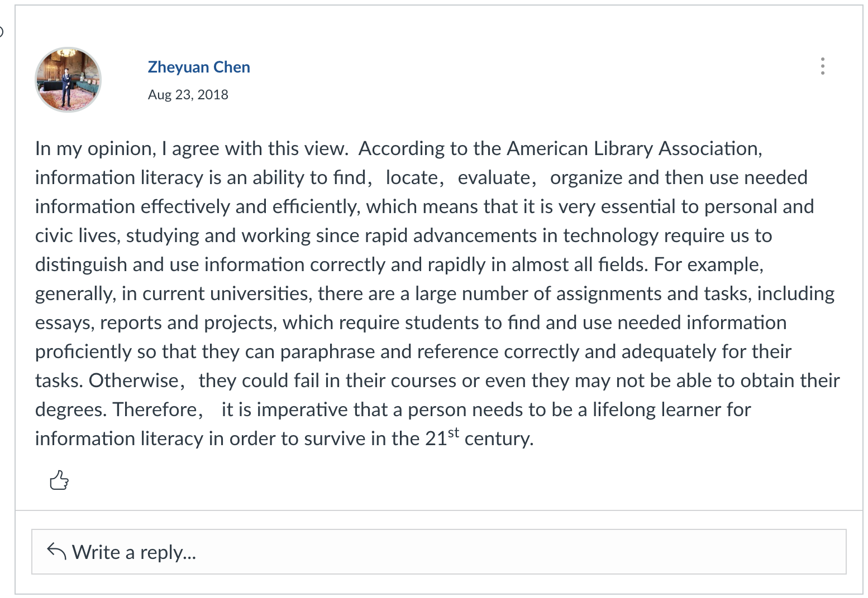
Notes:
This is typical pattern of response – for a class of 18 (classes name on left and no. of responses on right). Most stds engage and post but not all, some classes there is no response to the task at all (teacher set up…!!).
These are typical kinds of responses - typically stds just post their individual response to the prompt, some might agree or disagree with a previous post but there is very little interaction, it’s really largely just a place to post their answer to the prompt
Teacher is still quite central to the task cos the students require feedback either by pot or in the classroom or they tend to ….

Slide 19
DEC 36
DEC 25
DEC 15
DEC 10
Depth of engagement
Scaffolded language practice
Quality of contribution to class discussion
Extent of participation
Collaboration
Participation in online community
Notes:
So how well does this achieve our principles?
Critical literacy principle: DEPTH & integration
Stds revisited reading & other input in order to post and even sometimes refer to these in their posts
Reflected on / engaged with the issue in writing before face to face discussion – can formulate ideas and the language to express them before the face to face discussion which improved the quality of contributions to in-class discussions and scaffolds language practice
BUT Digital literacy principle:
The social element of learning isn't there: Extent of collaboration and participation in the online community limited to a single post that may or may not respond to a previous post
No real collaboration in achieveing the task – stds are just developing their ability to use the tool and to express an opinion, to work with and learn the language constructs etc
But they can look at each others posts and model their own post from those etc
That’s enough at this stage – the task increases in complexity as we move into the higher levels and there we expect the students to develop the latter outcomes in the next layer of 15/10
AND teacher role is still quite central here – if the teacher is not on the DB also responding to students posts and ‘correcting’ then the stds often don’t see the task as valuable and participation drops over time.

Slide 20
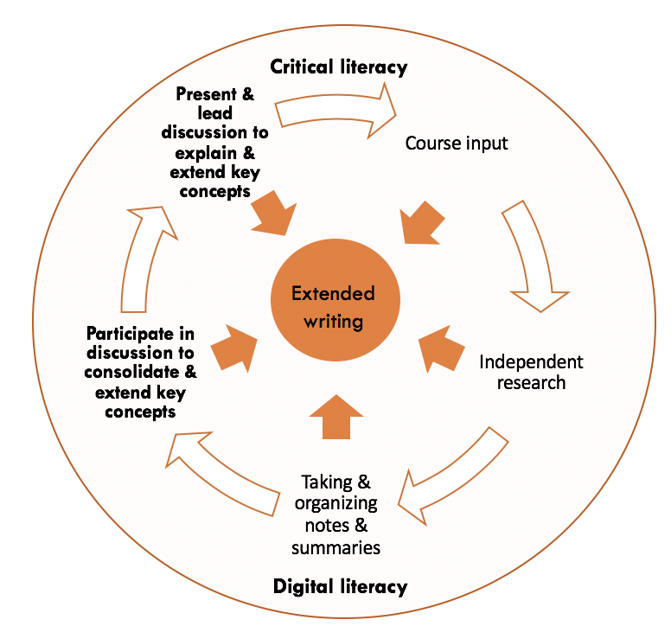
DEC 36
DEC 25
DEC 15
DEC 10
Task redesign
Fortnightly cycle:
Week 1:
Content & language input
Discussion board:
- student moderated
Week 2
Further content & language input
Student-led seminar
Notes:
When we move up to the higher levels of DEC 15 and DEC 10 we take the same digital tool and the same task but increase the complexity and the depth.
DEPTH & CL We move away from the weekly / fortnightly rotation of topics to five week cycles where the students explore one topic for 5 weeks and explore a different sub-theme of that topic each week so that each week feeds into and builds on each other. Over a 5 week period the hours and depth of content is something akin to what they will cover in a semester in a unit of study – this depth contributes to the critical literacy. The discussion tasks also become part of the scaffolding not just for in-class discussion but for an extended writing task that is completed over the 5 weeks.
DL & integration: We take the same tool and the same task (the DB and the in class discussion) and we increase the depth and complexity of this too., the DB becomes student driven and feeds into a student driven seminar discussion
Each week one group is responsible for running the discussion board, responding to other students posts and encouraging further discussion of the issues raised
The following week the same group is responsible for identifying the major themes or points of contention that came out of the discussion board and then preparing and running a seminar discussion that summarises these major themes or points of contention and extends them with their own discussion questions
Underlying this is how critical literacy develops

Slide 21
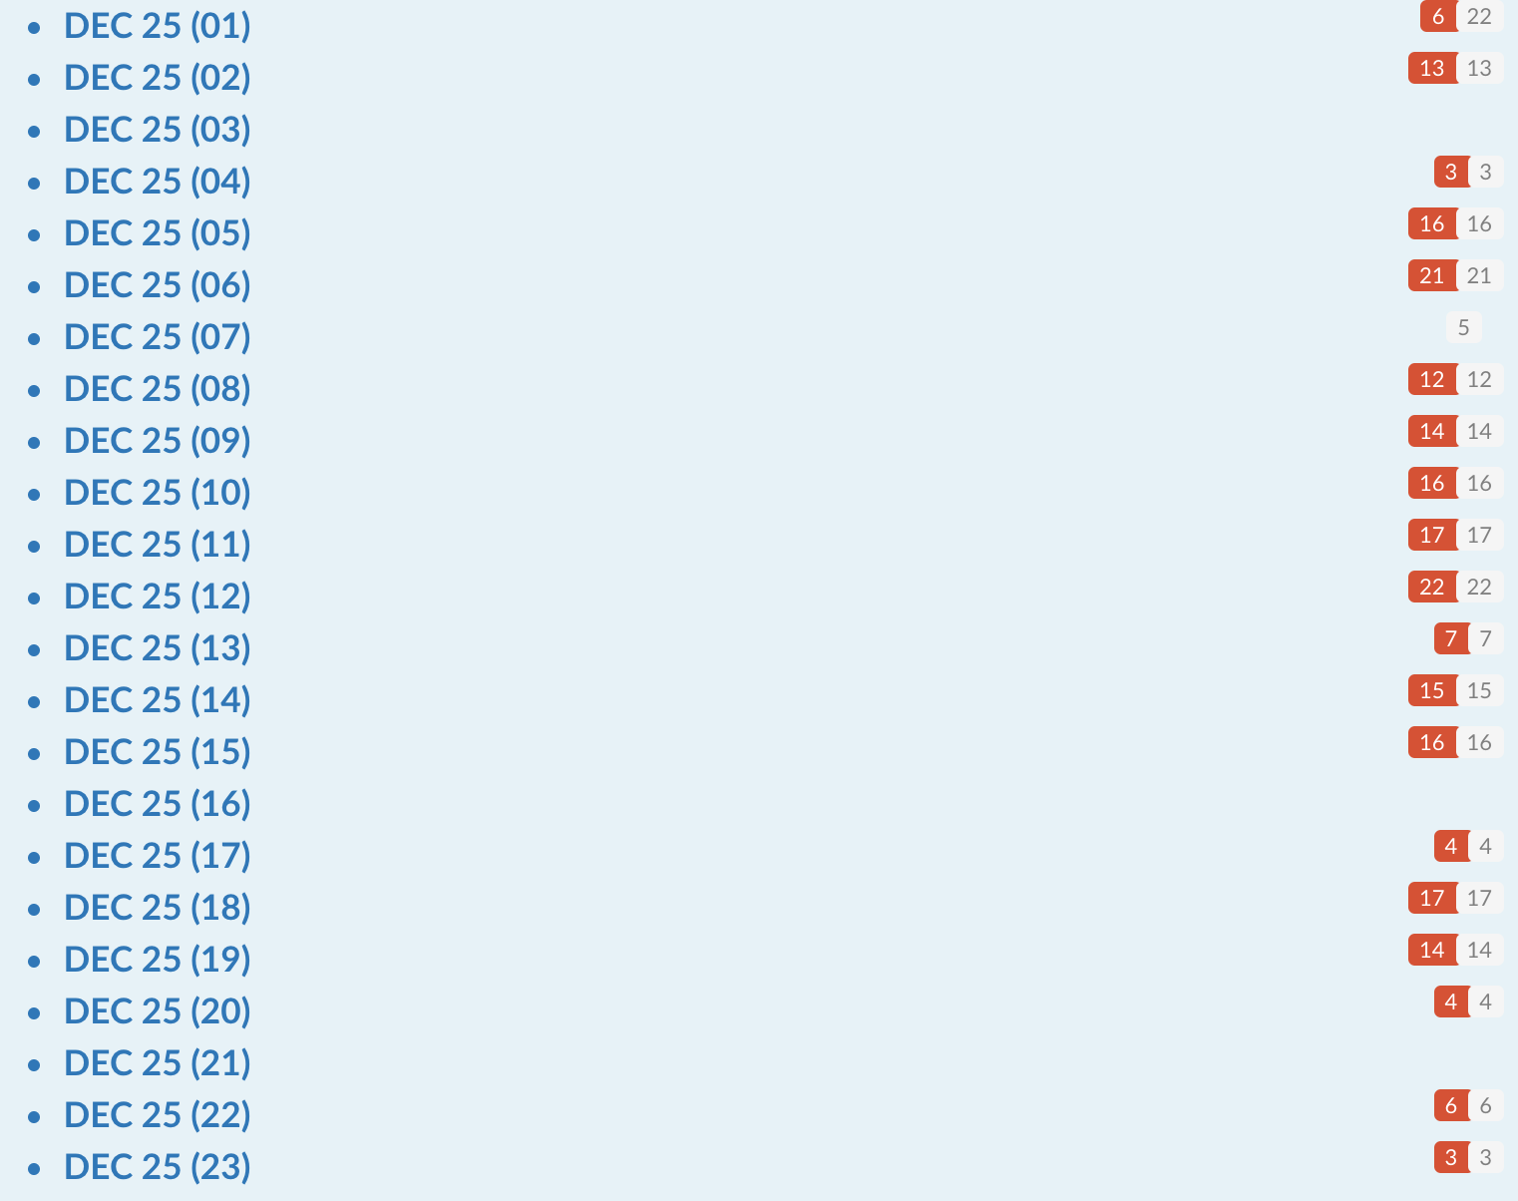
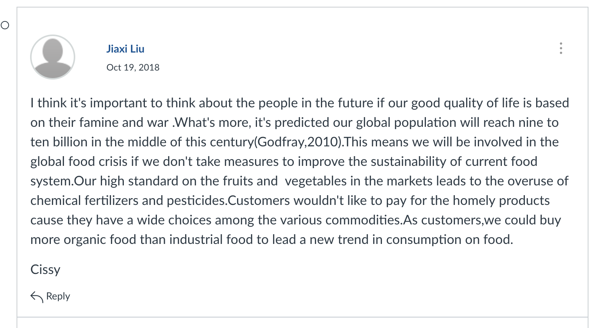
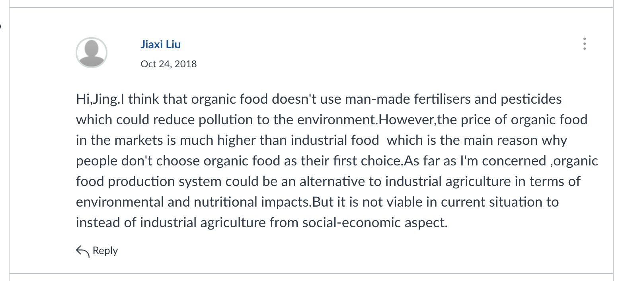
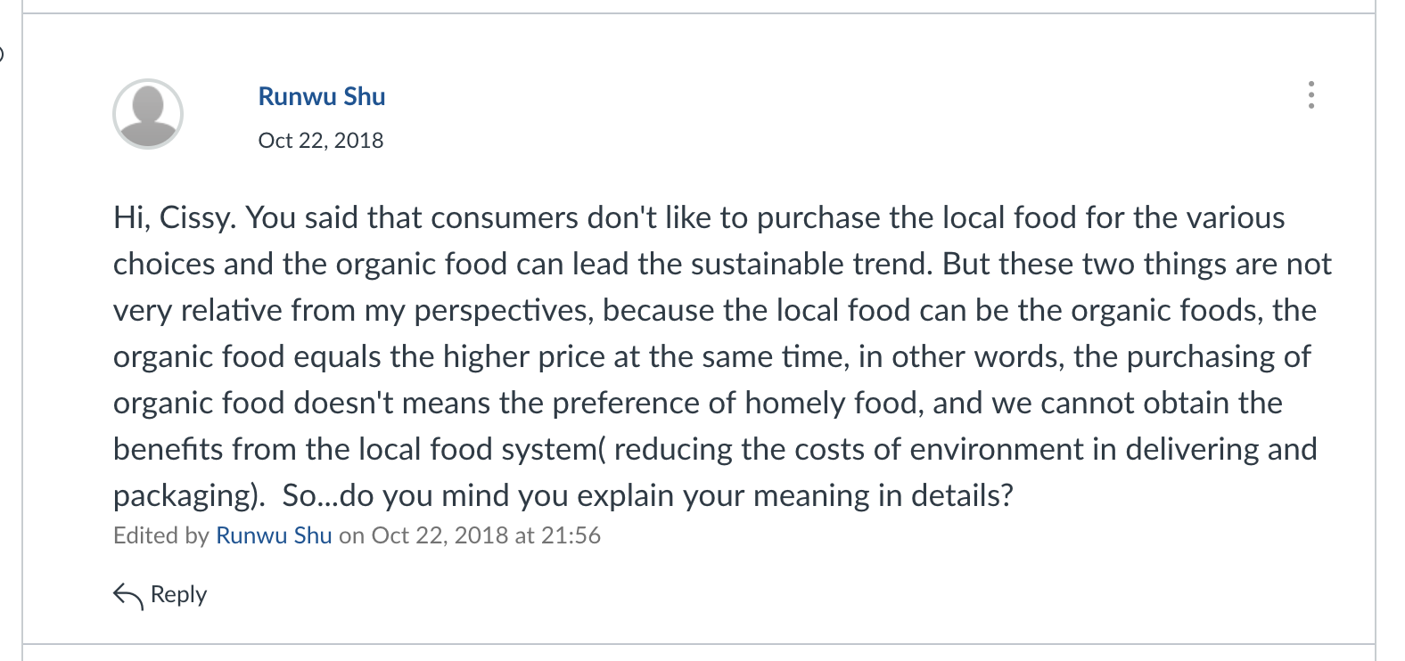
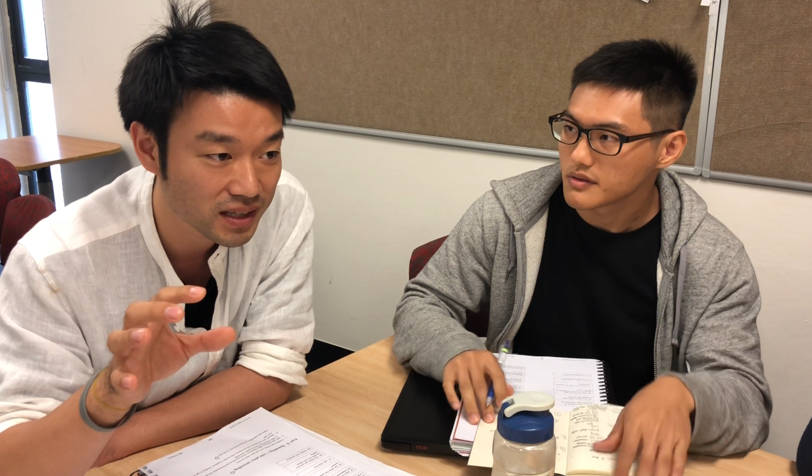
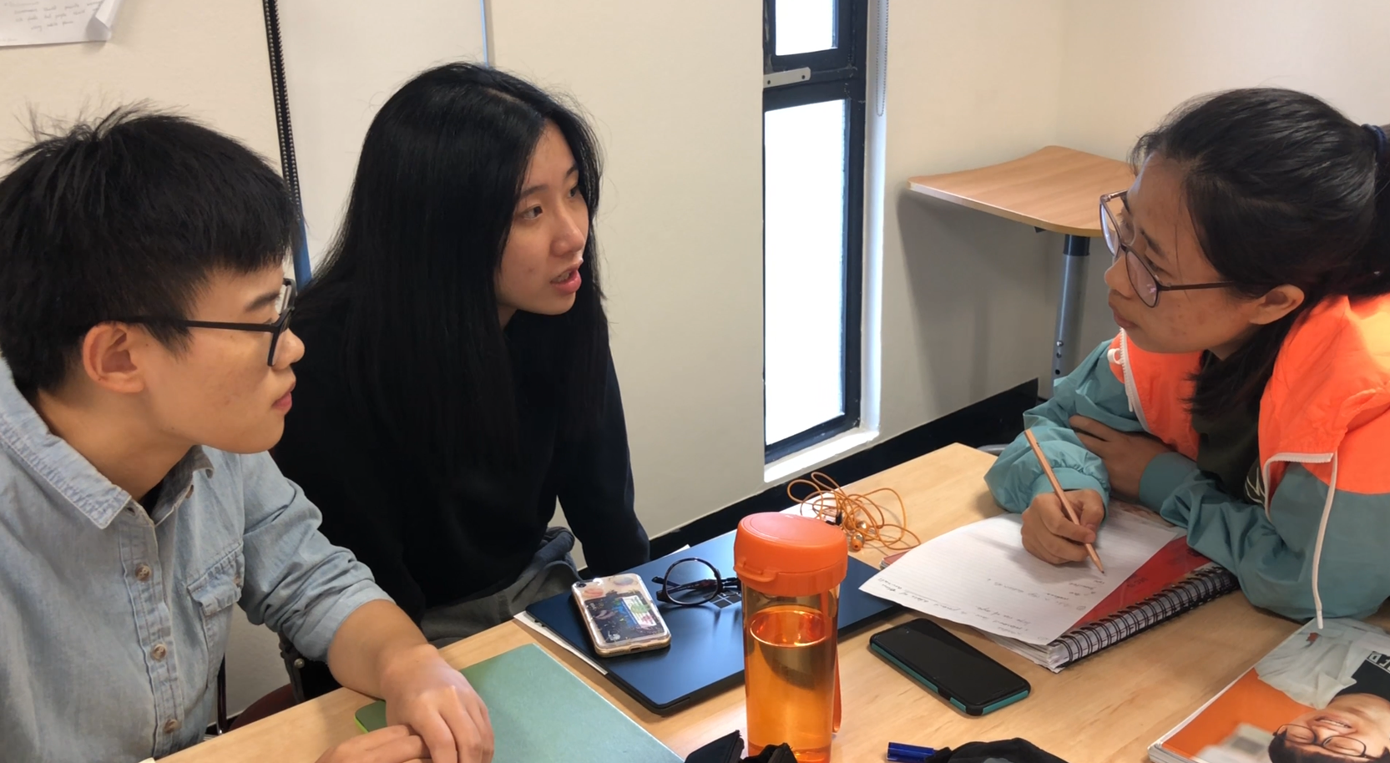
B
A
A
C
A
A
B
Notes:
Level of participation increases – many more responses per class (still ony classes of 18) – at least half here have 30 or more posts to the DB instead of the previous example where we saw that less than every student in the class is posting.
Pattern of interaction here changes also – stds are engaging more and in more depth – A posts, B replies, A replies to B and then C jumps in with a response to A also.
And what we’re seeing is that they by changing the task we’ve scaffolded them into the the skill of DB protocol and genuine critical engagement with the content
And then the group responsible needs to consider and evaluate the various posts, tease out themes and issues from the contributions and decide what is worth exploring further – they then present the class with a summary of what they’ve identified and extend these in a seminar discussion which they are responsible for preparing and facilitating.
At no stage is the teacher involved in this except as feedback on the seminar. Teacher has moved to the periphery and this points to the developemnt of self-dircted learning – at the lower levels the teacher is quite central to the task but at thislevel the stds have become more self-directed and more crticial and teach has moved to facilitation role.

Slide 22
DEC 36
DEC 25
DEC 15
DEC 10
Depth of engagement
Scaffolded language practice
Quality of contribution to class discussion
Extent of participation
Collaboration
Participation in online community
Increased depth of engagement
Critique & reflection
Scaffolded language practice
Improved quality of contribution to class discussion
Extent of participation
Collaboration
Participation in online community
Notes:
So how well have we achieved addressed our design principles now?
Stds are now collaborating and participating in an online community organized and run by themselves. The communicartion is more extended and meaningful and the engagement wit the issues and the language to express their position on the issue is more extended before they come to face to faxce discussion.
-
The interaction and communication is more meaningful and relevant to the students which further increases the Critical engagement – in deciding what content from the discussion board they are going to take to the classroom, the moderating group needs to actively compare other students contributions, identify common themes and differences, evaluate the responses and decide what is worth discussing in more detail plus they need to decide how that discussion will be extended – all important to critical iteracy and important academic skills
AND teacher moves to the periphery – stds are responsible for the task completion and the teacher is not involved only as feedback in the seminar
- Because they have now Moved beyond just expressing an opinion to engaging in independent interaction and discussion without teacher involvement (it’s all student driven) it’s this increase in the complexity and depth that achieve the critical & digital literacy outcomes at t

Slide 23
Shifting Teacher Mindsets: Creating a Design Ecology
“Teachers need to be part of the process of innovation as researchers, aware of the broad social aims of Education but increasingly skilled in articulating and practising design ecologies that construct architecture for student learning”
( Bennet, Lockyer Agostinho 2018)
Notes:
What is necessary to achieve this type of reimagining is a curriculum team that has teaching expertise, qualification in learning teachnology and an expert in curriculum design underpinned with applied linguistics expertise.
More than this both the technologist and the curriculum specialist must have an empathy and understanding for each others role so they can work synergistically together and a combined passion for the final outcome which I believe we are very fortunate to have at CET.
It does take time to build this type of capability.
And so now I would encourage you to reflect on the courses you teach and the tasks you are creating and see if you can articulate a design ecology or pattern for teaching language across digital , physical and social spaces that deeply engages students in their language learning.
Because as Professor Diana Laurillard puts forward “Teaching is a design science”

Slide 24
References
Bennett, S. , Lockyer, L. and Agostinho, S. (2018, online first). Towards sustainable technology‐enhanced innovation in higher education: Advancing learning design by understanding and supporting teacher design practice. British Journal of Educational Technology. doi:10.1111/bjet.12683 Links to an external site.
Ellis, R. (2009). Task‐based language teaching: Sorting out the misunderstandings. International journal of applied linguistics, 19(3), 221-246.
Felipe Fajardo, M. (2015). A review of critical literacy belief and practices of English language learners and teachers. University of Sydney Papers in TESOL (10), 29-56.
González-Lloret, M. (2008). Computer-mediated learning of L2 pragmatics. Investigating pragmatics in foreign language learning, teaching and testing, 114132.
Gonzales-Lloret, M. (2017). Technology for task-basedlanguage teaching. In Chappelle, C. A. & Sauro, S. The Handbook of technology and second language teaching and learning. Hoboken, NJ: Wiley Blackwell.
Graham, C. R. (2006). Blended learning systems. The handbook of blended learning, 3-21.
Hinrichsen, J. & Coombs, A. (2014). The five resources of critical digital literacy: a framework for curriculum integration. Research in Learning technology (21), 21334. doi: 10.3402/rlt.v21.21334
Howard, S. K., & Thompson, K. (2016). Seeing the system: Dynamics and complexity of technology integration in secondary schools. Education and Information Technologies, 21(6), 1877-1894
Laurillard, D. (2002). Rethinking university teaching: a conversational framework for the effective use of learning technologies. London & NY: Routledge Falmer.
Laurillard, D. (2009). The pedagogical challenges to collaborative technologies. International Journal of Computer-Supported Collaborative Learning (4), 5-20.
Laurillard, D. (2013). Teaching as a design science: Building pedagogical patterns for learning and technology. Routledge.
Luke, A. (2013). Defining critical literacy. In Pandya, J. & Avila, J. Moving critical literacies forward. NY: routledge.
Papert, S. (1991). Idit Harel's book Constructionism.
Paran, A. & Wallace, C. (2016). Teaching literacy. In Hall, G. (ed). The Routledge handbook of English language teaching. London: Routledge.
Roche, T. (2017). Assessing the role of digital literacy in English for Academic purposes university pathway programs. Journal of Academic Language and Learning (11), 1, A-71 – A-87.

