Slide 1
Some light on a dark topic – International Students’ mental health
Presented by
Sophie O’Keefe,
PD Manager,
English Australia

Slide 2
English Australia PD
www.englishaustralia.com.au

Slide 3
Session Overview
Mental Health Guide research project: background
Common issues in ELICOS Student mental health (MH)
Challenges for colleges providing student MH support
Key features of assisting students experiencing MH difficulties

Slide 4
2018 –
“Guide to Best Practice in International Student Mental Health”
English Australia Guides to Best Practice
www.englishaustralia.com.au/best-practice-guides
Notes:
Why this topic?
4

Slide 5
The ‘Guide to Best Practice in International Student Mental Health’ is co-funded through StudyNSW's Partner Projects program, by Allianz Global Assistance and by English Australia.

Slide 6
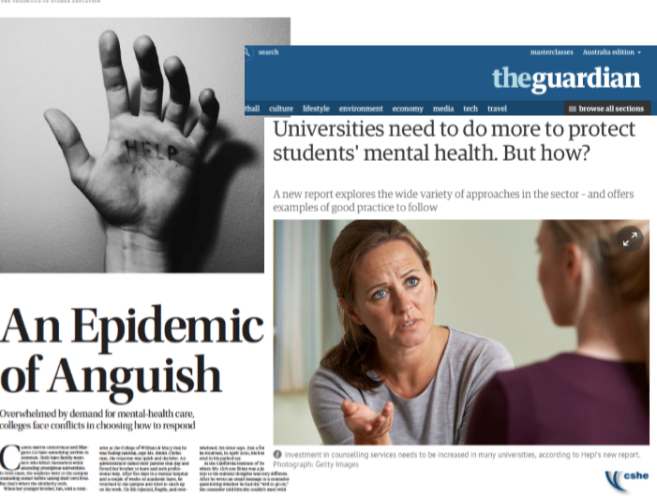
Media attention on university students’ vulnerability to mental health difficulties.
Notes:
Language barriers
Displacement from family, religion, culture, social networks
Cultural adaption
Adapting to new academic culture
Social isolation – difficulty forming local friendships, no sense of belonging
Mismatch between expectations and reality
Financial hardship
Employability in Aust.

Slide 7
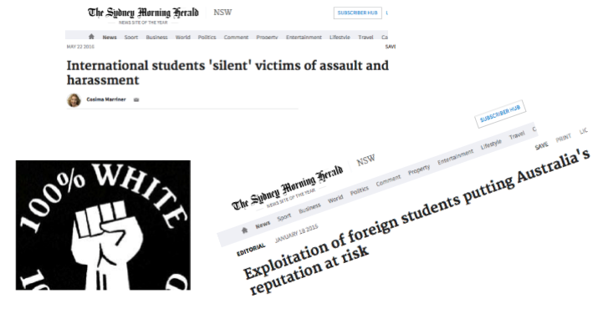
International student issues have been a media focus too.
Notes:
Exploitation by employers and landlords ----- Racism, assault, harassment

Slide 8
Notes:
Note here about larger and smaller providers. Larger institutions often have in-house student counsellors or access to university counsellors and psychologists. Other smaller providers do not have specialist staff and cite that they outsource counselling and psychological services. 40% of colleges do not employ a professional counsellor.

Slide 9
In the past 2 years, which mental health issues have students at your institution experienced?
Feelings of extreme highs & lows
Substance abuse
Self-harm or risk of self-harm
Debilitating acculturative stress
Eating disorders
Drastic change in behaviour
Psychosis
Post-traumatic stress
Paranoia
Anxiety 89 %
Depression 81 %
Extreme worry 73 %
Grief-related stress 68%
Social withdrawal 52%
Panic attacks 52%
Suicidal thoughts 39%
Internet/gaming addiction 38%
Domestic violence 38%
37%
30%
29%
25%
25%
21%
18%
15%
13%
Notes:
All of these issues would interfere with the students’ study goals and their well-being whilst in Australia. Some of these issues may have ripple effects on other students – acting out, trauma of assisting a friend. Interesting to note internet/gaming addiction and domestic violence higher than substance abuse. Can inform staff training focuses and connection to outsourced services.

Slide 10
What are the main challenges your institution faces in providing support to students experiencing mental health difficulties?
Notes:
15 mins in. 5 mins for Q discussion. 3 mins for FB.

Slide 11
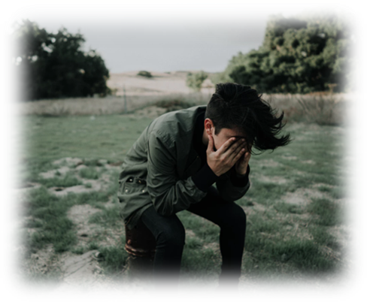
Top 6 challenges identified by ELICOS centres:
Lack of staff expertise & knowledge
Cost – for Ss and institutions
Students not seeking help (stigma)
High demand for counselling staff & limited human resources
Language barriers
Identifying students
Notes:
Person nominated as std counsellor was often DoS, Head teacher, student services staff. Many of these people have undertaken short training courses, such a MH First Aid.
3. Stigma related to different cultural paradigms of dealing with mental health and comments indicate also that Ss are fearful that disclosure may mean they are sent home.
4. Access to counselling staff in a timely way – wait periods; and smaller colleges are stretched for human resources (takes up a lot of time)

Slide 12
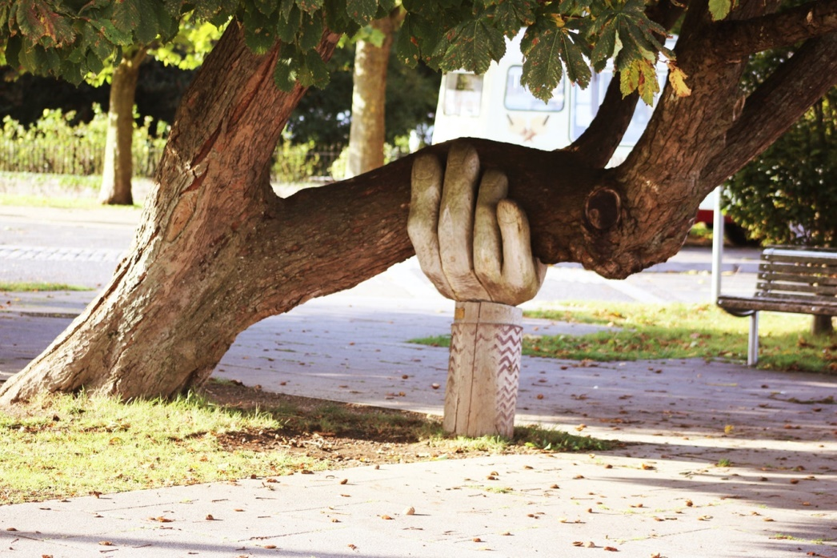
What do you see as key to effective practices for providing support to students experiencing mental health difficulties?

Slide 13
Key to effective practice
Staff training (for all staff members)
Holistic coordinated team approach
Training egs:
Mental Health First Aid, Accidental Counsellor, ASIST, training in working with people from diverse linguistic, religious and cultural backgrounds
Notes:
Holistic and coordinated team approach with clearly defined roles
+Orientation docs for staff include info. about MH procedures/Macquarie Uni twice a year seminars

Slide 14
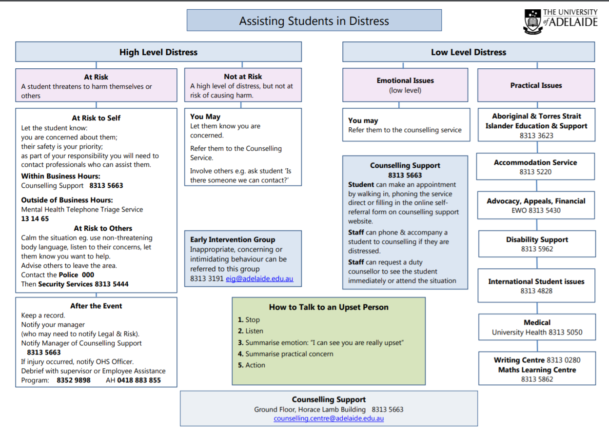

Slide 15
Key to effective practice
Clearly defined mental health policies and procedures
Clear protocols around confidentiality
Notes:
Written policy – there will be clearly articulated written policy for staff and for students outlining how the college addresses mental health issues.
Only half of respondents have a policy statement for responding to MH issues.
35% colleges - no firm policy around confidentiality.
Early identification leads to more effective intervention.

Slide 16
Key to effective practice
Normalising and promoting help-seeking
Promoting a healthy lifestyle
Notes:
Consistent reinforcement across range of media and via TEACHERS - Back of toilet doors, tips of the week, mental health newsletters/emails.
RUOK? Day, Mental Health Month, MH workshops at exam time
Accessibility of counsellling

Slide 17
Early identification and early intervention

Slide 18
1. As teachers, what training in the area of mental health would you find useful?
2. Has your centre had any effective PD sessions/training for teachers in the area of mental health?

Slide 19
How to suggest counselling
Set a time to talk privately Communicate your concern Ask and listen Bring up idea of counselling as resource Avoid a power struggle Don’t diagnose or be judgmental Remain calm Normalize counselling Stress confidentiality Describe the counselling service or nominated student counsellor at the institution and how to access, in detail. Recommend a specific counsellor Look for leverage: e.g. career or health focus Check back with student; allow some time

Slide 20
“When I did reach out to staff at uni, I really had no idea what I would get in return. Some staff were fantastic … but you were just as likely to get a response that they didn’t take you seriously, or had no idea what to do with you, which is not really what you want to hear when you’re struggling.” (International student) Orygen Report, p.16
Notes:
Be proactive with training at your institution
MH is everyone’s business

Slide 21
References
Baik, C., Naylor, R. & Arkoudis, S. (2015). The first year experience in Australian universities: Findings from two decades, 1994-2014. Melbourne CSHE.
Marginson, S.,Forbes-Mewett, H.,Nyland, C., Ramia, G., Sawir, E., (2012). International Student Security and English Language Proficiency. Sage Volume: 16 issue: 5, page(s): 434-454.
Orygen, The National Centre of Excellence in Youth Mental Health. Under the radar. The mental health of Australian university students. Melbourne: Orygen, The National Centre of Excellence in Youth Mental Health, 2017.
Reavley, NJ, Ross, A, Jorm, AF and Killacke, E (2011) Introduction to Guidelines for Tertiary Educational Institutions to assist them in Supporting Students with Mental Health Problems, JANZSSA, 38, October 2011, 22-33.
University of Adelaide Counselling Service: counselling.centre@adelaide.edu.au

Slide 22
sophieokeefe@englishaustralia.com.au

