Slide 1
The Curse of Knowledge in Education
..and how to manage it.

Slide 2
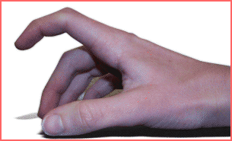
The Tapping Experiment
Three Songs
1.
2.
3.
Notes:
Elizabeth Newton Early 1990’s

Slide 3
The Tapping Experiment
Three Songs
1. Satisfaction- Rolling Stones
2. Twinkle, Twinkle
3. Billie Jean- Michael Jackson

Slide 4
The Tapping Experiment
From 120 songs
Correctly guessed by listeners?
Three songs (2.5%)
Predicted correct answers by tappers?
Sixty songs ( 50%)

Slide 5
The Curse of Knowledge
Once you know something it becomes incredibly difficult to imagine what it’s like not to know it.
We generally overestimate our audience’s current knowledge or ability to understand our message
Notes:
Once you know something it becomes incredibly difficult to imagine what it’s like not to know it.
It becomes difficult to recreate our audiences state of mind. As a consequence
We generally overestimate our audience’s current knowledge or ability to understand our message
As an educator one of the most powerful insights I've ever had about teaching.
Knowing something handicaps us from transmitting knowledge to someone else
Taking the ideas from our own heads and putting them into someone else's ( which is our job) is an art and skill that I had hitherto underestimated.
Today I’m Gonna talk about how We are all victims of this cognitive bias. It causes unnecessary confusion in our everyday lives. How it undermines good ideas and intentions.
But I'm also gonna talk about the way we as teachers are also guilty of the curse. How we hinder learning through imperfect instruction. How we overload our learners with too much information, too soon. How our familiarity with concepts and materials can actually work against us.
We cannot accurately imagine what its like not to know what we know. As a result, our classes are end up like a game where the teacher who understands the ideas in his/her head perfectly cannot get those ideas over accurately. Meanwhile the students desperately try and unlock the obscure information that is being presented to them. The whole thing resembles a game of charades. And it often looks like this.

Slide 6
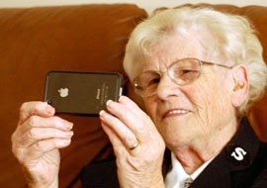
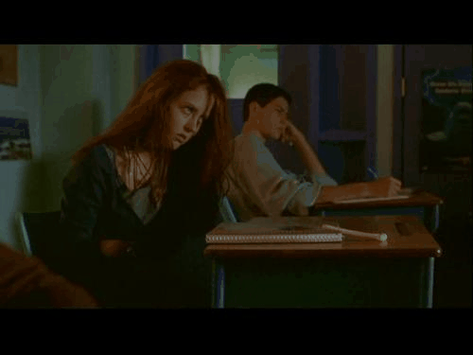
The curse of knowledge in action

Slide 7
The Curse of Knowledge

Slide 8
Has this ever happened to you?

Slide 9
Remote control 1977

Slide 10
Remote control 2015
Notes:
Feature creep

Slide 11
Remote control 2015

Slide 12
Page 55 of the guide
1. Turn on the device.
2. Press and hold (at least 6 seconds) the mode button you want to program until you see the lights flash twice. Release the mode button and make sure that the button continues to flash then press the POWER button.
3. Once the mode button light is solid press the UP cursor key repeatedly and slowly. Each time the key is pressed the remote will try to turn off the device. Test the remote to make sure that all of the features work.
4.If the device works properly then press the OK button to save the code. If the device doesn't work properly continue trying step 3.

Slide 14
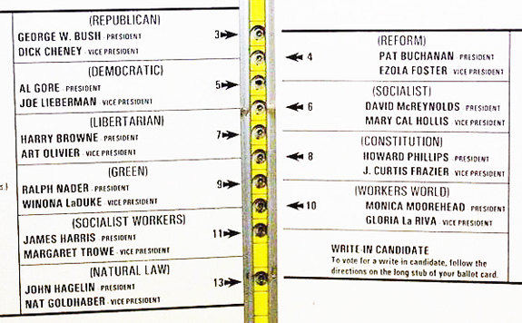
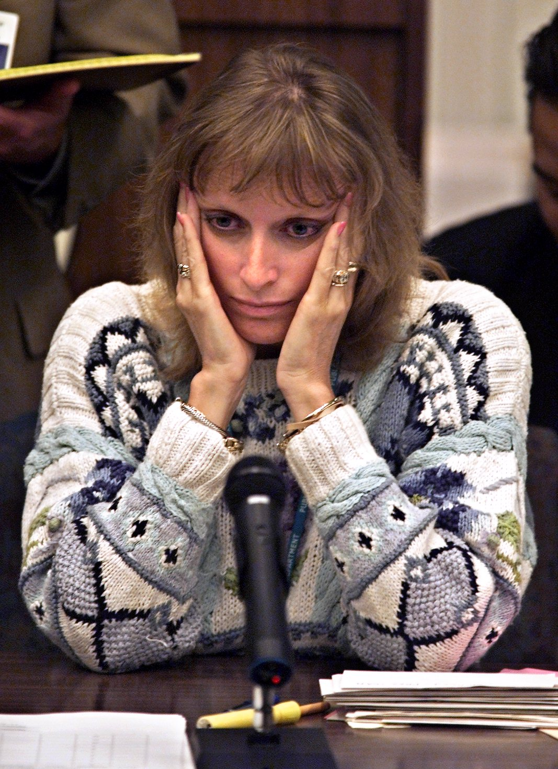
The Butterfly Ballot
Notes:
Teresa Lapore

Slide 15
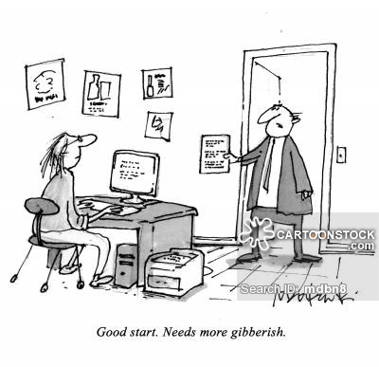
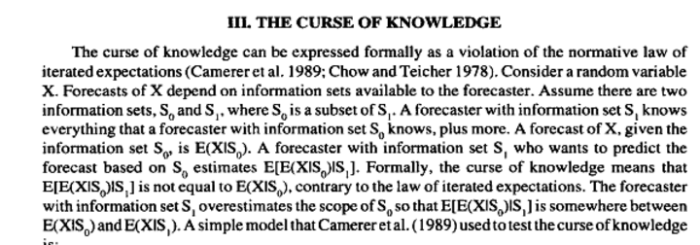
What about education?
Debiasing the Curse of Knowledge in Audit Judgement( Kennedy, 1995)
Notes:
What about education. How do we fare when it comes to the old curse of knowledge. Well I personally find it kind of odd that the field tthat is dedicated to the tansmition of ideas is one of the worst at doing it.
How do we feel about the curse of knowledge?
Lets have a look at this article.

Slide 16
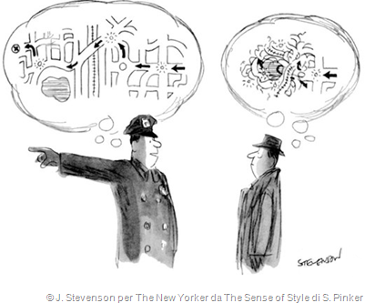
The Curse of Knowledge in Teaching: Instructions
Teacher: Ok now what I want you to do is in your groups we are going to get together and plan a trip around the world. And we are going to present it to each other at the end. Now listen we can only go in one direction and we must only stop in 5 places so choose those five places together. Oh and It must be in a straight line. You cant go backwards. Maybe one person can select their favourite place. Maybe even convince each other about our favourite places. Now let’s use the language we looked at this morning and then we will use some of this language to talk about our decision.(points at course book). Is that clear? Any questions?
Students: (silence)
Teacher: Yuri what do we have to do?
Student: ehh……..plan a trip
Teacher: That’s right and can we go backwards or only in one direction?

Slide 17
Curse of Knowledge: Grammar Active vs passive
1. Shakespeare wrote Romeo and Juliet (active)
2. Romeo and Juliet was written by Shakespeare (passive)
Notes:
How long did it take you to learn about the passive? Double it!!
Mobile phone 24 mins vs 12 mins
How long did it take you 24 mins

Slide 18
Curse of Knowledge: Grammar Active vs passive
1. Passive sentences move the focus of attention from the subject of an active sentence to the object.
2. In most cases, by and the agent are omitted in passive sentences. This is because the agent is not important, isn’t known or is understood.
3. Sometimes we prefer to start a sentence with what is known and end a sentence with what is ‘new’. In the passive the ‘new’ can be the agent of the active sentence.
4. In informal language, we often use you or they to refer to people in general or to no person in particular. In this way we avoid using the passive.
Notes:
How long did it take you to learn about the passive? Double it!!
Mobile phone 24 mins vs 12 mins
How long did it take you 24 mins

Slide 19
Is this why…. lessons are too rushed curricula are too ‘packed’ meetings are way too long inductions are too intense Is it why we end up taking work home and why time frames unrealistic?

Slide 20
Discussion
Think of a time when you were a victim of the curse of knowledge
You should describe
- when and where the situation took place
-why the information was difficult for you to understand
-how you felt
Say how the situation could have been handled better by both parties.

Slide 21
5 Tips for Managing the Curse
Notes:
Curse is chronic. No known cure
Some strategies for managing.

Slide 22
5 Tips for managing the curse
1. Remember the Curse
2.
3.
4.
5.

Slide 23
5 Tips for managing the curse
1. Remember the curse
Self-awareness
Seek clarification
Clarification is a human right
Notes:
Seems obvious but it might be the key strategy to mitigating the curse. We all suffer from the curse. Everyone of us.
But what is even more malignant about the curse is that we are often blind to how it effects us. We just don’t realize how unclear we are being.
Your instincts are not rational. When we teach, run a meeting talk with our colleagues we often overestimate how much they know or can take in one sitting.
We must strive to remember this at all times. We have a weakness.
But self awareness can help. Interrogate yourself. “am I guilty of the curse of knowledge here”
Knowing your short sighted doesn’t fix your eyesight. We need help.
2. As we are blind to our own bias it’s a good idea if we keep each other honest. Lindsasy
3. Seek clarification

Slide 24
5 Tips for managing the curse
1. Remember the Curse
2. Become a novice
3.
4.
5.

Slide 26
Becoming a Novice
Notes:
Whenever you can become a novice
Empathy is a learned skill
MRI: Novies/Experts think differently. People in this room have different levels of experience and think differently.
The length and depth of your relationaship with a idea/concept changes over time. You don’t think about money now the way you did when you were a six year old. And rightly if you were teaching a six year old about money you wouldn’t talk about tax, leverage or quantitate easing.
But there is amble evidence to suggest when we teach the more we know about a topic the harder it can be for us to teach it. Expertise can be a hindrance if we are not careful.
This might explain why many genius sports stars don’t make the transition to successful coaches. They just cant understand what its like not to be brilliant. They cant empathise what it’s like to be a novice.
Become a novie: guitar
We are all learners. Try and be a little more self reflective about your own learning process. At the moment I am reading a book on the GFC. It’s well written but it’s tough. Credit default swaps, short selling are new to me and it is taking time for them to become comfortable in my head.
Learn a language/ Live abroad/ Be a teenager ( Whiskey: self righteous loathing arrogance)
So why the ladder. An analogy from Chip and Dan Heath
Top looking down
Destination focused we forget the journey
Better to climb down and take the journey with them.

Slide 27
5 Tips for managing the curse
1. Remember the Curse
2. Become a novice
3. Be concrete, reduce abstraction
4.
5.

Slide 28
Be concrete, reduce abstraction
“Once we know something we forget how abstractly we think about it.”
Notes:
Once we know something we forget about how abstractly we think about it.
Remember that definition of the passive or the remote control.
Now abstraction and meta language are useful tools for thinking about the world. But be careful, abstraction is hard. Thise complex concepts you have in your head like art, love, grammar, the /s/ drive, these concepts were hard earned and took you time. You went from periods of initial fuzziness to gradual understanding. And remember the time it took you to understand……double it.
But there is a way to help our learners understand abstract concepts sooner. Through concrete language. That is language that draws on physical things. Things we can touch, see or feel.

Slide 29
Use imagery, analogy and metaphor
“Chinese soil is different to Arabic soil.”
“Studying IELTS only gives you plastic flowers”
“Everyone grows different types of flowers”
“Learning has different seasons”
Notes:
The use of imagery, analogy or metaphor is an incredibly powerful tool for passing on complex or abstract concepts.
1/3 of our brains is dedicated to vision. We are hard wired to understand images.
The trick of using metaphors and analogy is that they allow new and difficult ideas and concepts to piggy back on old and familiar ones.
Example
“ Teachers like me can only explain ideas to you. I can give you the rules and opportunities to practice in a controlled way. However, research shows us time and time again that if you don't use this language in authentic situations with meaningful communication then the ideas will never take hold in your mind.”
Passion, bought it. Passion never got passed the elevators.
Analogy ( dining out every since)\
Teachers plant the seeds in the learners mind. That’s all we can do. But only when you go outside and use the language in the real world does the sun shine and the rain fall. The more sun and rain you give the seed. The more seeds will grow.
Great response: Best lesson ever

Slide 30
5 Tips for managing the curse
1. Remember the Curse
2. Become a novice
3. Be concrete, reduce abstraction
4. Boil it down and break it up
5.

Slide 31
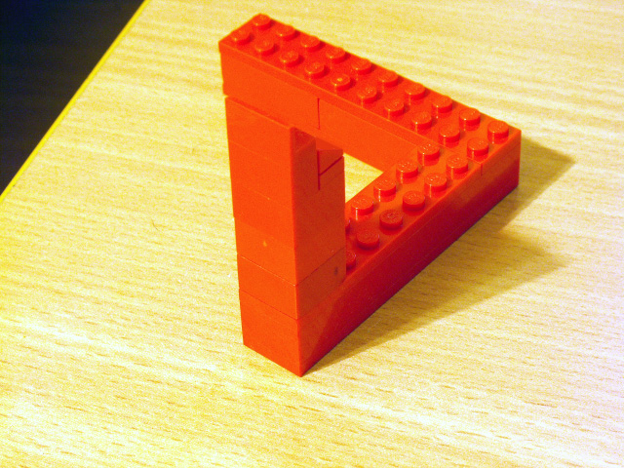
Remember how your knowledge was made
Notes:
Now like I said earlier one of the most common features of the curse is that we totally over estimate how much our audience already knows or how much or quickly they can learn the things we know.
We have forgotten how long it has taken us to master some things. Evidence is everywhere. Classes are too rushed, curricula are too busy, its why meetings are tooo long, inductions to packed, its why we take work home. Its why we feel over-whelamed.
How many people here were involved in a roll out of a new course. MEB/ME. How did you feel the first time you delivered it? What about people who have gone through an induction? The most common response is over whelming. So much information to take in. so quickly. Then we say with time it becomes easier, The second third time its much better. But its always the first time for our learners!
Have you noticed this. Once we complete something once, twice maybe three times we get better at it. What was once hard We can complete with little effort. We can sometimes do it on autopilot. Think about what it was like when you first stared driving……. to how you drive now ( drove here without really thinking)
Now as we get better at things and do them automatically we free up space in our thinking. More space means, lets add more stuff. Now we can drive, talk to the passenger, change the radio and of course text people.
How does this happen? How do we get so automatic at things
The answer is chunking
New concept ( giving,
Builds over time: trade, buying selling, profit, loss, finance, tax, quantitate easing and credit default swaps)
When you pass that info on to a novice the idea comes in lots of packages
Grammar/essay swriting/ concepts in the readings

Slide 32
Boil it down and break it up
Notes:
What we need to do as teachers is boil to information down to what is necessary for the learners to know and them break that information into manageable learning chunks. Remember the curse. That knowledge you have was hard and long earned. It is unrealistic to pass it on in one fell swoop.
Focus our lesson aims to what is manageable. Come down the ladder and take it one wrung at a time. Unpack concepts into their smaller components and deliver them clearly and succinctly. Be realistic about how much people can take in on one sitting, week or course.

Slide 33
5 Tips for managing the curse
1. Remember the Curse
2. Become a Novice
3. Be concrete, reduce abstraction
4. Boil it down and break it up
5. Get some feedback

Slide 34
Get Some Feedback
Phone a friend
Ask the audience
Use analytics
Notes:
My final tip is get some feedback.
If we know we are biased, if we know we are prone to giving too much information too soon. Lets find out.
My first tip is to phone a friend. You don’t literly have to phone them. I’m using a well known trope for comedic effect but ask a colleague. Hows my curse od knowledge here. Does this makes sense. Look over this worksheet Ive made. Where are the pitfalls for the learners.
My second tip is ask the audience.
And I don’t mean saying Any questions? Did you understand?
Seek genuine feedback on understanding. We need to start reckoning with what learners don’t understand.
I think technology is starting to solve some problems around this.

Slide 36
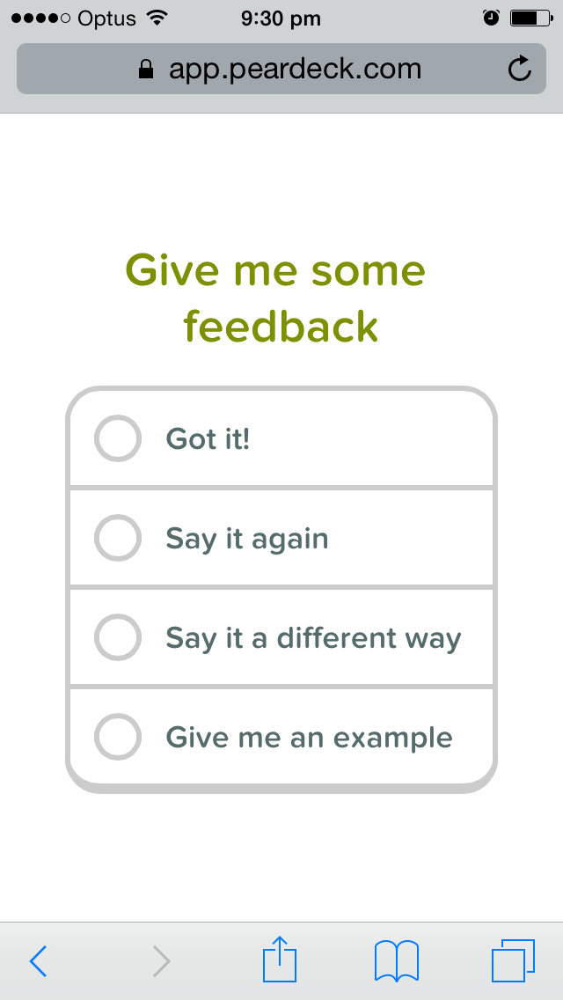
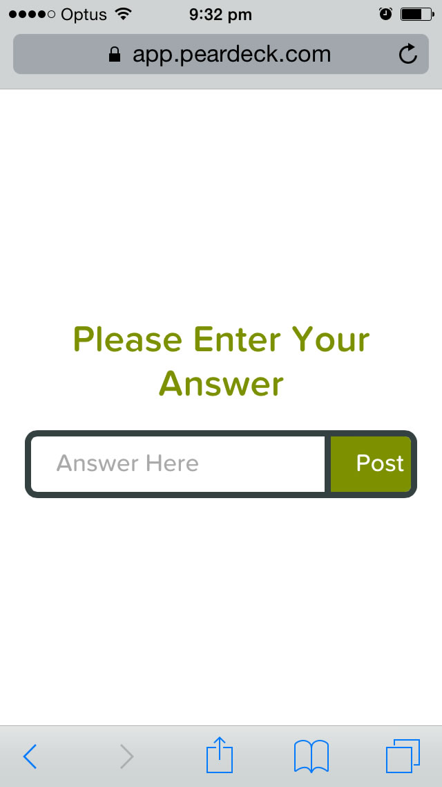
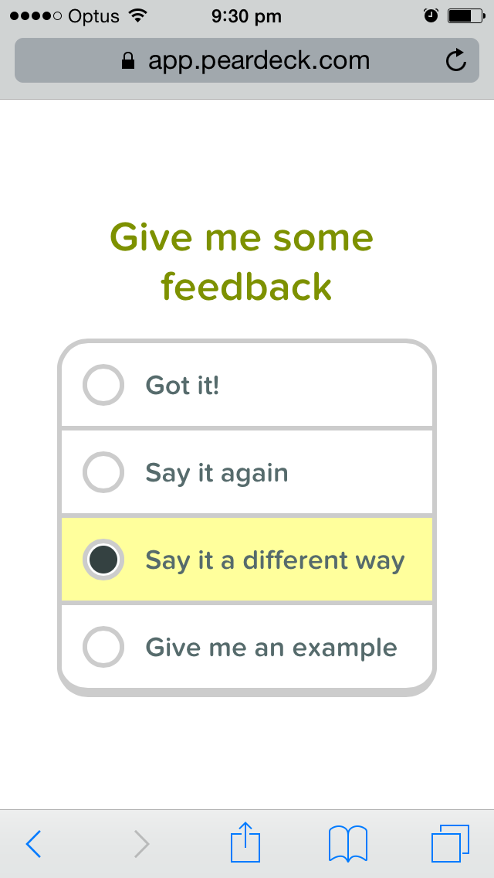
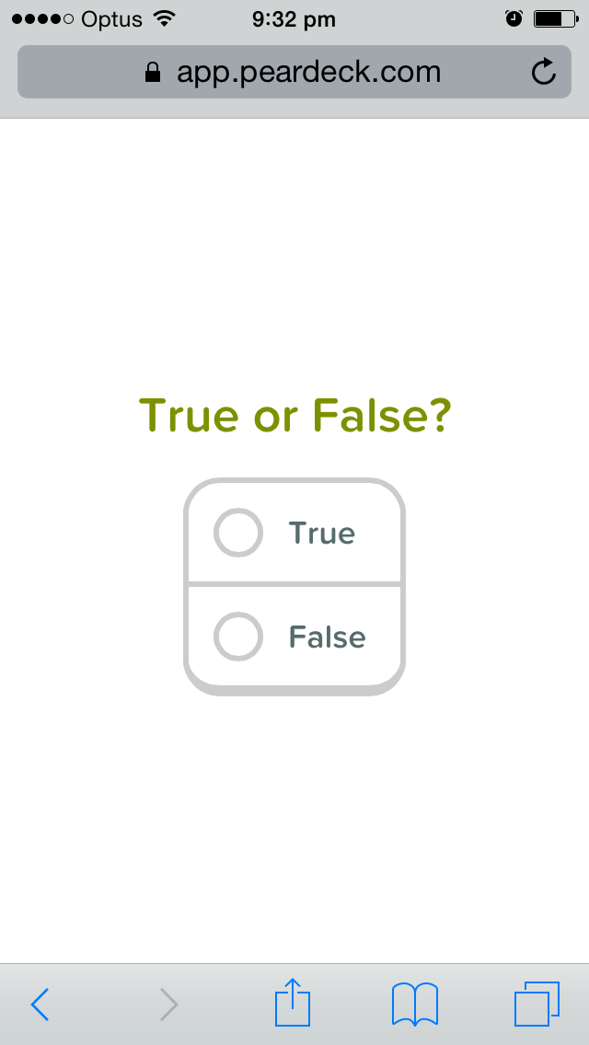
Pear Deck: What are they really thinking?

Slide 37
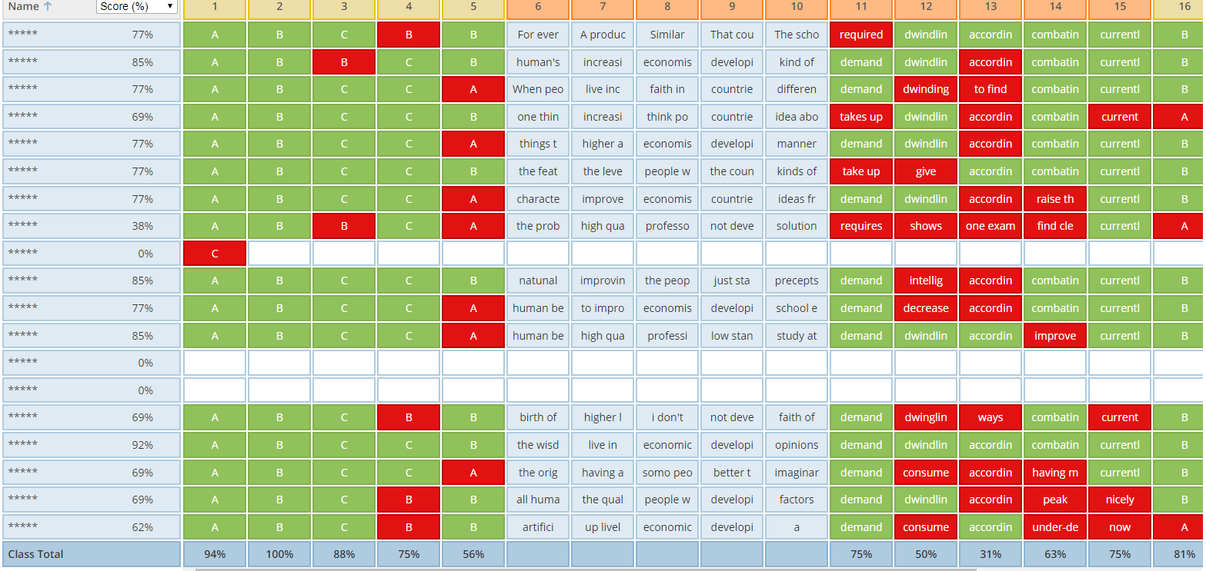

Slide 38
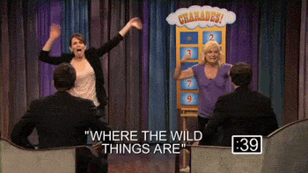
Lets move from this…
…to this

Slide 39
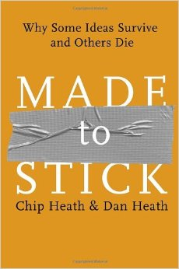
Further reading
Chapter 3: The curse of knowledge

Slide 40
5 Tips for Managing the Curse
Notes:
Curse is chronic. No known cure
Some strategies for managing.

Slide 41
5 Tips for managing the curse
1. Remember the Curse
2. Become a Novice
3. Be concrete, reduce abstraction
4. Boil it down and break it up
5. Get some feedback

Slide 42
Activity 1
Participant A
Speak about a selected topic for two minutes
You will have one minute to prepare your answer
Participant B
Listen carefully to participant A’s answer.
Do not contribute
Pay attention to the quality of the vocabulary they use.
Do they fully answer the question
Give them feedback on their answer after the task

Slide 43
Activity 2: Participant B
Think of a time when you were guilty of the curse of knowledge
You should describe
- when and where the situation took place
- why the information was difficult for your audience
to understand
- how you imagine they felt
Say how the situation could have been handled better by both parties.

Slide 44
Activity 3: Using analogy and metaphor
A: Writing an essay is a detailed process with many stages. These stages are brainstorming, researching, selecting the appropriate information, drafting, redrafting and proofreading.
B: Teachers should treat all classroom tasks as a diagnostic tool. For example, a classroom activity such as reading a text and answering comprehension questions should allow the teacher ( and student) to make decisions about what they are going to learn next and how they are going to learn it.
C: In order for classrooms to be successful we must provide the conditions for meaningful communication, deep thinking and authentic tasks. When learners are confronted with tasks that require nothing of them beyond the mechanical recitation of facts and rules, they quickly disengage with the learning process.

Slide 45
Questions

