Slide 1
How many sides to a triangle?
Diversity Education increasingly has moved away from a one-size-fits-all approach and seeks to welcome and promote diversity. It needs to provide opportunities that encourage all students to feel included, to feel they are encouraged to participate and supported to succeed.
Mary Brennan
casual academic
CQUEnglish

Slide 2
To become engaged, people … need to be invited to participate by those they know and trust McCoy & Scully, 2002, p. 120

Slide 3
ORID technique
Objective easy to answer facts and info: relieve stress and invite active participation
Reflective elicit emotional response and personal reactions: think, feel, gauge
Interpretive invite sharing and build consciousness
Decisional develop opinions that lead to future actions and clarify expectations for improvement
Adapted from a wikispace Iowafiercetrainers: source no longer available

Slide 4
adapt don’t adopt
Attributed to: Marianne Celce-Murcia

Slide 5
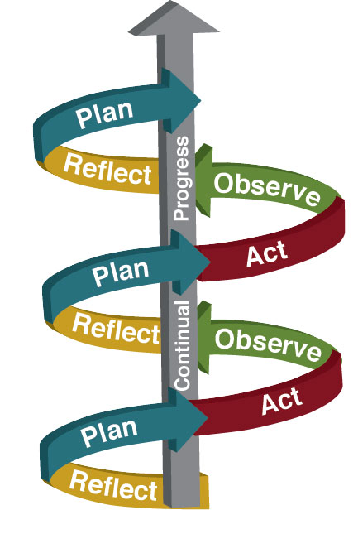
Source: Valenciacollege.edu

