Slide 1
UECa PD Fest Monash College August 4th 2018
Darren Brookes
Connecting digitally: using the Canvas LMS and social media to engage ASEAN research grant recipients online

Slide 2
Order of Presentation
The Project to Date
Communities of Practice
Social Media
Canvas LMS & LTIs
Final Questions & Discussion

Slide 3
Project Overview
“In addition to receiving financial assistance, each research grant recipient is matched with an experienced research partner from another country. Partners communicate through email and/or Skype and offer help to the extent they feel appropriate. The role of peer mentor is to facilitate in any way possible to help researchers write good academic papers. The main purpose is to support and network the research grant recipients with more experienced researchers who could help the grant recipients’ (3500 word) papers reach a standard suitable for an academic publication (e.g., LEIA).”
IDP Regional Research Grants Guidelines, 2013

Slide 4
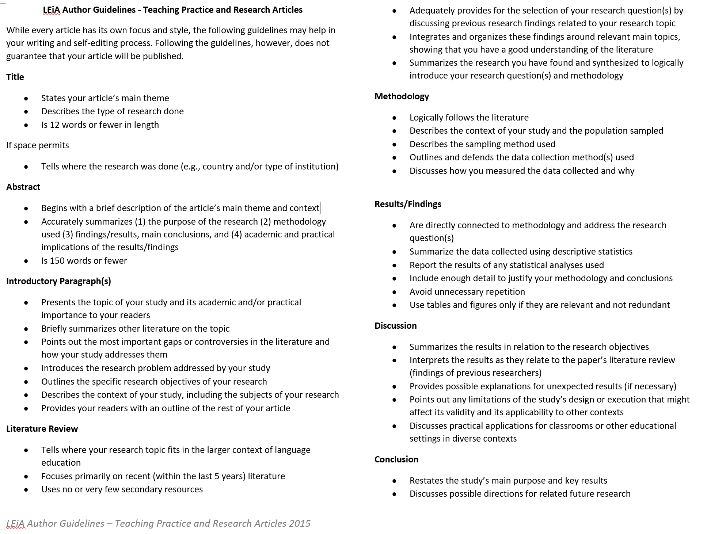

Slide 5
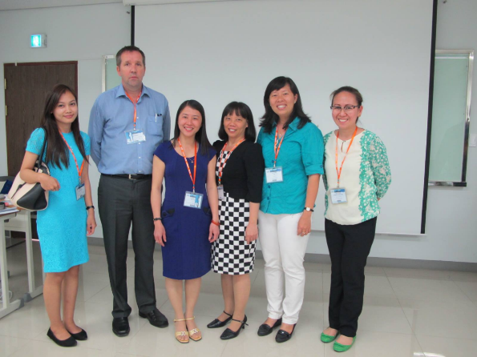
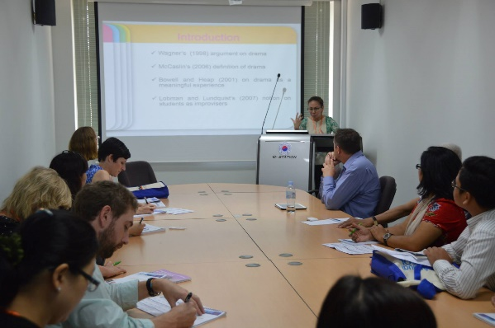
Cambodia TESOL Research Grant Recipients 2013
Research Topics covered a diverse area including:
Attitudes toward ESP for Law in Cambodia
Writing Problems
Primary Teachers Issues
Teacher Adoption of Technology
Collaborative Learning
Speaking motivation through Drama Techniques
8 Early career academics from:
Cambodia
Vietnam
Myanmar
The Philippines
Indonesia
Working online with a mentor in Australia to write and present 6 quantitative research papers

Slide 6
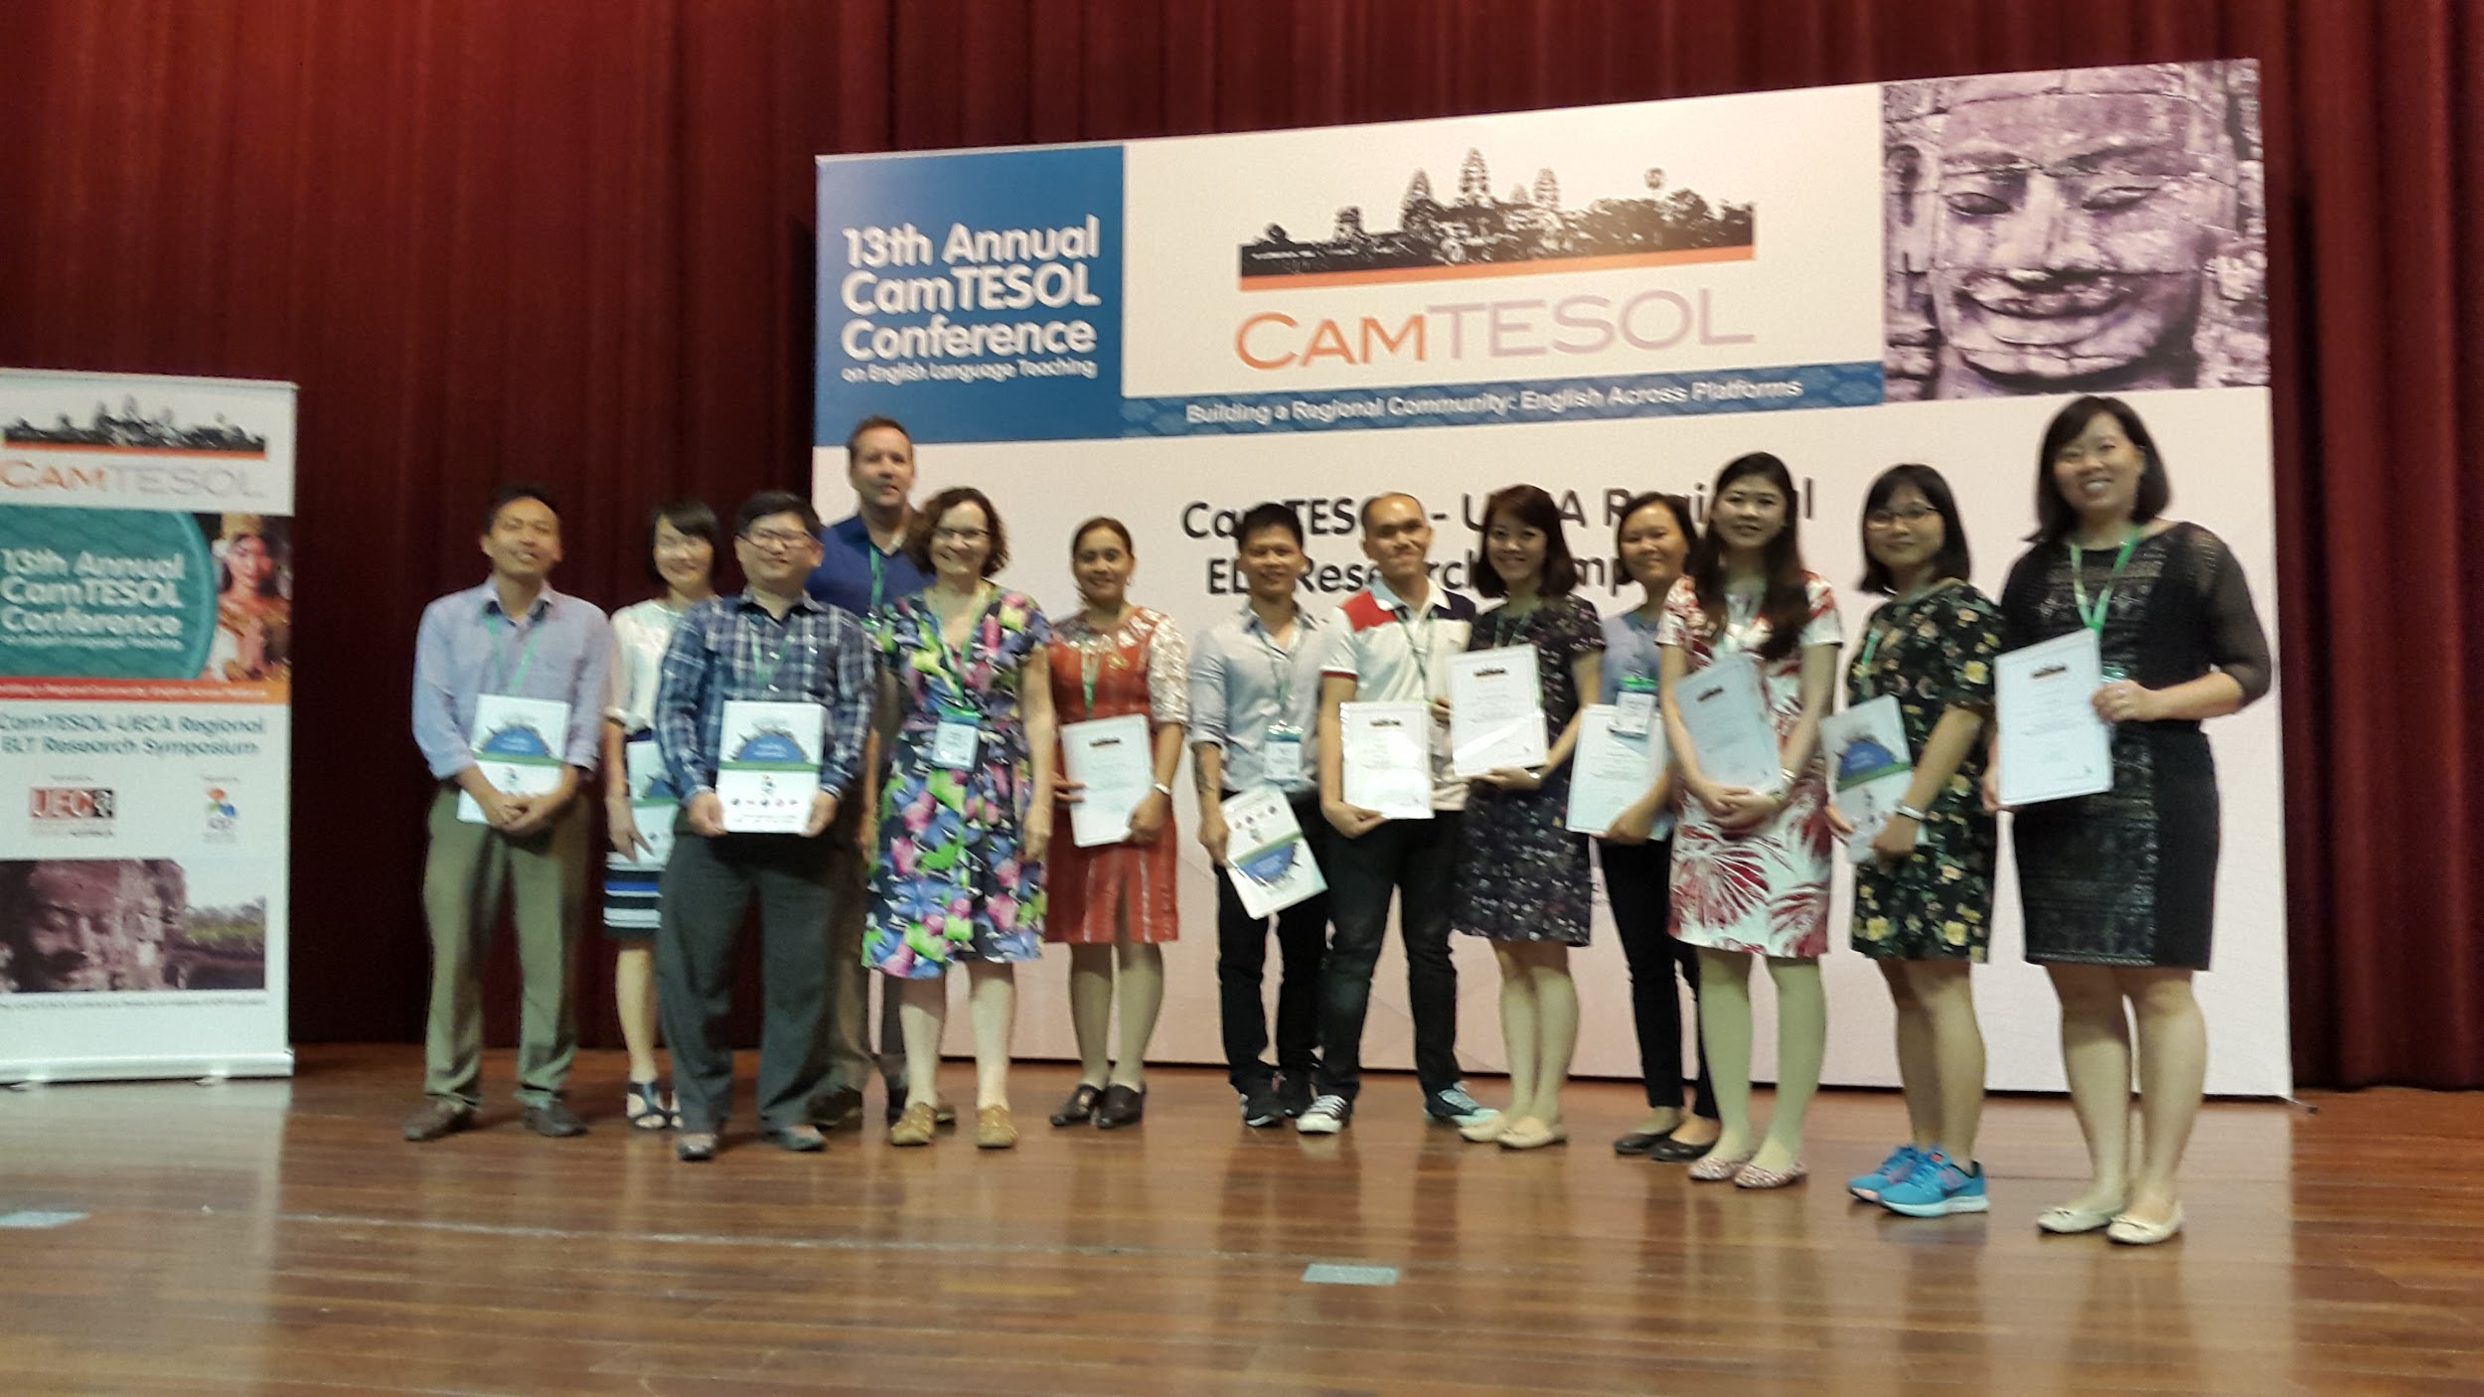
Cambodia TESOL Research Grant Recipients 2017-18
2017-18 countries:
Laos
Cambodia
Vietnam
The Philippines
Vietnam
Indonesia

Slide 7
2017-2018 Research Grant Recipient Topics
Using Pair-Coaching Conference to Scaffold Cambodian Students’ Writing Proficiency in English
Lao Language Interference in Translating Lao into English
Western-published ELT Coursebooks: Their Role and Relevance in EFL Classrooms
ESL Writers’ Proficiency in Using Prepositions of Time and Location: An Analysis of Written Corpus.
English Language Skills of Alternative Learning System Recipients of Lamut District, Province of Ifugao, Philippines.
Primary EFL Teachers’ resilience in the context of new curriculum reform in Vietnam.
Application of Digital Teaching Portfolio in Professional Development of General English Lecturers: Strengths and Challenges.
Service Learning integration in ESP courses: its impacts on students’ life skills development and academic achievement.
EFL Teachers’ Professional Development in the Mekong Delta, Cambodia and Viet Nam: Needs and Impact.
Mobile apps on improving student’s performance in learning grammar and other skills.

Slide 8
2017-18 Research Grant Recipient Partners
ASEAN Institutions | Australian Institutions
Research Grant Recipient Institutions COERR Language Skills Centre National University of Laos King Mongkut’s University Thailand Polytechnic University of The Philippines Ifugao State University, The Philippines Tay Bac University, Vietnam Can Tho University, Vietnam Vietnam-UK Institute for Research and Executive Education Cambodia TESOL Sponsor IDP Cambodia | $500 Research Grant Donors UTS Insearch, NSW Curtin University, W.A. UNSW Global, NSW University of Western Australia, W.A. University of Adelaide, S.A. University of Newcastle, NSW University of Wollongong, NSW Deakin University, Victoria Western Sydney University, NSW Research Symposium Sponsors NEAS UECa

Slide 9
2018-19 Research Grant Recipient Partners

Slide 10
“Communities of Practice (CoP) are groups of people who share a concern or a passion for something they do and learn how to do it better as they interact regularly. A community of practice is a social learning system.
The Domain: A community of practice is not merely a club of friends or a network of connections between people. It has an identity defined by a shared domain of interest.
The Community: In pursuing their interest in their domain, members engage in joint activities and discussions.
The Practice: A community of practice is not merely a community of interest. Members of a community of practice are practitioners. (1998, pp. 1-2)”
Wenger, E. (1998) Communities of practice: learning, meaning and identity. Cambridge University Press.

Slide 11
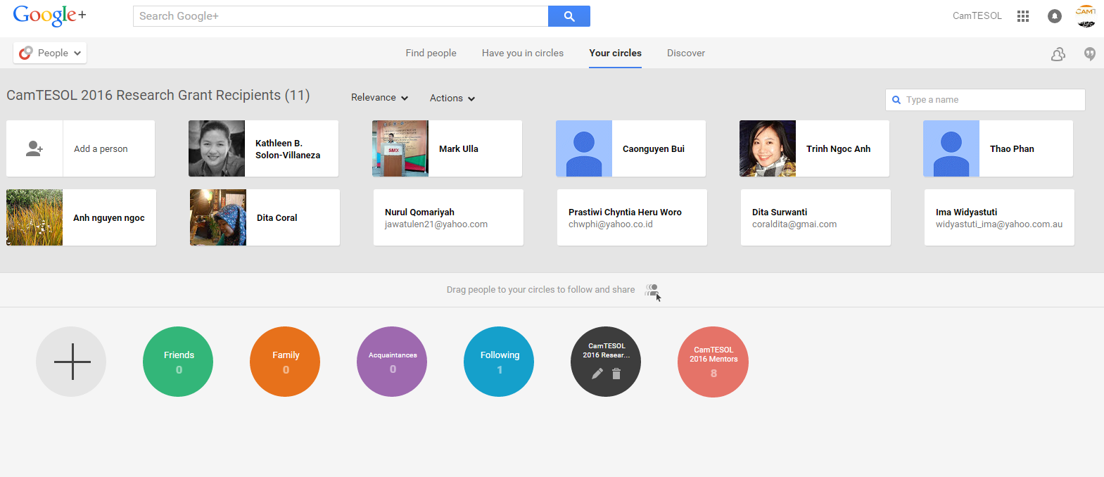
Establishing The Domain - Google Circle

Slide 12
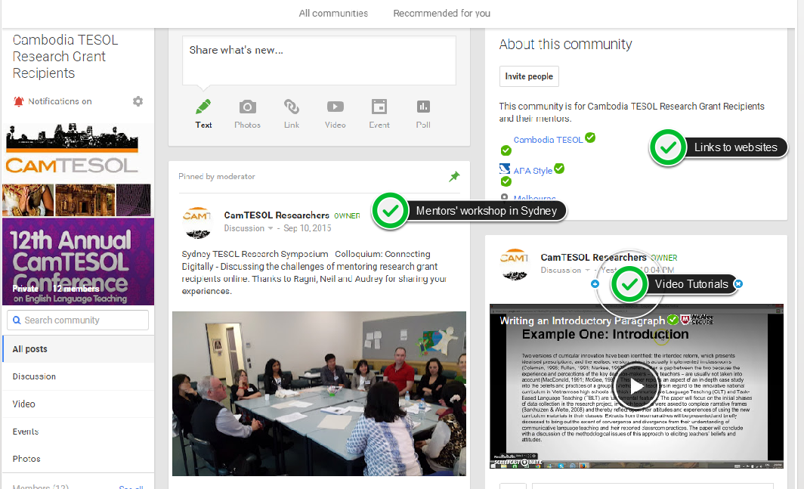
Google Community
Notes:
Initial informal ‘needs analysis’
Key question to ask at the start = What has researcher done so far and in what ways can I help?
First few weeks -> I worked out what Ha’s focus and research plan way, wrote it into my own words and have asked her to check the accuracy of an update on our progress a couple of weeks ago
Ha’s research seemed clear and well planned – so I followed her requests -> the first one was to find some relevant literature as she felt she didn’t have enough
Working out methods/frequency of communication
As Darren has mentioned, there are many ways of communicating, and the aim is to find which one best supports the researcher
For us, email seems to be working well – it allows space for the other person to think and take their time in replying
We are in email contact once every 7-10 days
Sensitivity to researcher’s needs
Support without too much pressure!
After a few weeks, I felt I was maybe bombarding Ha with too much information and too many emails, so I told her honestly in an email that I was worried about this, and that she should tell me if she felt too much pressure! She replied that she found the pressure motivating – but I’m still careful to leave a few days before replying to her emails so she doesn’t feel she needs to reply straight away either.
Creating professional connections/relationships
One of the main benefits of this program I think is the collaboration – learning from and with someone else in a different context
Great to extend professional network – hopefully Ha and I can meet at CamTESOL or another conference – could lead to collaborative research

Slide 13
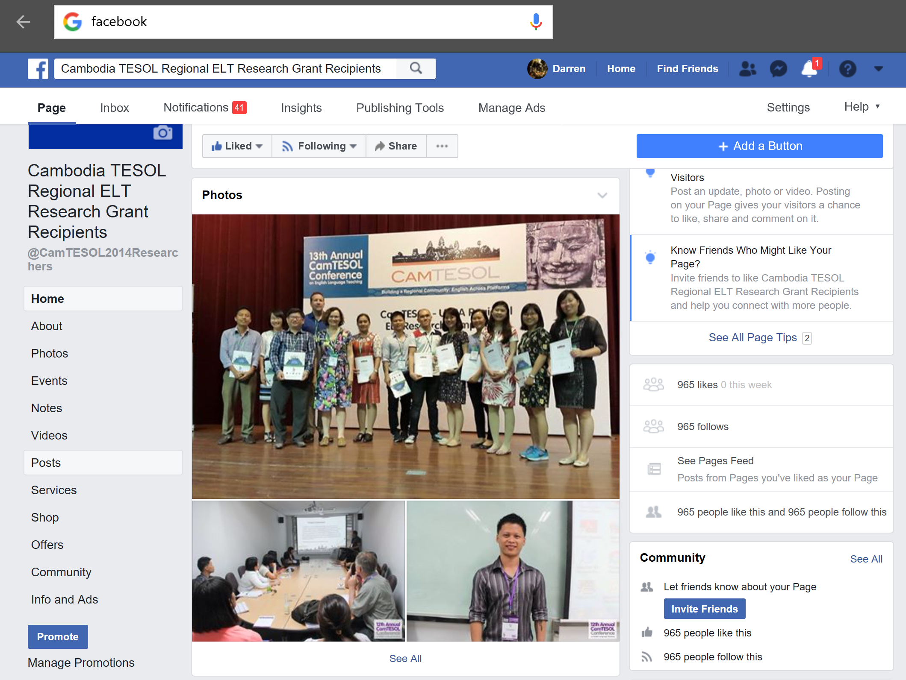
Establishing Community - Facebook

Slide 14
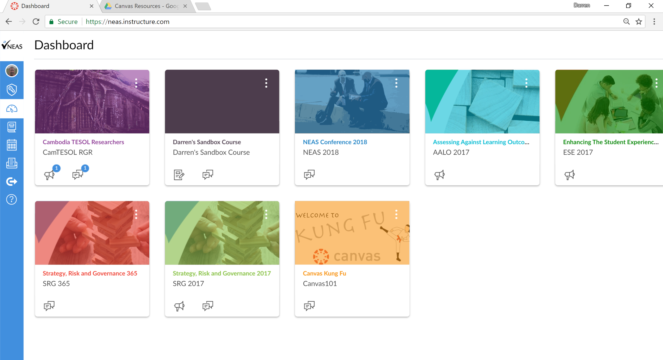
Combining Community Resources and Social Media with Canvas

Slide 15
Tools used to create Canvas Support Course for Researchers
(back to NEAS Canvas)

Slide 16
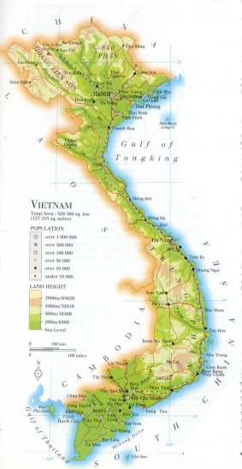
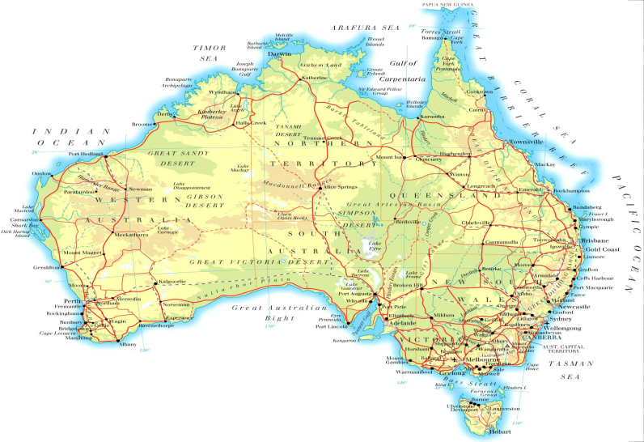
Project title: Features of academic writing in students’ research proposals and the influence of intensive writing training on their performances
The Practice – Mentor and Researcher working one to one
Researcher: Thi Thu Ha Nguyen
(Hanoi National University of Education, Vietnam)
Mentor & co-author: Emily Edwards
(UNSW & UTS: Insearch, Australia)
Notes:
INTRO
I’d like to briefly introduce the project I’m working on to co-author with a Vietnamese teacher researcher, Thi Thu Ha, who works at the Hanoi National University of Education. My name is Emily and I’m a PhD student at UNSW, as well as a teacher and course developer at UTS:Insearch.
Ha’s project has the following title:…
CONTEXT
I’ll quickly describe the context of Ha’s research. She’s working with 4th year students at the Faculty of English at her university, who previously studied a ‘Second Language Research’ course in their 2nd year. Having completed this course, the students must then write up a research proposal, and students must then submit a graduation thesis in order to graduate (or take an exam). So the research proposal is very important, but Ha has noticed that academic writing is often problematic for these students, especially certain features.
PURPOSE
So, the purpose of this study is to investigate features of academic writing in students’ research proposals, and analyse the effect of a short training course in the 4th year to boost their performance in the thesis proposal. The specific features that we’re focusing on are nominalization and lexical density.
The project also involves creating materials to raise students’ awareness and enhance academic writing.

Slide 17
The Practice - Our project planning
Notes:
SCHEDULE
One of the main ways a mentor can assist is in planning and ensuring we’re working in the right direction towards goals – even if these are not always met on time!
DATA COLLECTION
Includes:
Calculating LD and analysing use of nominalization in students’ proposals after taking the Second Language Research course but before the intensive training, and then the same after the intensive training
Interviews with students before and after the intensive training to gain insights into their needs and the challenges they face in academic writing, as well as how their use of academic features has developed
TIMELINE
At the moment Ha is designing the materials for the intensive training course, which will take place in September. She’ll conduct interviews before the course, and also later on in January when the students are required to submit their final research proposals.
We’re currently working on reviewing the relevant literature, especially studies that have analysed nominalization and lexical density from a Systemic Functional Linguistic perspective – a framework we will probably also adopt for our analysis. We are also working on our CamTESOL abstract, and look forward to the presenting and publishing our work next year.

Slide 18
The Practice - Our mentoring process
1) Informal ‘needs analysis’
2) Method and frequency of communication
3) Sensitivity to researcher’s needs – support but not too much pressure!
4) Creating professional relationships
Notes:
Initial informal ‘needs analysis’
Key question to ask at the start = What has researcher done so far and in what ways can I help?
First few weeks -> I worked out what Ha’s focus and research plan way, wrote it into my own words and have asked her to check the accuracy of an update on our progress a couple of weeks ago
Ha’s research seemed clear and well planned – so I followed her requests -> the first one was to find some relevant literature as she felt she didn’t have enough
Working out methods/frequency of communication
As Darren has mentioned, there are many ways of communicating, and the aim is to find which one best supports the researcher
For us, email seems to be working well – it allows space for the other person to think and take their time in replying
We are in email contact once every 7-10 days
Sensitivity to researcher’s needs
Support without too much pressure!
After a few weeks, I felt I was maybe bombarding Ha with too much information and too many emails, so I told her honestly in an email that I was worried about this, and that she should tell me if she felt too much pressure! She replied that she found the pressure motivating – but I’m still careful to leave a few days before replying to her emails so she doesn’t feel she needs to reply straight away either.
Creating professional connections/relationships
One of the main benefits of this program I think is the collaboration – learning from and with someone else in a different context
Great to extend professional network – hopefully Ha and I can meet at CamTESOL or another conference – could lead to collaborative research

Slide 19
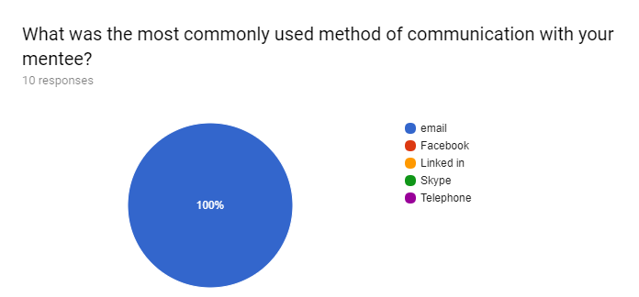
Google Form Survey Feedback Communication
Notes:
Initial informal ‘needs analysis’
Key question to ask at the start = What has researcher done so far and in what ways can I help?
First few weeks -> I worked out what Ha’s focus and research plan way, wrote it into my own words and have asked her to check the accuracy of an update on our progress a couple of weeks ago
Ha’s research seemed clear and well planned – so I followed her requests -> the first one was to find some relevant literature as she felt she didn’t have enough
Working out methods/frequency of communication
As Darren has mentioned, there are many ways of communicating, and the aim is to find which one best supports the researcher
For us, email seems to be working well – it allows space for the other person to think and take their time in replying
We are in email contact once every 7-10 days
Sensitivity to researcher’s needs
Support without too much pressure!
After a few weeks, I felt I was maybe bombarding Ha with too much information and too many emails, so I told her honestly in an email that I was worried about this, and that she should tell me if she felt too much pressure! She replied that she found the pressure motivating – but I’m still careful to leave a few days before replying to her emails so she doesn’t feel she needs to reply straight away either.
Creating professional connections/relationships
One of the main benefits of this program I think is the collaboration – learning from and with someone else in a different context
Great to extend professional network – hopefully Ha and I can meet at CamTESOL or another conference – could lead to collaborative research

Slide 20
Google Form Survey Feedback Grant Recipients
I was confused at first since I had two mentors. The first was of no help to my paper; the second was sent from heaven as she helped and guided me throughout the whole research process. I learned a lot from this research mentoring thing. I have actually not worked with my mentor for this project. I am too frantically busy with all office work and teaching and plus doing research. My mentor always replies to my mail quickly and is ready to give advice when I'm in need. I find her friendly and helpful.She did give some useful comments that made me think over the methodology of my research. Most of the time, we worked on our own. We just reported to him on what we have done. Well, the mentor hasn't been a real help after all. Very helpful. He's very supportive. Nice experience. Michelle has always been an inspiring mentor who takes patience and willingness to stick to my project to the very last minute. Without her supervision, my project wouldn't be completed. I'm honored to have her mentorship.My mentor is awesome. Very helpful. My mentor, Dilhara Mendis, is of great help. She initiated our correspondence and offered help. She gave constructive feedback on both of our methodology and writing. She sent us relevant articles which assisted us in orientating our research. Frankly speaking, I don't have much to discuss with my mentor. I think I can deal with my research, but if I have any questions I can ask her/him any time. She is very helpful and I would say that my mentor is excellent. I did not have a chance to work with my mentor.
Notes:
Initial informal ‘needs analysis’
Key question to ask at the start = What has researcher done so far and in what ways can I help?
First few weeks -> I worked out what Ha’s focus and research plan way, wrote it into my own words and have asked her to check the accuracy of an update on our progress a couple of weeks ago
Ha’s research seemed clear and well planned – so I followed her requests -> the first one was to find some relevant literature as she felt she didn’t have enough
Working out methods/frequency of communication
As Darren has mentioned, there are many ways of communicating, and the aim is to find which one best supports the researcher
For us, email seems to be working well – it allows space for the other person to think and take their time in replying
We are in email contact once every 7-10 days
Sensitivity to researcher’s needs
Support without too much pressure!
After a few weeks, I felt I was maybe bombarding Ha with too much information and too many emails, so I told her honestly in an email that I was worried about this, and that she should tell me if she felt too much pressure! She replied that she found the pressure motivating – but I’m still careful to leave a few days before replying to her emails so she doesn’t feel she needs to reply straight away either.
Creating professional connections/relationships
One of the main benefits of this program I think is the collaboration – learning from and with someone else in a different context
Great to extend professional network – hopefully Ha and I can meet at CamTESOL or another conference – could lead to collaborative research

Slide 21
Google Form Survey Feedback Mentors
One of the biggest issues I have had with my mentee is that she is very busy with other things at her university (writing reports and attending conferences) which has limited opportunities for communicating with her. I am also worried that this will restrict the amount of time she has to properly analyse the data and write her report. My mentee did not need me.
It's a steep learning curve! My mentor was experienced with this process as he had received previous grants. He knew the timeframes and sent me work to edit well in advance. He was highly motivated. Editing the work was time consuming but it was rewarding and I enjoyed it. I was lucky that my mentee was so skilled. It has been a good experience. The most important aspect was speaking directly to the mentees early on in the process to get a better understanding of their research focus. I find I am mostly an editor in this process as the researchers I amy working with are highly experienced. After the initial introduction and sending of readings, he was clear in not wanting my help. Very different to last year's mentee. I found the initial proposal quite confusing and would have liked to have suggested a totally different approach using quantitative data rather than solely qualitative. Additionally, I wasn't sure whether the research instruments / questionnaires would (will) result in an objective outcome, but the mentees were really too far along to suggest many changes apart from grammar and academic style changes. It was difficult to tell whether both mentees had the same level of English skills as only one of the mentees communicated with me.
Notes:
Initial informal ‘needs analysis’
Key question to ask at the start = What has researcher done so far and in what ways can I help?
First few weeks -> I worked out what Ha’s focus and research plan way, wrote it into my own words and have asked her to check the accuracy of an update on our progress a couple of weeks ago
Ha’s research seemed clear and well planned – so I followed her requests -> the first one was to find some relevant literature as she felt she didn’t have enough
Working out methods/frequency of communication
As Darren has mentioned, there are many ways of communicating, and the aim is to find which one best supports the researcher
For us, email seems to be working well – it allows space for the other person to think and take their time in replying
We are in email contact once every 7-10 days
Sensitivity to researcher’s needs
Support without too much pressure!
After a few weeks, I felt I was maybe bombarding Ha with too much information and too many emails, so I told her honestly in an email that I was worried about this, and that she should tell me if she felt too much pressure! She replied that she found the pressure motivating – but I’m still careful to leave a few days before replying to her emails so she doesn’t feel she needs to reply straight away either.
Creating professional connections/relationships
One of the main benefits of this program I think is the collaboration – learning from and with someone else in a different context
Great to extend professional network – hopefully Ha and I can meet at CamTESOL or another conference – could lead to collaborative research

Slide 22
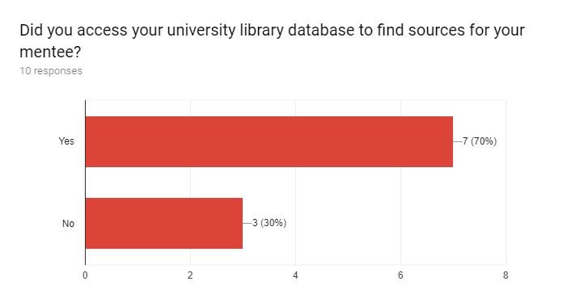
Google Form Survey Feedback Mentors
Notes:
Initial informal ‘needs analysis’
Key question to ask at the start = What has researcher done so far and in what ways can I help?
First few weeks -> I worked out what Ha’s focus and research plan way, wrote it into my own words and have asked her to check the accuracy of an update on our progress a couple of weeks ago
Ha’s research seemed clear and well planned – so I followed her requests -> the first one was to find some relevant literature as she felt she didn’t have enough
Working out methods/frequency of communication
As Darren has mentioned, there are many ways of communicating, and the aim is to find which one best supports the researcher
For us, email seems to be working well – it allows space for the other person to think and take their time in replying
We are in email contact once every 7-10 days
Sensitivity to researcher’s needs
Support without too much pressure!
After a few weeks, I felt I was maybe bombarding Ha with too much information and too many emails, so I told her honestly in an email that I was worried about this, and that she should tell me if she felt too much pressure! She replied that she found the pressure motivating – but I’m still careful to leave a few days before replying to her emails so she doesn’t feel she needs to reply straight away either.
Creating professional connections/relationships
One of the main benefits of this program I think is the collaboration – learning from and with someone else in a different context
Great to extend professional network – hopefully Ha and I can meet at CamTESOL or another conference – could lead to collaborative research

Slide 23
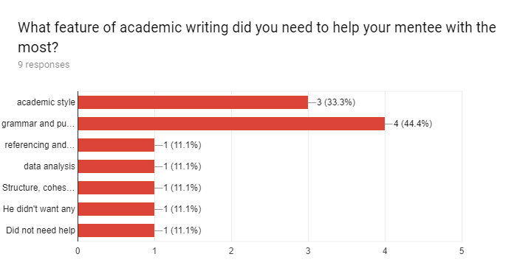
Google Form Survey Feedback Mentors
Notes:
Initial informal ‘needs analysis’
Key question to ask at the start = What has researcher done so far and in what ways can I help?
First few weeks -> I worked out what Ha’s focus and research plan way, wrote it into my own words and have asked her to check the accuracy of an update on our progress a couple of weeks ago
Ha’s research seemed clear and well planned – so I followed her requests -> the first one was to find some relevant literature as she felt she didn’t have enough
Working out methods/frequency of communication
As Darren has mentioned, there are many ways of communicating, and the aim is to find which one best supports the researcher
For us, email seems to be working well – it allows space for the other person to think and take their time in replying
We are in email contact once every 7-10 days
Sensitivity to researcher’s needs
Support without too much pressure!
After a few weeks, I felt I was maybe bombarding Ha with too much information and too many emails, so I told her honestly in an email that I was worried about this, and that she should tell me if she felt too much pressure! She replied that she found the pressure motivating – but I’m still careful to leave a few days before replying to her emails so she doesn’t feel she needs to reply straight away either.
Creating professional connections/relationships
One of the main benefits of this program I think is the collaboration – learning from and with someone else in a different context
Great to extend professional network – hopefully Ha and I can meet at CamTESOL or another conference – could lead to collaborative research

Slide 24
Questions and Discussion

