Slide 1
Focus Education:
2018 and beyond
Responding to a changing world of work
PROFESSOR ZLATKO SKRBIS Senior Pro Vice-Chancellor (Academic), Monash University

Slide 2
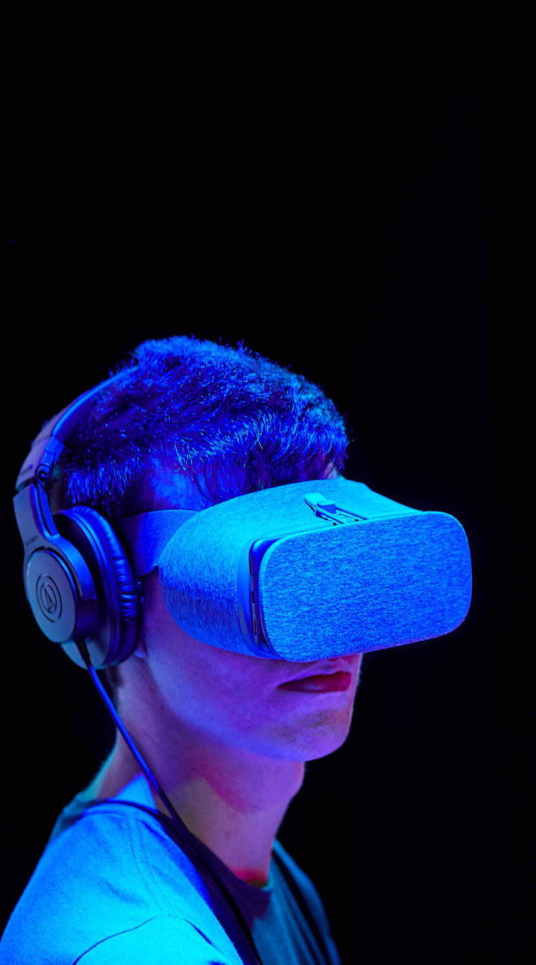
RESPONDING TO A CHANGING WORLD OF WORK
The new world of work
New models of education
A Case Study: The Monash response
Strategy
Focus areas
Discipline expertise
Skills for a changing world
Industry and community experience
Career management
Communicating the program
Underpinned by collaboration

Slide 3
THE NEW WORLD OF WORK
Driven by global megatrends, especially digitalisation
Not just new jobs but also new ways of working
Growing need for T-shaped workers
Decline of repetitive tasks and increase in need for creativity, problem solving etc.
Not simply discrete STEM jobs but a STEM overlay for many existing roles

Slide 4

“We have entered the Fourth Industrial Revolution, an era where automation, machine intelligence and universal interconnectivity is transforming the workplace and redefining opportunities.”
Schwab 2017

Slide 5

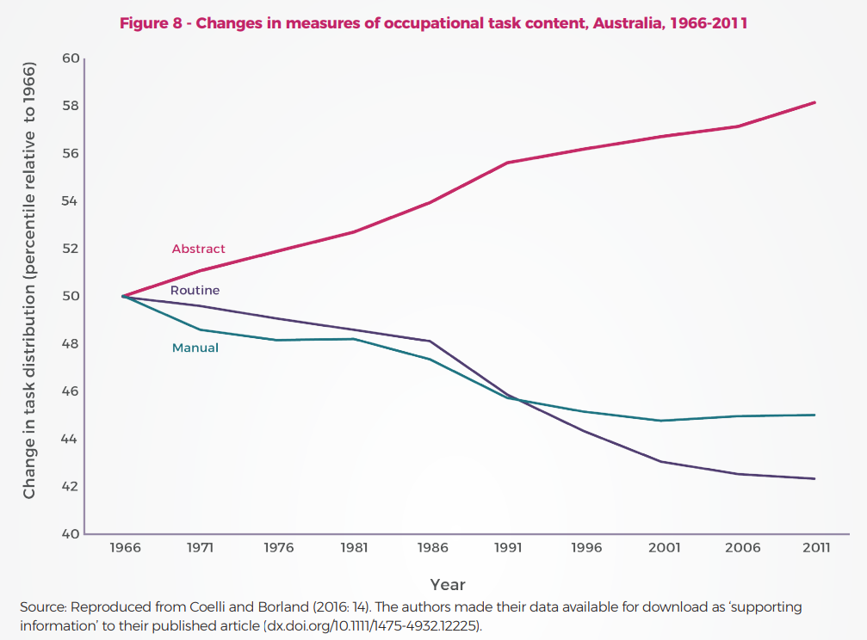
Changes in measures of occupational task content, Australia, 1966 - 2011

Slide 6

When | Where | Jobs Destroyed | Jobs Created | Study
2018 | US jobs | 13,852,530 | 3,078,340 | Forrester
2020 | Sampling of 15 countries | 7,100,000 | 2,300,000 | World Economic Forum (WEF)
2030 | Worldwide | 400,000,000 – 800,000,000 | 555,000,000 – 890,000,000 | McKinsey
Source: ‘Every study we could find on what automation will do to jobs, in one chart’ – MIT Technology Review

Slide 7

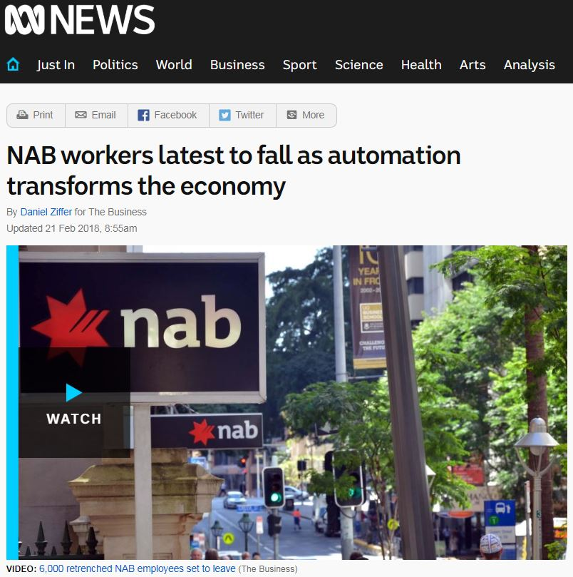

Slide 8
NEW MODELS OF EDUCATION
Traditional and prestigious education providers now offering:
Free content via MOOCs
Free and fee-paying micro-credentials as a source of revenue and pathway into full courses
Premium fully-online offerings
Courses in partnership with each other

Slide 9

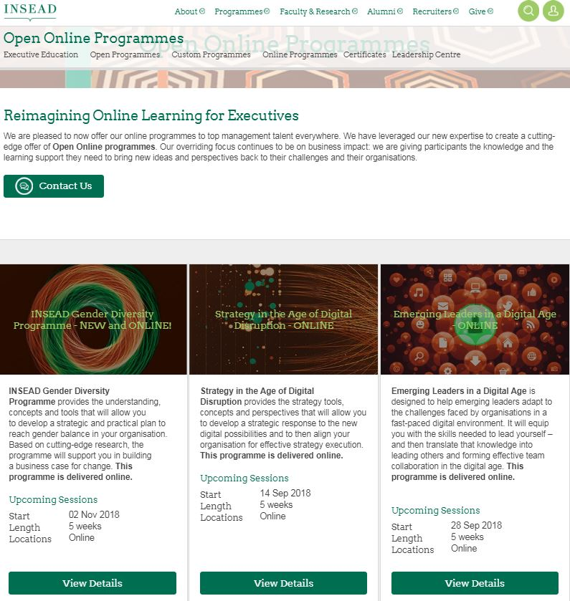
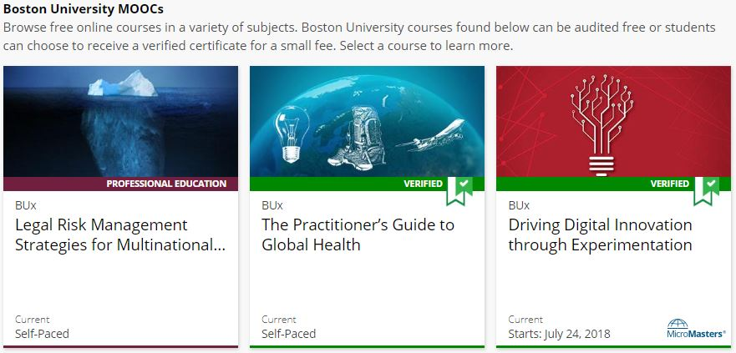


Slide 10
NEW MODELS OF EDUCATION
Emerging education providers now offering:
Low-cost micro-credentials to address the immediate trends in the labour market
Low-cost blended short courses in collaboration with industry
Short, online offerings to support ongoing professional development
Adaptive AI tutoring software to replace or complement traditional teaching

Slide 11
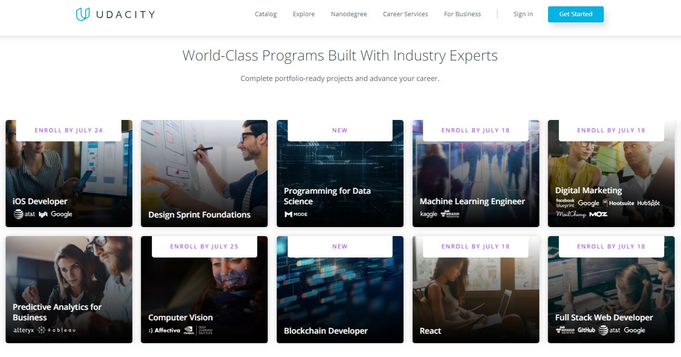
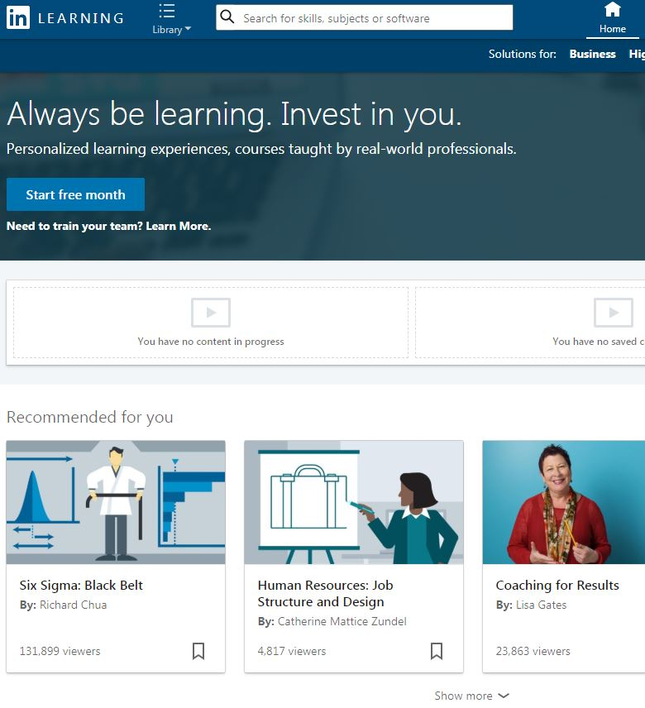
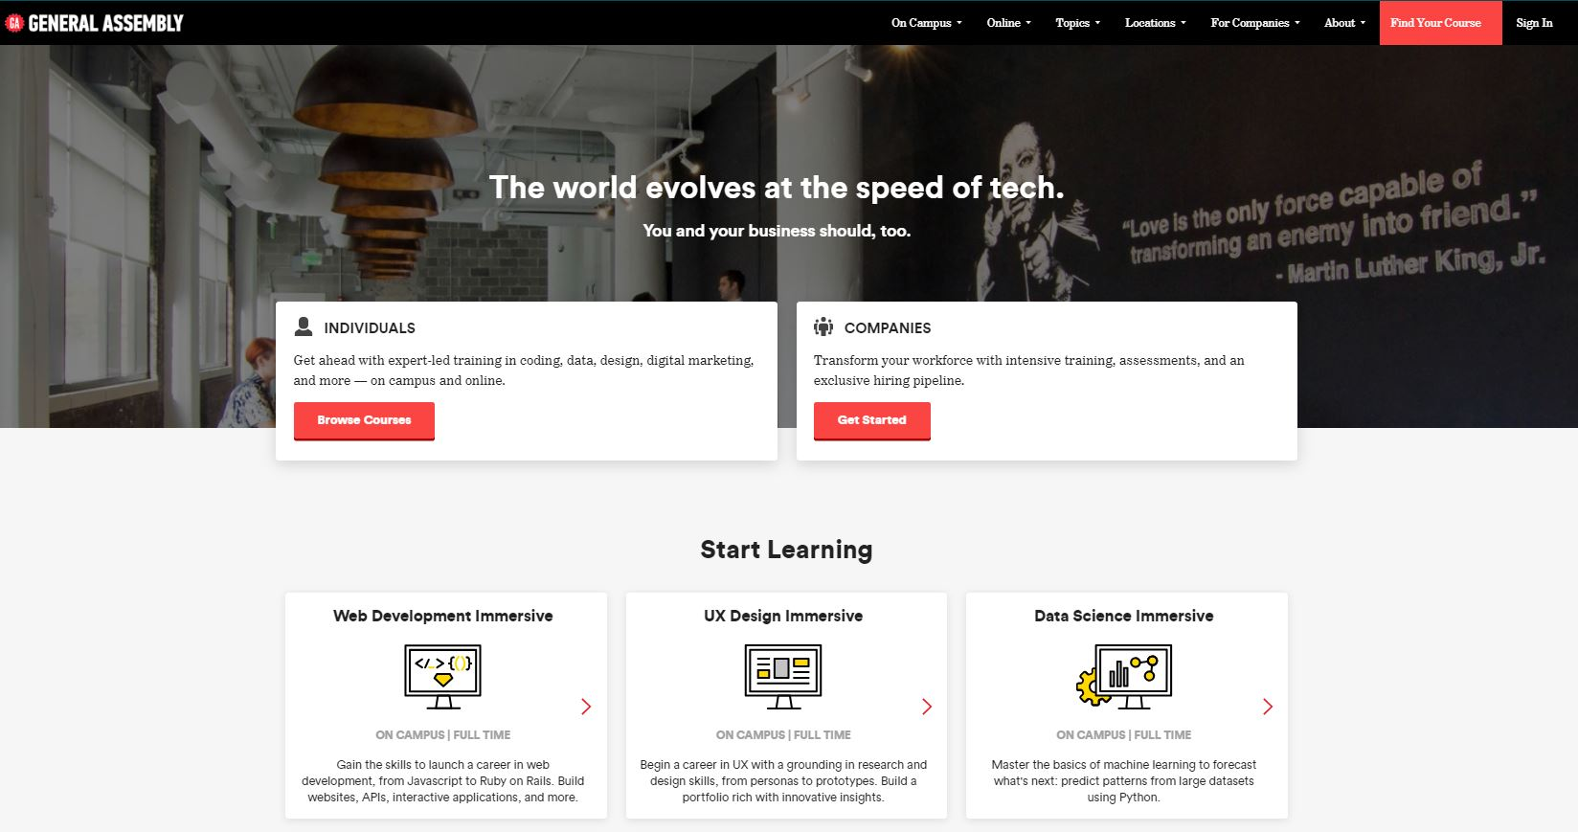

Slide 12

MONASH: STRATEGY
Focus Monash
Focus Education
Professions of the Future

Slide 13


MONASH: STRATEGY
Focus Monash (University strategy)
Enterprising education
Focus Education (Education strategy)
Future-focused education
Rich experiences

Slide 14

The Professions of the Future program is a coordinated series of initiatives designed to provide our students with an immediate and ongoing career advantage in a labour market being reshaped by the convergence of disruptive global megatrends.

Slide 15

MONASH: FOCUS AREAS
1. Discipline expertise for envisioned professions: Deep domain knowledge that prepares students to embrace and shape the future of work
2. Skills for a changing world: An evolving skillset relevant to the needs of the labour market, regardless of discipline
3. Industry and community experience: Authentic engagement with the workplace and beyond, grounded in reflective practice
4. Proactive and resilient career management: Strategies and skills for lifelong career planning and development

Slide 16
MONASH: FOCUS AREAS
 | Discipline expertise for envisioned professions | Skills for a changing world | Industry and community experience | Proactive and resilient career management
Curricular | e.g. New courses | e.g. New units | e.g. Scaling up work-integrated learning | e.g. Integrating career management into the curriculum
Co-curricular |  | e.g. Redevelopment of existing activities | e.g. Framework for existing activities | e.g. Career service
Governance & Communication

Slide 17

MONASH: DISCIPLINE EXPERTISE
Comprehensive
Global
Impactful
Future-focused ‘research turn’ (eg. AI)

Slide 18
MONASH: SKILLS FOR A
CHANGING WORLD
Interdisciplinary collaboration
Intercultural competence
Ethical and transformational leadership
Innovation and entrepreneurship
Data analytics and critical thinking
Strategic communication

Slide 19
MONASH: INDUSTRY &
COMMUNITY EXPERIENCE
Partnering with alumni for access to industry partners
Maximising relationship with Monash College/Monash Professional Pathways
Developing virtual WIL experiences
Drawing experiential opportunities into a framework or program to help students navigate the opportunities

Slide 20
MONASH: CAREER MANAGEMENT
Identifying and redeveloping specific career management units in the curriculum
Integrating career management into existing units
Partnering with the careers service to maximise impact for large student cohort

Slide 21
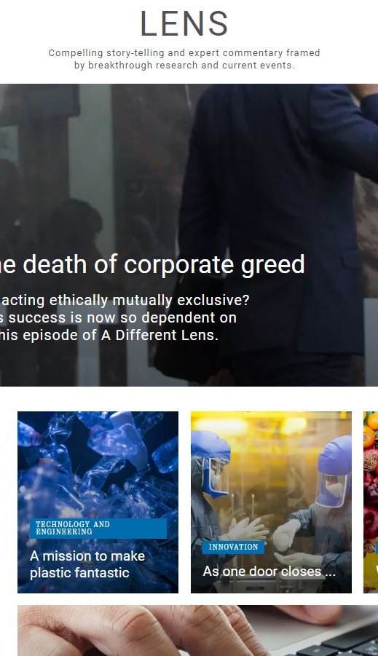
MONASH: COMMUNICATING
THE PROGRAM
Integrating Professions of the Future into how we present our:
Courses
Co-curricular opportunities
Campus experience
Research and teaching staff

Slide 22

MONASH: INTERNAL COLLABORATION
Drawing together various and disparate internal stakeholders to meet the challenge, including:
Faculties
Education Portfolio
Enterprise Portfolio
Alumni Team
Careers Service
Marketing
IT
Buildings & Property

Slide 23
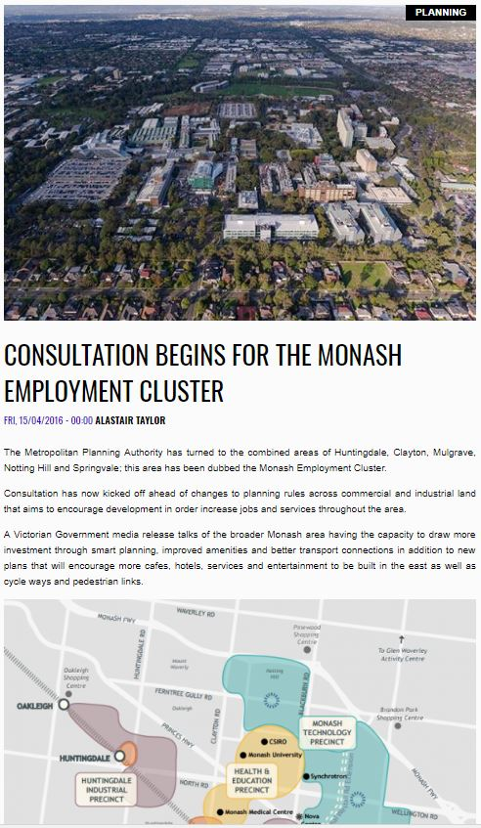
MONASH: EXTERNAL COLLABORATION
Drawing together various and disparate external stakeholders to meet the challenge, including:
Industry bodies
Individual industry partners
Alumni
Federal government
State government

Slide 24
THE FUTURE IS DIGITAL
Digital Strategy
Micro-credentials
Partnering to enable digital future

Slide 25
PROFESSOR ZLATKO SKRBIS Senior Pro Vice-Chancellor (Academic), Monash University

