Slide 1
Spelling Old problems and new solutions
Notes:
Thanks everybody for sticking around this afternoon- I know when I attend these type of sessions I am looking for ideas that I can use in my own class. So for the next 30 minutes I plan to show you a few activities and tools that you can use with your own students.
The topic that I am going to focus on today is spelling and how the OLD revision process that is commonly used in classrooms can be improved with some NEW solutions through different activities such as digital games to make it more engaging and effective for students.

Slide 2
Notes:
Now I have to admit I am not a particularly good speller so before we get started I thought it might be fun to put the shoe on the other foot and give you all a spelling quiz. So I found some words that are commonly misspelt on an Oford website so if you want to join in -I have left some paper and pencils for you to use so feel free to grab them and we can get started.
Ok say 1st word is
1) Pharaoh
2) Indict
3) Millennium
4) Liaison
5) Harass
6) Pterodactyl
7) Phoenix
8)Hemorrhage
9) Judiciary
10) Cantankerous

Slide 3
SPELLING WORDS
1) Pharaoh
2) indict
3) millennium
4) liaison
5) harass
6) Pterodactyl
7) Phoenix
8) hemorrhage
9) judiciary
10) cantankerous
Notes:
Ok so you can check your answers up here

Slide 4
Notes:
So my interest in spelling started from my 3 year stint in Dubai where I was teaching at the womens University with all my students being Arab learners. - anyone who has taught Arab learners know that they have some major challenges when it comes to spelling -----to give you an example this is what the typical student was producing after nearly 10 years of formal English education.

Slide 5
afard afraid
aperant appearance
avilebal available
butifull beautiful
blieve believe
comptation competition
desaes disease
enouph enough
fuchier future
Notes:
So you can see the sample on the right and I have just retyped a few of the mistakes on the left it so you can see it clearer
With such a low level of spelling it effects many areas of language learning including the writing process

Slide 6
“Good spelling makes writing much easier, allowing the writer to focus on the ideas to be conveyed, not the letters needed to put those ideas on paper” (Joshi. 2007). Uncertainty about how to spell words can further influence the words students choose to use, as they are less likely to use words they cannot spell (Graham & Harris, 2005).
Notes:
as many poor spellers are likely to focus on the letters of the words rather than the ideas they wish to convey , it also effects the choice of words they use as they often feel
restricted to use the words they can safely spell, thereby inhabiting the writing process.

Slide 7
In a recent meta- analysis, Graham, Harris, and Hebert (2011) found that papers with misspelled words were scored by teachers more harshly for quality of ideas than the same papers with no spelling errors
Notes:
Teachers are also harsher with their marking when a piece of writing contains spelling errors.

Slide 8
Reading
Competence in spelling has an effect on a student’s ability to read and in particular, comprehend the content (Ehri 2000).
The link between spelling and reading comprehension was tested in a study involving 61 intermediate adult students learning ESL. The results indicated that spelling knowledge affected the comprehension of the text. Such an outcome suggests that a combination of spelling instruction along with vocabulary acquisition can facilitate improvements in reading ability (August, 2011).
Notes:
Spelling also effects the students ability to read – particularly in terms of being able to comprehend the content.

Slide 9
Notes:
And of course poor spelling is an important component of the IELTS listening test as candidates much spell answers
correctly in order to get a mark even if they have heard the word correctly

Slide 10
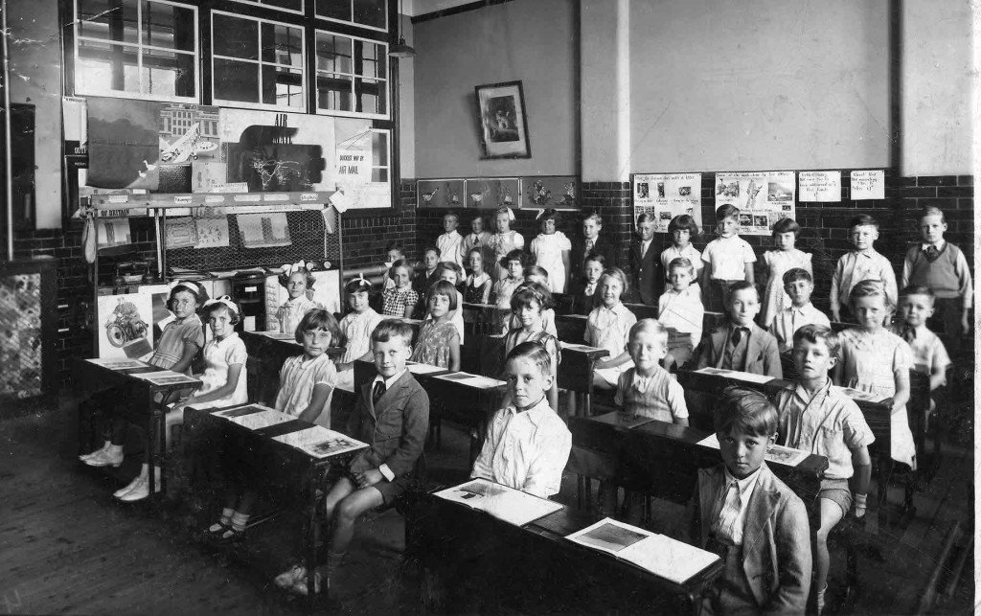
Traditional methods
Notes:
So I decided to do some research to see if different revision methods could be used to assist students with the spelling
I found that in all the classrooms the common traditional methods were being used such as …

Slide 11
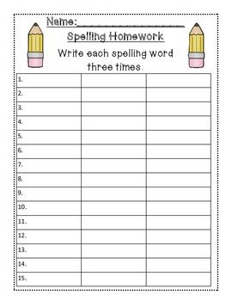
Notes:
writing down the words numerous times
putting the words in a sentence and using the look cover say write check method
https://www.youtube.com/watch?v=-mZhWqh446o

Slide 12
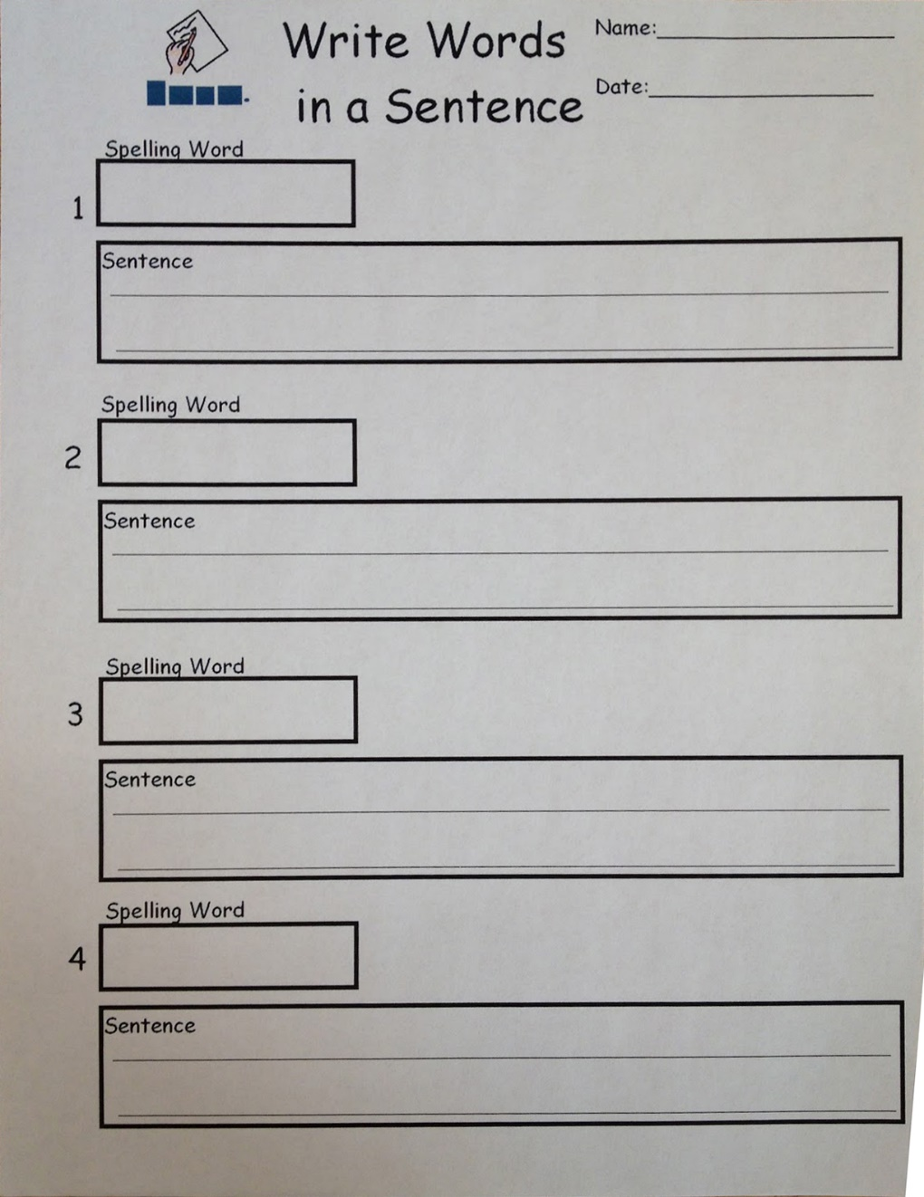
Notes:
putting the words in a sentence

Slide 13
Notes:
and sometimes using the look cover say write check method – SO while these methods can be effective the OLD PROBLEM is …

Slide 14
So what is the old problem ?
Notes:
That these revision methods are often considered very boring to most students ( show Vietnamese quote) which results in students being

Slide 15
" Put quote here about motivation"
Notes:
very demotivated- and motivation is one of the key factors of learning. So fitting into our theme of today of new solutions to make our students more
engaged and motivated
I am going to show a few of the digital games and activates that I used with my students to help with the often mundane spelling process.

Slide 16
Notes:
The first game is called SPELLOO which is designed specifically for second language leaners- ( OPEN UP THE GAME) how this game works is the teacher logs in and types the words
they want their student to learn (TYPE THE WORDS) then they save the list and are given a code which is xxxx
Students log in by putting in their nickname ( the code for the list) which was xxxx and importantly choose their native language and click enter which takes they can practice the words
So I got students to play a digital game which was designed specifically for second language learners. How this game works is (show video) you log in and type the words you want your students to learn and then they get to practice the words on the flashcard. Now as you probably know students from different backgrounds have different spelling problems. For Arab learners it is

Slide 17
Spelling errors specific to Arab learners
“Most spelling mistakes are based on mother tongue interference”
Al Busaidi & Al-Saqqaf (2015)
Vowels- misordering
Confusion between letters /b/ and /p/ e.g. proplem along with the letters /v/ and /f/ eg savety
Consonant doubling errors
Silent letters – especially silent ‘e’
Notes:
Research has shown that spelling errors are often based on the students native language- so the game here focuses specifically on these areas based on
this research

Slide 18
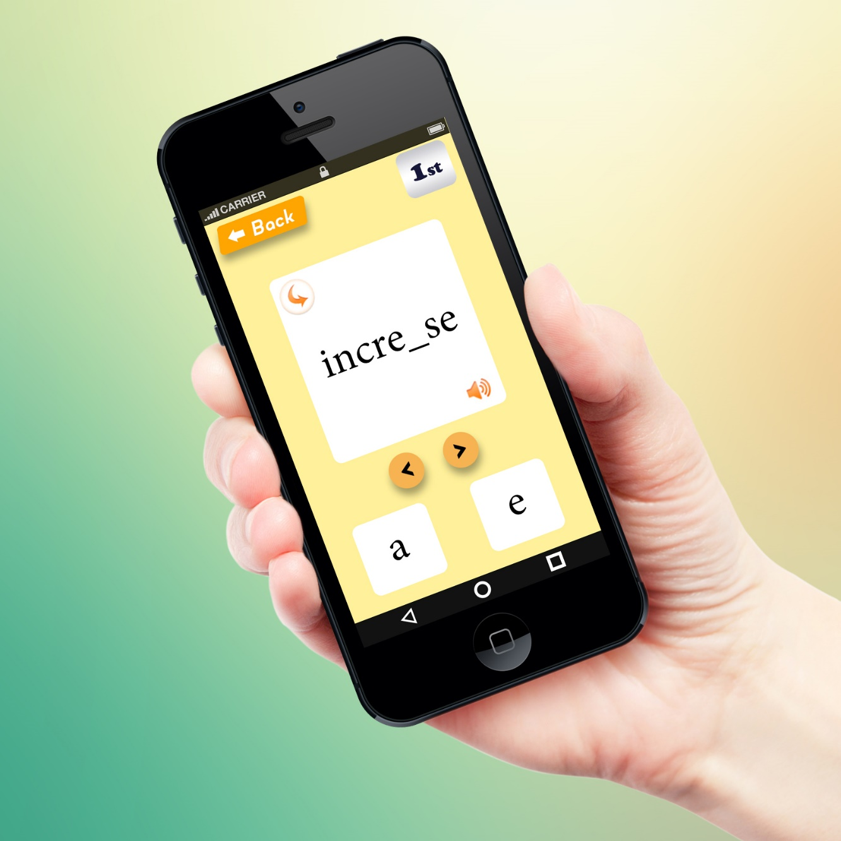
Arab learners can be prone to ‘vowel blindness’ in which they ignore the presence of vowels when storing vocabulary and exercise seemingly indiscriminate choice as to which vowel to use when one is needes ( Ryan,1997, p189)
Notes:
Vowels are perhaps the most challenging aspect that Arab learners have with spelling – with them being accused of having vowel blindness
so you can see that in the game the vowels and their order are focused on.

Slide 19
“Arabic does not have two distinctive bilabial plosives, only the voiced /b/ and hyper corrected spelling that represents b and p as p”
(Thompson-Panos & Thomas-Ruzie,1983 p681)
Notes:
So here for example as the quote shows- Arab learners often confuse b and p so in the game they can practice the common confusion
My students really struggled to pronounce the letter P- so often heard that their favourite cola is a bebsi or they forgot their bencil

Slide 20
Newer teaching methods reflect the importance of visual comparison, and may involve having students compare and contrast categories of word features (Bear, Invernizzi, Templeton, & Johnston, 2000) or look for patterns in letter combinations
(Templeton & Morris, 2001).
Notes:
Here for example students get to practice the often problematic silent letters with the Arabic word for phone shown above the choices.

Slide 21
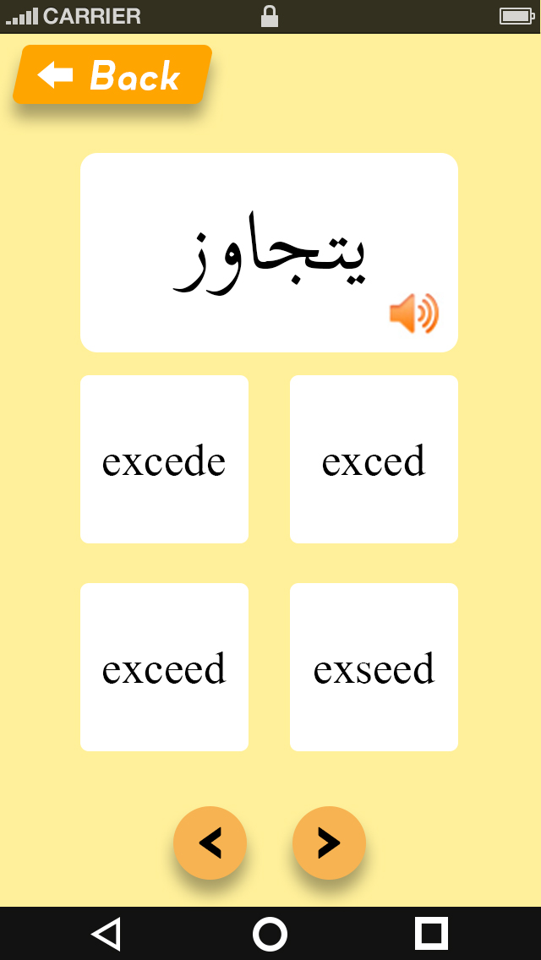
A popular technique used successfully is headword matching (Bowen, 2011). This requires students to circle the correct spelling of a word when given a number of choices and is an effective method of recognising different features within a word (Bowen, 2011).
Notes:
and here student practice finding the correct features of the word.

Slide 22
Competition
Notes:
From my observations along with the focus groups conducted- one of the most important motivating factors for students was competition- part of the game Spelloo is getting
students to compete with other members of their class to see who is the best speller of the words practiced in that level,
Now I have a special prize here so I thought it might be fun to do a spelling race amongst ourselves but as not all don’t speak a second language I have used pictures of famous people and your job is to type the surname of the person you see on your screen. There will be 10 names some very challenging and the first person to finish wins the prize. (PLAY THE GAME)

Slide 23
Table 2
Individual weekly tests (Aggregated scores as a Percentage)
Control Group, n=16
Digital Games Group, n=17
Median
46.25
67.5
Range
22.5 - 90
22.5 - 100
Notes:
From the results of my study we can see that the digital games group were a lot more on task with 83 percent compared to 57 percent for the control group

Slide 24
 | Control Group n=16 | Digital Games Group n=17
Median | 46.25 | 57.5
Rang | 22.5 - 90 | 22.5 - 100
Notes:
From the results of my study we can see that the digital games group were a lot more on task with 83 percent compared to 57 percent for the control group

Slide 25
Show results here
Table 2
Individual weekly tests (Aggregated scores as a Percentage)
Control Group, n=16
Digital Games Group, n=17
Median
46.25
67.5
Range
22.5 - 90
22.5 - 100
Notes:
The actual results of the digital games group were also superior with a difference in the median percentage of more than 12 percent.

Slide 26
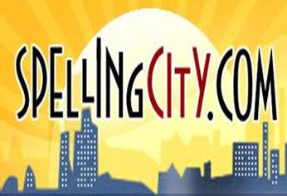
Summary
Recommendations
Regulation
Allowance
Extend dormitory
(Paltridge, Mayson & Schapper 2010)
Reasons & Problems
https://www.spellingcity.com/hangmouse-kids-hangman-online.html?listId=6111855Freedom
Comfortable
Safety
Price & Relationships
Notes:
Another game that we can play is spelling city- they have a wide variety of games to play with most of them being in the paid premium area but there are some good games that you can play for free- and this stie allows you to practice specific words. One of the games I like is the rat game - don’t worry that its kiddy as adult students still enjoy it
https://www.spellingcity.com/hangmouse-kids-hangman-online.html?listId=6111855

Slide 27
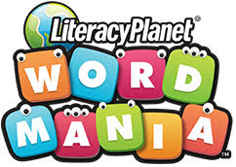
Issues
Improvements
Notes:
Id like to show you some other games that I use in the class and that is Next game is digital and like the game we just played it doesn’t practice specific words however it is still a really fun one and they way I do it is again to split the class into 2 and have 3 members come out and the rest of the team can call out and help them play answers
Word mania https://www.wordmania.com/au/
THEN PLAY FINISH WORD GAME IF TIME ALLOWS

Slide 28
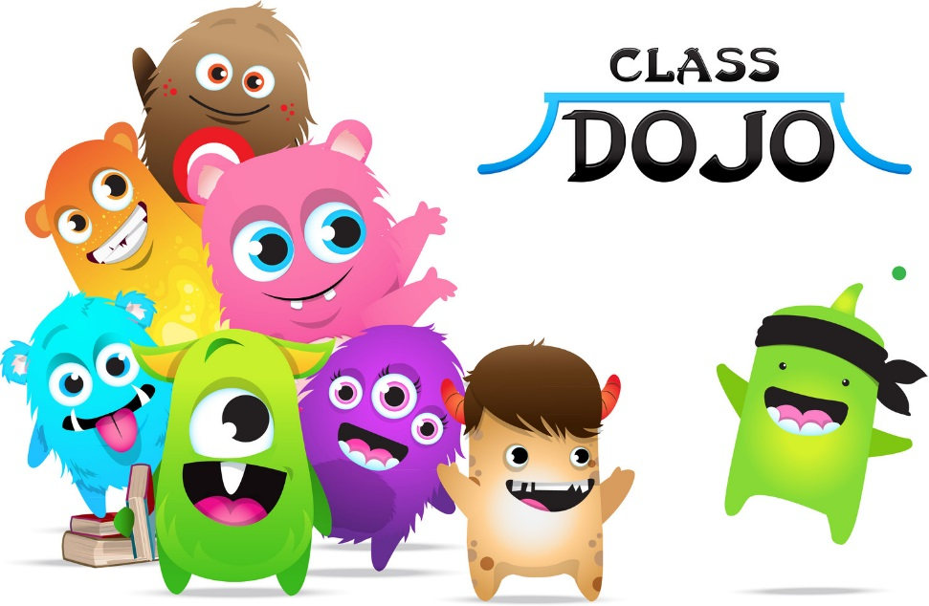
" Put quote here about motivation"
Notes:
Class dojo to finish
Finally just to finish up – having some kind of reward really gets students going and a site that I use to reward good performance is class dojo. So any type of activity you do – you can reward your students with a point and then at the end of the intake I like to give a little prize and again even though it’s a bit kiddy the students really get into it and it works well

