Slide 1
Learning Style Models; To use or not to use? The risks and rewards of learning style models: A new perspective Ben Colthorpe Quality Assurance Assessor
Notes:
Hi everyone. Thanks for coming to this presentation where we’ll be looking at some of the risks and rewards of using learning style models to cater to individual differences.
Now, there is a strong appeal in the idea that teachers can achieve better outcomes for their students by identifying their learning style and adjusting their teaching style accordingly, so most teachers in the ELT sector have probably been exposed to learning style models or at least the terminology used in them at some point in their career.
However, there is a growing body of research which suggests that at the least; we have been misinterpreting or misusing learning style models, and at the most; the very concept of ‘learning styles’ is a myth and dangerous for learning in general.
So, what I aim to do today is identify some of the emerging risks and weigh them up against some of the rewards of using learning style models as a resource for catering to individual differences.

Slide 2
Discuss
How do you currently cater to individual differences in your class?
Do you use learning style models?
How do you measure the effectiveness of your approaches?
Notes:
So, I’d like to begin by asking you to consider your current practices.
Just turn to the person next to you and discuss these 3 questions;
How do you currently cater to individual differences in your class?
Do you use learning style models?
How do you measure the effectiveness of your approaches?

Slide 3
What are learning styles?
“The composite of characteristic cognitive, affective, and physiological factors that serve as relatively stable indicators of how a learner perceives, interacts with, and responds to the learning environment (Keefe, 1979)."
Notes:
Ok, so to get started – It’s important to identify that one of the main ongoing issues with learning styles is that there has been confusion over how to clearly define the concept.
Some definitions take into account many elements of individual differences such as; sensory modality preference, motivation, cognitive and metacognitive factors while others refer to only one specific element.
So, for the purposes of this presentation, I am referring to Keefe’s original definition which you can see here.

Slide 4
Popular learning style models
Fleming & Mills’ Visual, Aural, Reading/Writing, Kinaesthetic | VARK
Gregorc’s Style Delineator | GSD
Honey & Mumford’s Learning Styles Questionnaire | LSQ
Kolb’s Learning Style Inventory | LSI
Myers-Briggs’ Type Indicator | MBTI
Sternberg’s Thinking Styles Inventory | TSI
Gardner’s Multiple Intelligences | MI
Allinson & Hayes’ Cognitive Styles Index | CSI
Dunn & Dunn’s model and instruments of learning styles | -
Hermann’s Brain Dominance Instrument | HBDI
Notes:
Now, before I begin talking about the risks, I just want to highlight 10 of the more commonly used learning style models.
And, I’m sure you have heard of the VAK or VARK model which refers solely to sensory modality preferences.
But, have you heard of some of the others?

Slide 6
Risks
Majority associated with sensory modality preference - VAK / VARK
Lethaby & Harries, (2016) – ‘Neuromyths’
Misconception based on the fact that visual, auditory, and kinesthetic information is processed in different parts of the brain (Dekker et al, 2012).
Incorrect to assume only one sensory modality involved in learning.
Pidgeonholing / labelling students as a ‘visual learner’ or an ‘auditory learner’ etc. can be damaging.
Notes:
Ok, so firstly let’s look at the major risks
Now, it’s important to note that the majority of recent arguments against learning styles are targeted at the VAK or VARK model.
In a recent paper published in the ELT Journal, Lethaby and Harries spoke about the concept of neuromyths, which are generated by the misunderstanding or misinterpretation of brain research.
And, they propose that it’s incorrect to assume only one sensory modality is involved in learning.
But, on reading this, I thought typically, teachers only refer to VARK sensory modalities as a preference; We generally don’t assume that this model identifies the sole sensory modality used for learning.
However, despite this awareness, what still tends to happen is students are labelled as visual or auditory learners for example based on these preferences, and what critics have gone on to suggest is that this labelling process may actually be quite damaging for their learning, not only of English but learning in general.

Slide 7
Students’ self efficacy
Negatively shape and constrain L2 learning – disengagement / poor self-efficacy when teaching & learning activities are delivered in a ‘style’ not matching their own.
Questionable evidence that teaching to preferred learning styles enhances learning – ‘meshing hypothesis’ (Rogowski et al, 2015)
Rogowski, (2015) – No significant relationship between preferred sensory modality, teaching mode and results of the tests.
Coffield et al, (2004) - Many studies based on small-scale applications of particular models to small samples of students in specific contexts.
Notes:
And, here are some of the reasons why…
First of all, it can effect students’ self-efficacy and engagement.
If a student believes they are a visual learner for instance, they could develop negative attitudes towards language input that is not supported with visuals which may affect their motivation and ultimately disadvantage their language learning.
And secondly, the idea that teaching to preferred learning styles enhances learning, known as the ‘meshing hypothesis’ may in fact have no valid experimental support.
In a major study published by Rogowski in 2015, teaching to preferred sensory modality did not appear to significantly affect test results.
Coffield and associates also noted that many of the studies conducted to test learning style models were based on small-scale applications to specific students.

Slide 8
Validity of assessment instruments
Krätzig & Arbuthnott, (2006)
40% of students self-identified as visual learners,
60% identified as visual learners on questionnaire,
Only 23% performed best on the visual test
(Lethaby & Harries, 2016)
“I want to teach you something…” (Reiner & Willingham, 2010)
Notes:
Another risk, particularly of the VARK model is the validity of the assessment instruments used to identify preferences.
In this particular example, 40% of students.....
Reiner & Willingham pose a pivotal question in their argument against learning styles which is that; “If I told you that I want to teach you something, and asked you whether you would rather learn it by seeing a slideshow, reading it as text, hearing it as a podcast, or enacting it in a series of movements, do you think you could answer without first asking what you were to learn?”

Slide 9
What about other models?
Coffield et al, (2004) Identified 71 different models.
Notes:
So, are there risks associated with other learning style models? Yes, there are.
Coffield et al identified 71 different models in their critical review, and this in itself poses a risk. How can teachers possibly feel confident in using learning style models when the field itself is so divided and a single-unified model for language learning does not exist?

Slide 10
‘The validity of these learning style inventories is based on the assumption that learners can accurately and consistently reflect’ (Price & Richardson, 2003)
Coffield, F, Moseley, D, Hall, E & Ecclestone, K. (2004). Learning styles and pedagogy in post-16 learning: a systematic and critical review, LSRC reference, Learning & Skills Research Centre, London.
Notes:
Of the 71 different models, 13 major models were evaluated on their assessment instruments against a set of minimal criteria; Internal consistency, test-retest reliability, construct validity and predictive validity.
As you can see, only a few came close, and only 1 did actually meet the minimum criteria which was Allinson & Hayes’ model.
So, based on this study alone, teachers should reconsider the effectiveness of questionnaires and testing instruments that are often used to identify learning styles.
And Price and Richardson made the point that ‘the validity of these learning style inventories is based on the assumption that learners can accurately and consistently reflect’ on their own learning.

Slide 11
Rewards
Used to ensure pedagogical balance
Each style preference is considered in lesson planning.
To succeed, not only in L2 learning but in any profession, students will need attributes associated with all learning style categories (Felder, 2010).
Notes:
So, in spite of some clear issues relating to the use, validity and assessment of learning styles, a lot of useful information about learning has been uncovered from the decades of research in this area.
And, I think it’s important to acknowledge the rewards that can still be achieved by using learning style models in perhaps a slightly different way for catering to individual differences.
First of all, learning style models can still be used by teachers in developing learning programs that are pedagogically balanced. In many cases, it’s the learning style’s assessment instrument that may be flawed, but the model itself may still be a valid representation of students’ different approaches to learning.
Felder, among many other researchers, believes that students should be encouraged to develop skills & strategies associated with all categories in a learning style model, and thus believes the idea of balancing teaching styles to facilitate learning in all styles is important.

Slide 12
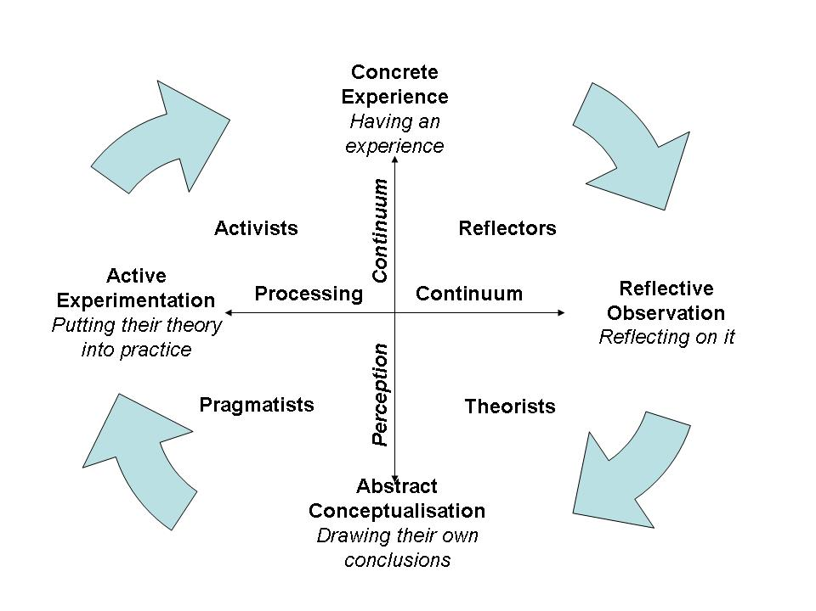
Introduce vocabulary to talk about learning, motivation and metacognition (Coffield, 2004)
Particularly models reflecting learning as a process
Honey & Mumford’s Learning Styles
“A learning styles model specifies a small number of dimensions that collectively provide a good basis for designing effective instruction. Like all models in the physical, biological, and social sciences, they are incomplete but potentially useful representations of reality, and should be judged by how well they characterise and interpret observations and inform professional practice” (Felder, 2010)
Notes:
A second reward is that learning style models, particularly those reflecting learning as a process such as Honey & Mumford’s, can be used to introduce metacognitive processes and vocabulary for discussing the concept of learning to learn.
In this sense, learning style models can be used to promote learner autonomy.
If we recognise their limitations and make our students aware of these, then there is no reason why they can’t be used as a resource to stimulate class discussion and reflection about how we each prefer to learn.
Felder says, learning style models should be judged by how well they characterise and interpret what we observe in the classroom.

Slide 13
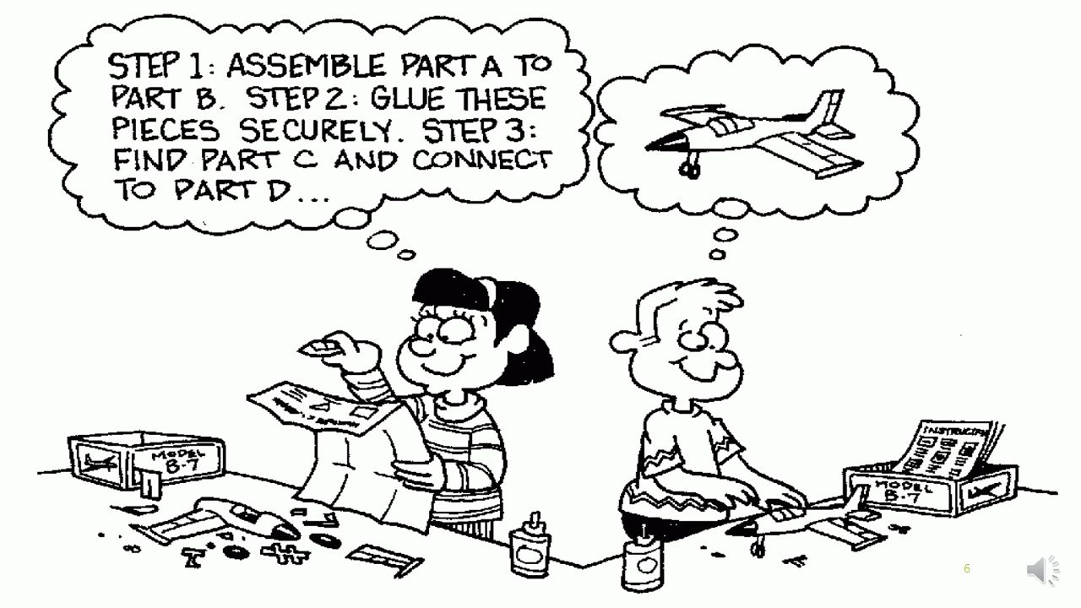
Allinson & Hayes’ Cognitive Styles
Allinson, C. & Hayes, J. (2012). The Cognitive Style Index: Technical Manual and User Guide. United Kingdom: Pearson
Notes:
Here is an example of that point;
This is Allinson & Hayes’ Cognitive Styles which is the only model which met the minimum criteria in the table we just looked at
The cartoon illustrates the difference they have tried to characterise and interpret in their model, from a very analytical or bottom up approach to an intuitive or top down approach to learning.
Who is more like the character on the left? Who is more like the other character?

Slide 14
Increase student awareness of learning strengths and weaknesses.
“Learners do have preferences about how they like to learn” (Lethaby & Harries, 2016)
“Honey and Mumford, have been prolific in showing how individuals can be helped to play to their strengths or to develop as all-round learners (or both) by means, for example, of keeping a learning log or of devising personal development plans” (Coffield et al, 2004).
Assist teachers in understanding learning strategy selection
Possible connection between Cognitive style and choice of strategy (Littlewood, 2001)
Better self-awareness may lead to more organised and effective approaches to teaching and learning (Coffield et al, 2004).
Notes:
Finally, learning style models can increase students’ awareness of their own strengths and weaknesses with regards to learning.
Now, typically we haven’t been supposed to think of learning styles as strengths or weaknesses, just preferences. However, if we do adopt Felder’s view that learners should develop attributes associated with each category, then that’s exactly what they are.
So, despite their strong argument against learning styles, Lethaby & Harries do acknowledge that learners have preferences about how they like to learn.
And Coffield also recognises the rewards of increasing student awareness of learning strengths and weaknesses.
In doing this, it is believed the teacher can also better understand why learners select particular learning strategies.
As Littlewood’s study suggests, teachers can also possibly even predict which learning strategies students will naturally prefer and which ones they will need scaffolding with according to their strengths and weaknesses identified in learning style models.
At the crux of this is Coffield’s claim that better self-awareness, provided it is accurate, may lead to more organised and effective approaches to teaching and learning.

Slide 15
Adapted from: Anderson, M. (2004) Mind Styles: Anthony Gregorc. Retrieved 04/04/17 from: www.cortland.edu.
Notes:
So, I have a learning style model for you. This is Gregorc’s model.
And, what I’d like you to do now is consider the risks and rewards that have been identified and discuss with the person next to you how effective it might be as a resource for catering to individual differences.
Post activity discussion
How effectively do you feel this model captures different approaches to learning a second language?
Do you think you could use this model to achieve some of the rewards that we have identified? (Pedagogical balance, learning metalanguage, metacognition & student autonomy)
What might be some risks or limitations of this model?

Slide 16
Activity
Discuss Gregorc’s model with a partner & evaluate it’s potential as a resource for catering to individual differences in your class
How effectively do you feel this model captures different approaches to learning a second language?
Do you think you could use this model to achieve some of the rewards that we have identified? (Pedagogical balance, learning metalanguage, metacognition & student autonomy)
What might be some risks or limitations of this model?
Notes:
Back to model for discussion

Slide 17
Suggestions for catering to Individual Differences
Do
Don’t
Assess students’ interests
Pigeon hole / labels students
Assess background knowledge
Try to match instructional style to learning style
Teach learning strategies for developing core skills
Rely on ONE model
Use learning style models with the aim of producing balanced, integrated learners
Overload learners with learning stimulus
Notes:
So, to sum up, I have some suggested do’s and don’ts for catering to individual differences in the classroom.
DO – Continue to assess students’ interests; Questionnaires, group discussions and getting to know you activities are widely used and are an important part of any new learning program. However, the information that we obtain from students during these activities can often be forgotten, so it’s important to actually try to record this information and use it to tailor supplementary and self-study material for our group of students.
DO – Assess background knowledge regularly; Lethaby & Harries identified this as one of the major factors affecting the learning outcomes of students. It is important to assess background knowledge of the specific language feature being taught as well as background knowledge of the topics and content used to teach it.
DO – Teach learning strategies for developing core skills; Rather than focusing on teaching learning strategies to students based their identified learning style, learning style models could be used to inform the planning of core skills required for a course. Then, students can be provided with a range of appropriate strategies and encouraged to select those most appropriate to the task at hand.
DO – Use learning style models with the aim of producing balanced, integrated learners; If you do decide that learning style models have a place in your curriculum, researchers such as Felder suggest that this should be their primary aim.
DON’T – Pigeon hole / label students; This has typically been one of the major functions of learning style models. However, this is a controversial practice and may best be avoided until there is more clarity on the true impact of labelling students according to learning style preference.
DON’T – Try to match instructional style to learning style; We’re still not sure whether or not this is effective, and in doing this, we’re not really encouraging students to develop as balanced, integrated learners.
DON’T – Rely on ONE model; This point mainly refers to the model’s assessment instrument. If you do choose to assess learning styles, it would be worthwhile analysing a number of models to identify similarities and differences and conducting several tests in order to form a more reliable indicator of learner preferences.
And finally, DON’T – Overload learners with learning stimulus; Perhaps you are aware of this concept, but Butcher believes that any additional learning stimulus such as visuals that do not directly support comprehension of a text are actually counterproductive for learning. So, trying to cater to different VARK preferences in a single lesson would not only be a LOT of extra work for teachers, but may actually be causing students more harm than good.

Slide 18
“Present information in the most appropriate manner for our content and for the level of prior knowledge, ability, and interests of that particular set of students” (Reiner & Willingham, 2010)
Notes:
So, in my opinion, teachers can still reap a multitude of rewards from the decades of research that has been conducted into learning style models.
However, I think it’s also important to consider the very real risks that have been identified with regards to these models and continually adjust our teaching practices in response to them.
I propose that teachers should now make their own educated decisions with regards to learning style models based on what they feel provides the most positive learning outcomes for their particular group of students.
Ultimately, I agree that teachers should present information in the most appropriate manner for our content and for the level of prior knowledge, ability, and interests of that particular set of students.

Slide 19
References
Allinson, C. & Hayes, J. (2012). The Cognitive Style Index: Technical Manual and User Guide. United Kingdom: Pearson
Butcher, K. R. (2006). Learning from text with diagrams: Promoting mental model development and inference generation. Journal of Educational Psychology, 98: 182-197.
Coffield, F, Moseley, D, Hall, E & Ecclestone, K. (2004). Learning styles and pedagogy in post-16 learning: a systematic and critical review, LSRC reference, Learning & Skills Research Centre, London.
Dekker, S., Lee, N.C., Howard-Jones, P. and Jolles, J. (2012). Neuromyths in education: Prevalence and predictors of misconceptions among teachers. Front. Psychology, 3(429): 1-8.
Felder, R. (2010). Are learning styles invalid? (Hint: no!). On-Course Newsletter, September 27. Retrieved 31/05/17 from: https://pdfs.semanticscholar.org/76e8/4ba4b1548dc04b27b2dac569818acbdbe2bb.pdf
Keefe, J.W. (1979) Learning style: An overview. NASSP's Student learning styles: Diagnosing and proscribing programs (pp. 1-17). Reston, VA. National Association of Secondary school Principles.
Krätzig, G.P. and Arbuthnott, K.D. (2006). Perceptual learning style and learning proficiency: A test of the hypothesis. Journal of Educational Psychology, 98, 238-246.
Lethaby, C. & Harries, P. (2016). Learning styles and teacher training: are we perpetuating neuromyths? ELT Journal, 70(1): 16-27.
Littlemore, J. (2001). An empirical study of the relationship between cognitive style and the use of communication strategy. Journal of Applied Linguistics, 22 (2): 241- 265
Littlewood, W. (2000). Do Asian students really want to listen and obey? ELT Journal, 54(1): 31-36.
Price, L. & Richardson, J. T. E. (2003). Meeting the challenge of diversity: a cautionary tale about learning styles. In Coffield, F, Moseley, D, Hall, E & Ecclestone, K. (2004). Learning styles and pedagogy in post-16 learning: a systematic and critical review, LSRC reference, Learning & Skills Research Centre, London.
Reiner, C. & Willingham, D. (2010). The myth of learning styles. Change: The magazine of higher learning, 42(5): 32-35.
Rogowsky, B. A., Calhoun, B. M., & Tallal, P. (2015). Matching learning style to instructional method: Effects on comprehension. Journal of Educational Psychology, 107(1), 64.
Notes:
Thanks for your attention.
I hope you enjoy the rest of the day.

Slide 20
Questions or comments?

