Slide 1
Engaging Students with Game-Based Learning Platforms
Or “How to Trick Students into Practising Grammar and Vocabulary by Playing a Game”

Slide 2
Games in more advanced classrooms
Richard-Amato (1996) encouraged teachers to consider the pedagogical value of games in second language teaching.
They are effective as they provide motivation, decrease students’ stress levels, and give them the chances for real communication.
Richard-Amato, P 1996, Making it happen, Longman, New York.

Slide 3
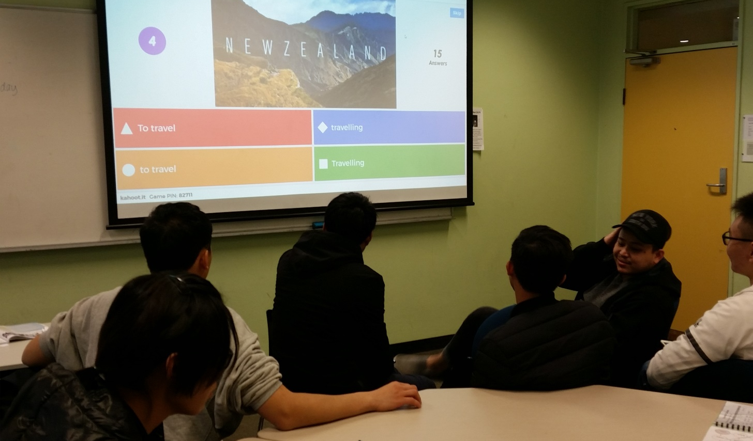
1) Kahoot!
kahoot.it

Slide 4
Find me on Kahoot at
anneteacher2015

Slide 5
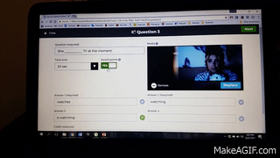
Award points? No thanks

Slide 6
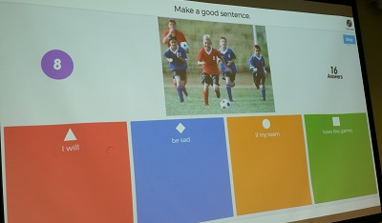
2) Kahoot Jumble
kahoot.it

Slide 7
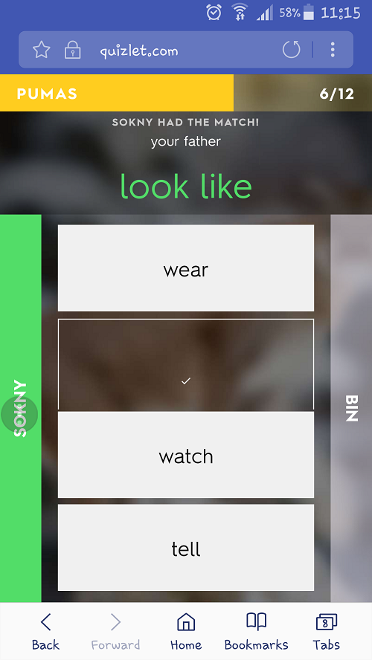
3) Quizlet
Live
quizlet.com/live

Slide 8
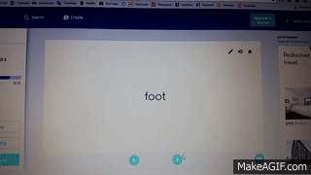
You can create many different kinds of flashcards

Slide 9
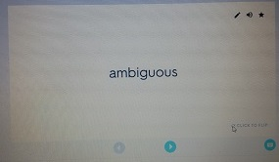
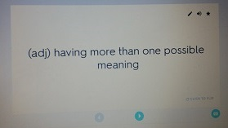
dictionary definition

Slide 10
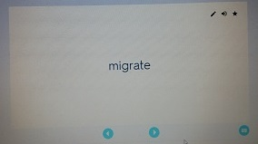
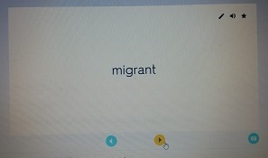
word forms

Slide 11
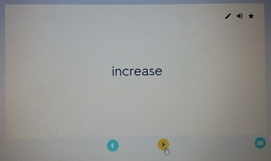
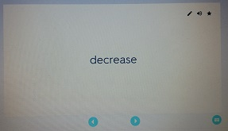
opposite verbs and adjectives

Slide 12
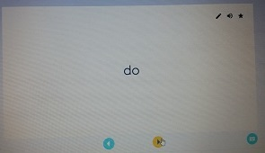
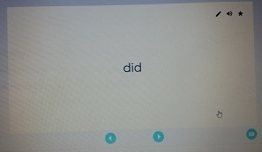
grammar

Slide 13

Heyer, S 1997 More True Stories, Pearson-Longman, New York.

Slide 14
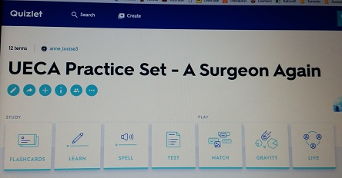
Student Self-Study Activities on Quizlet.

Slide 15
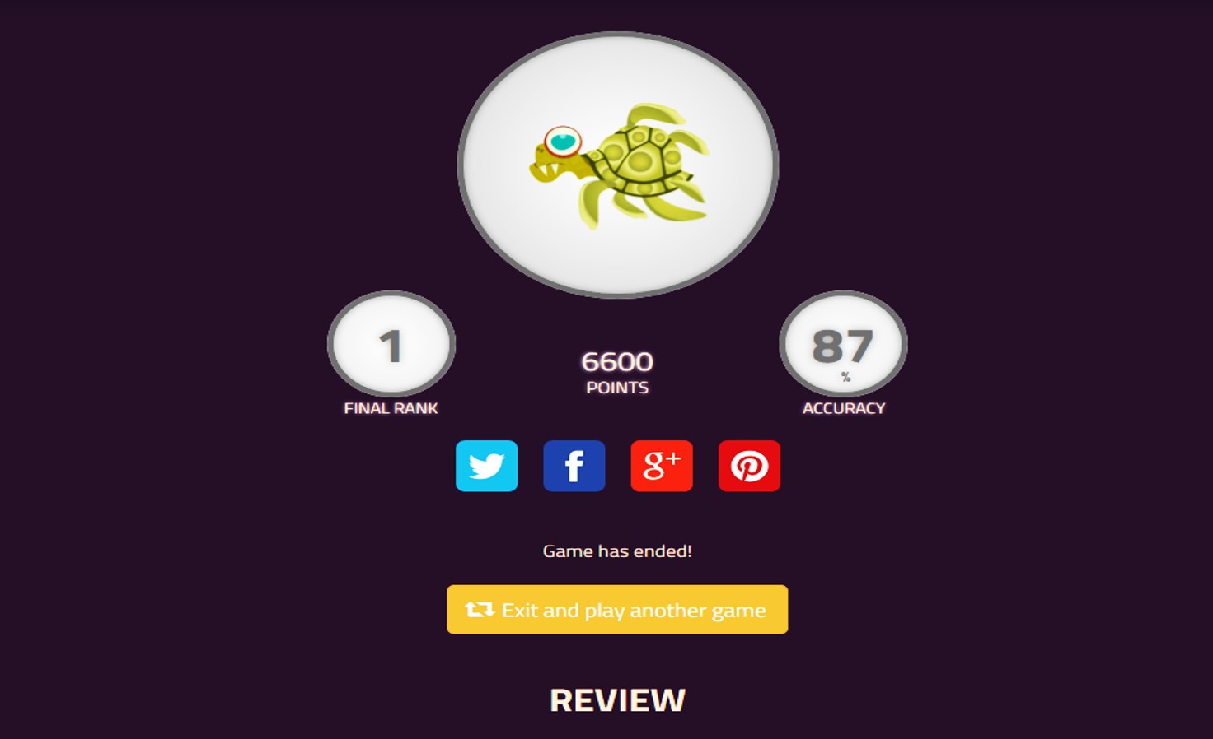
4) Quizizz
quizizz.com/join/

Slide 16
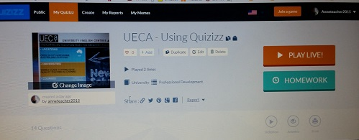
Play live or assign for homework. Or both!

Slide 17
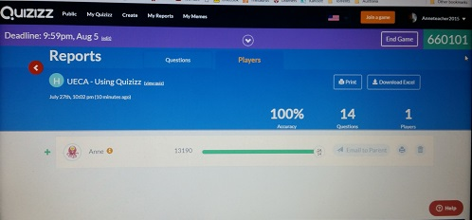
Check up to see students’ progress

Slide 18
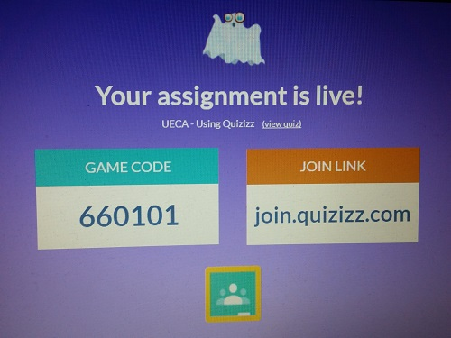
Your homework

Slide 19
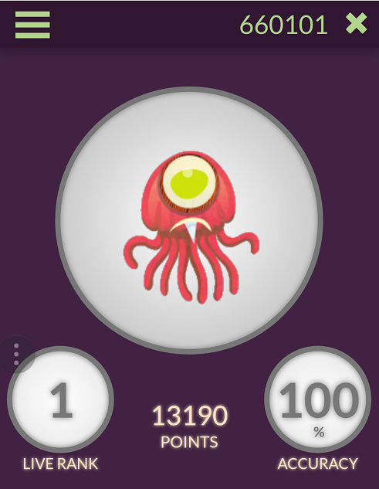
Beat me if you can!

Slide 20
Thank you! abutterfield@swin.edu.au
or LinkedIn: Anne Louise Butterfield

