Slide 1
Text Inspector for materials & test developers
Cara Dinneen
Hawthorn-Melbourne
Navitas Australasia

Slide 2
What sort of knowledge is important in reading & listening comprehension?
Types of knowledge
Grammar
Content
World
Discourse structure
Vocabulary

Slide 3
“vocabulary may be the major factor in reading comprehension”
(Laufer & Ravenhorst-Kalovski 2010:26, emphasis added).
“some 60 to 70% of variance in CEFR levels can be explained by differences in vocabulary size” (Milton 2010:211)

Slide 4
Text inspector
A lexical profiling tool that analyses the vocabulary content of texts - particularly for second language learners.

Slide 5
Overview
Making claims about students’ levels of competency
Validating claims
Designing course reflective materials
4. Working with Text Inspector

Slide 6
Making claims about students’ levels of competency for Direct Entry
CEFR
B2+
IELTS 6.5
TOEFL iBT
79
CEFR
B2
IELTS 6.0
TOEFL iBT
60
PTE
58
PTE
50
IELTS
7.0
CEFR
C1
TOEFL iBT
94
PTE
65
CEFR B1+
IELTS 5.5
TOEFL iBT
46
PTE
42

Slide 7
Text Inspector & CEFR
A1
A2
B1
B2
C1
C2
D1
D2
Advanced Academic level
Academic level for UG

Slide 8
Validating claims through course reflective assessment
Listening skills learning outcomes
Identify & comprehend main ideas or arguments in spoken structured spoken discourse
Note supporting detail / exemplification of well-structured text on concrete and abstract topics
Identify and analyze relationships among units within spoken discourse
Identify speaker attitude toward subject matter
How do you select the right text?

Slide 9
Test Specifications (Listening)
Textual features | The use of an anecdote, fascinating fact or rhetorical question to set the theme Clearly structured introduction that sets out the theme and sub-themes of the lecture Signposted transitions among sub-themes Built-in redundancy between sections of detail Exophoric reference to other researchers / resources
Language features | Contrastive and evaluative language Cause /effect, and/or advantages & disadvantages Modals for advice, certainty/uncertainty Use of hedging to create distance from an idea Opinions (self and others) Polite structures between speakers A small range of lexical items likely to be unfamiliar to an AE3 student

Slide 10
“vocabulary may be the major factor in reading comprehension”
(Laufer & Ravenhorst-Kalovski 2010:26)
“some 60 to 70% of variance in CEFR levels can be explained by differences in vocabulary size” (Milton 2010:211)
Inspect the text!

Slide 11
Free version Paid version (with CEFR scorecard)

Slide 15
Lexical Profile for B2+/C1+ level text
CEFR Level B2+/C1+ | Listening mode | Reading mode
Average syllables / sentence | 25 or less | n/a
Average words / sentence | 15 to 18 | 17 to 22
% of AWL types | 5 to 7 | 8 to 10
Flesch Kincaide Reading Ease | 50 to 60 [fairly difficult] | 40 to 50 [difficult]
Flesch Kincaid Reading Grade | 8 to 11 | 10 to 13

Slide 16
Trouble shooting
CEFR Level B2+/C1+ Listening | TARGET | ACTUAL MEASURE
Average syllables / sentence | 25 or less | 23.73
Average words / sentence | 15 to 18 | 17.24
% of AWL types | 5 to 7 | 11.67
Flesch Kincaide Reading Ease | 50 to 60 [fairly difficult] | 59.39
Flesch Kincaid Reading Grade | 8 to 11 | 9.26

Slide 17
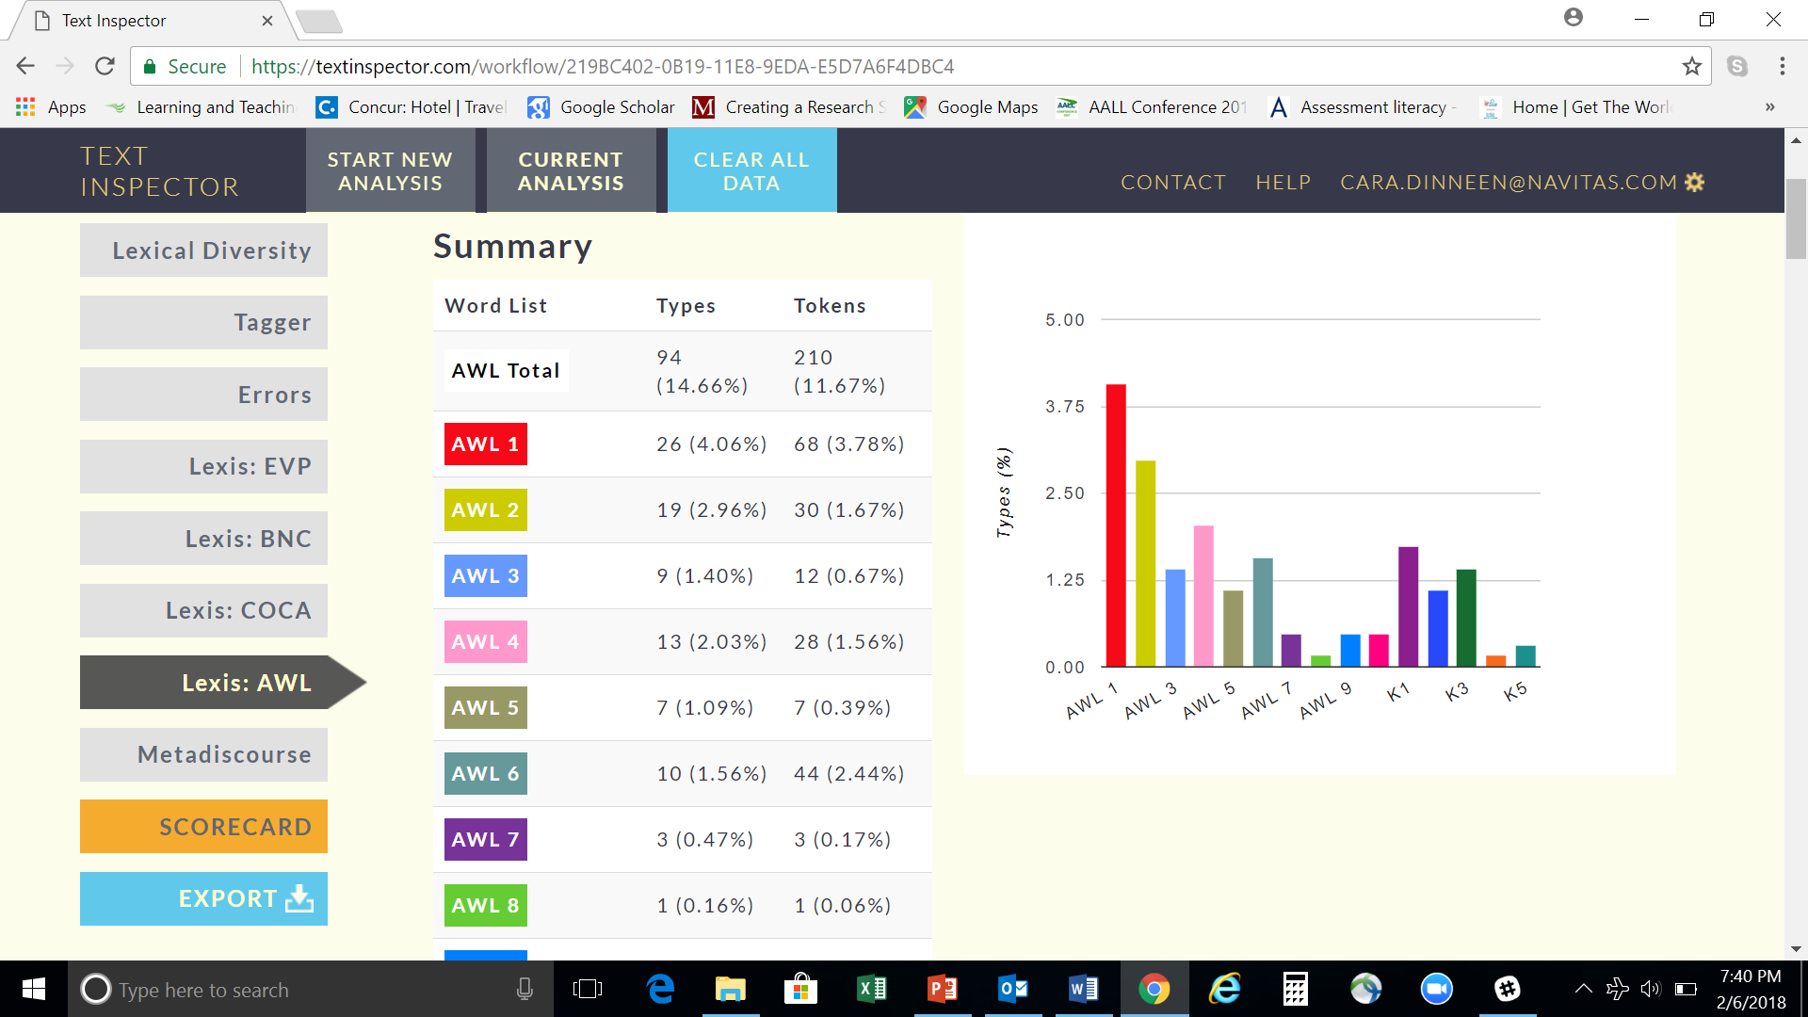

Slide 19
topic specific lexis

Slide 20
Learning & Teaching uses
Student writing
Student speaking (transcribed text)

Slide 21
METADISCOURSE

Slide 22
Student Essay excerpt (see rating on next slide)
It is evidently reasonable for some people argued that parents should not take the responsibility for youngsters’ obesity. To start with, parents should support the whole family by working outside. Today, the competition of the works are increasingly stiff, which deprive of time from parents to take care of their children. Actually, parents want to prevent their children becoming obese, but they really have not time as working is time-consuming. Moreover, children themselves should mainly responsible for becoming obeses rather than parents. That is to say, children should learn to take care of themselves well. Instead of overly dependent on their parents.
In contrast, some other people suggested that parents should be hold the responsibility. It atributed to several reasons. First of all, parents spend little time on their children Specifically, parents need to work and they do not have enough time to prepare food for their children; therefore, children turn to buy more fast food.

Slide 23
C1+ rating for student’s essay – reflective of vocabulary but not writing skill

Slide 24
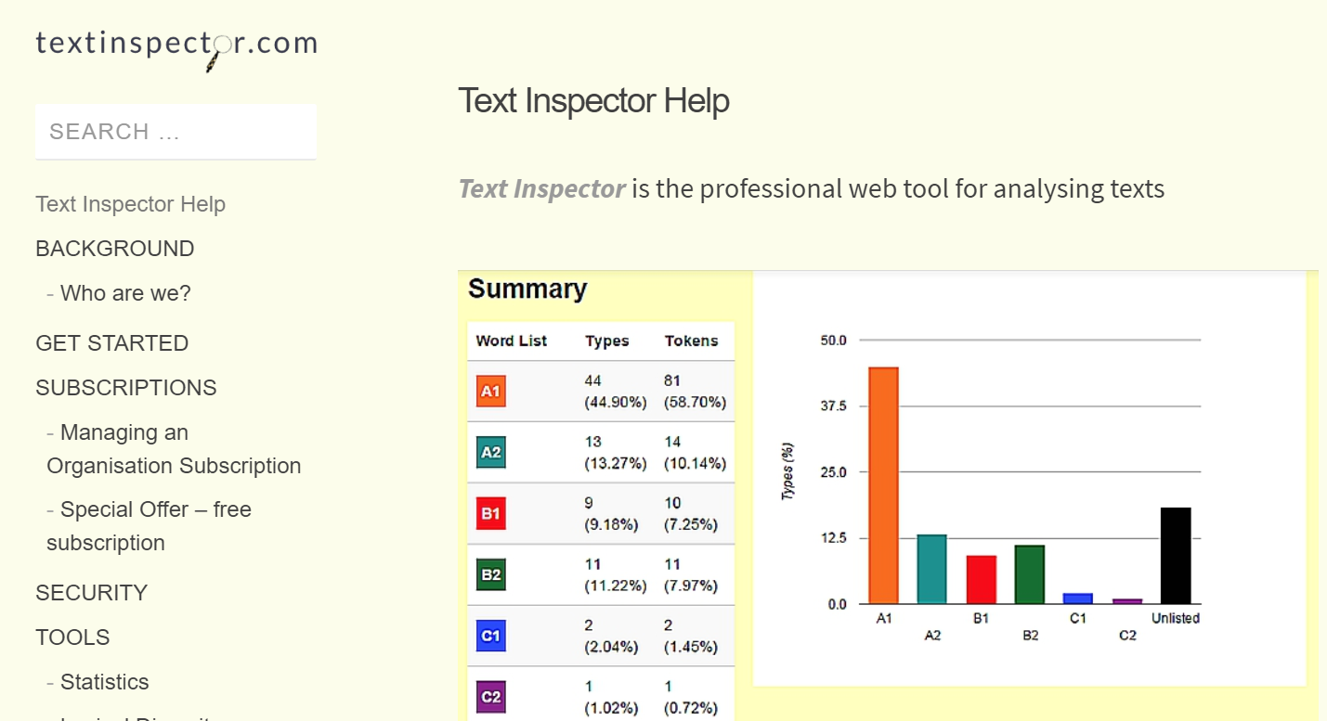

Slide 25
References
Laufer, B. & G. Ravenhorst-Kalovski (2010) ‘Lexical threshold revisited: Lexical text coverage, learners’ vocabulary size and reading comprehension’ Reading in a Foreign Language, ISSN 1539-0578, April 2010, Vol. 22, No. 1, pp.15-30.
Miltone, J. (2010) “The development of vocabulary breadth across the CEFR levels”, in The development of vocabulary breadth across the CEFR levels, I. Bartning, Martin, M., and Vedder, I. Eurosla, 2010, pp. 211-232
Text Inspector (2018), “About text inspector”, accessed 7 February 2018. https://textinspector.com/help/

