Slide 1

Developing high quality reading tests
The test development cycle
Megan Yucel
UECA Assessment Symposium, Saturday, 14 July, 2018

Slide 2
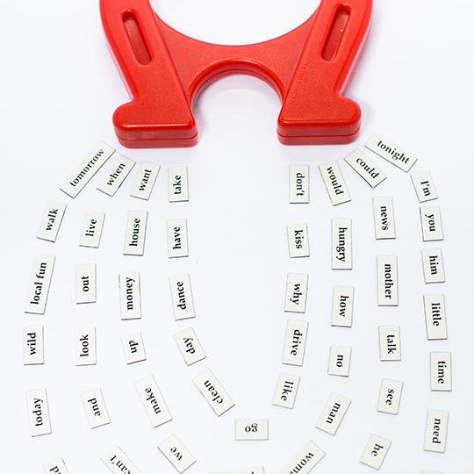
Challenge
How to develop reading tests for use in direct entry courses that are valid, reliable, and fair.

Slide 3
Outline
1
4
Context & rationale
Development cycle
2
5
Specifications
Text and task selection
3
6
Writer recruitment
Writing the items

Slide 4
Context & rationale

Slide 5

Context

Slide 6

The ELICOS Standards include a general requirement to ensure that assessment is valid, reliable, fair and clearly referenced to criteria. More specifically (Standard P4 at P4.1 c (ii)):
in the case of ELICOS courses which are provided under a direct entry arrangement to a tertiary education course, formal measures must be in place to ensure that assessment outcomes are comparable to other criteria used for admission to the tertiary education course of study, or for admission to other similar courses of study.
TEQSA needs to be satisfied that these requirements are met for students entering higher education on the basis of an ELICOS program.

Slide 7
Rationale
Needs
Responses
Need to produce multiple receptive skills tests of comparable level, appearance, quality
Need for the tests to be valid, easy-to-use
Need for the tests to perform a gate-keeping function (entry to UQ)
Planning – resources and time required, test specifications
Creation of an item-writing team as opposed to relying on individual teachers to produce tests
Putting in place a system whereby each test emerged from the same process

Slide 8
Test Usefulness
Reliability
Interactiveness
Impact
Practicality
Authenticity
Construct Validity
(Bachman and Palmer, 1996)

Slide 9
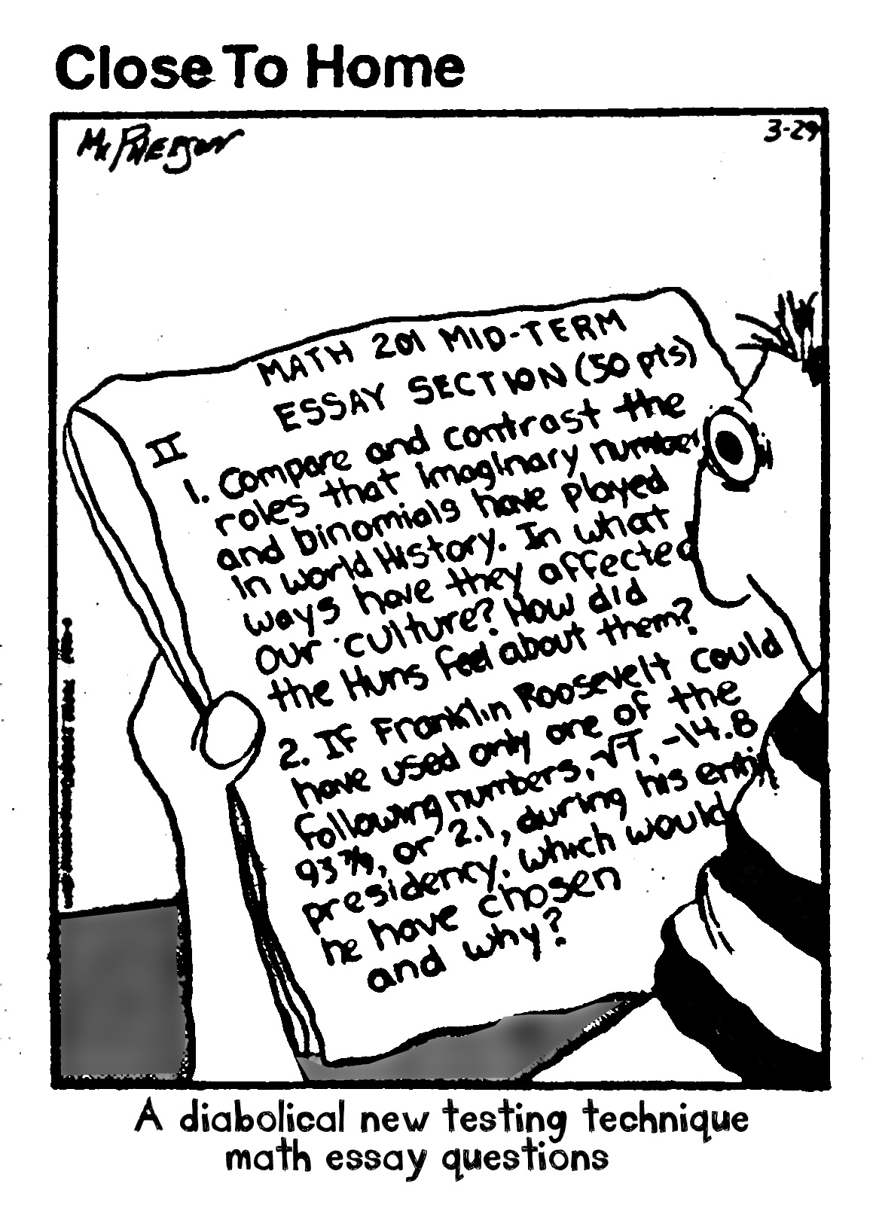
Comparability: Low
Authenticity: Low
Interactiveness: Low
Construct Validity: Low

Slide 10
Specifications

Slide 11
Purpose
To ensure that any assessment which is produced is:
standardised
modular and flexibly interchangeable so that a bank of assessment materials are available and tests can be assembled by selecting components from the bank
readily comparable with other accepted English language proficiency tests for the purposes of establishing the empirical validity of BEP assessment
practical in terms of the processes available for securely piloting and benchmarking assessment material

Slide 12

Contents
rationale
purpose
constructs
task types
texts
length
formatting
test-taking conditions
marking guides

Slide 13
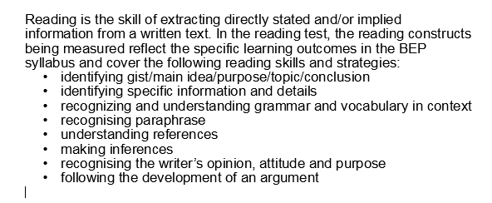
Construct

Slide 14
Writer recruitment
Notes:
Once the specifications had been developed, recruitment and training of item writers could occur so that we could then start producing items.

Slide 15

Writers and Editors: BEP Reading Tests

Slide 16
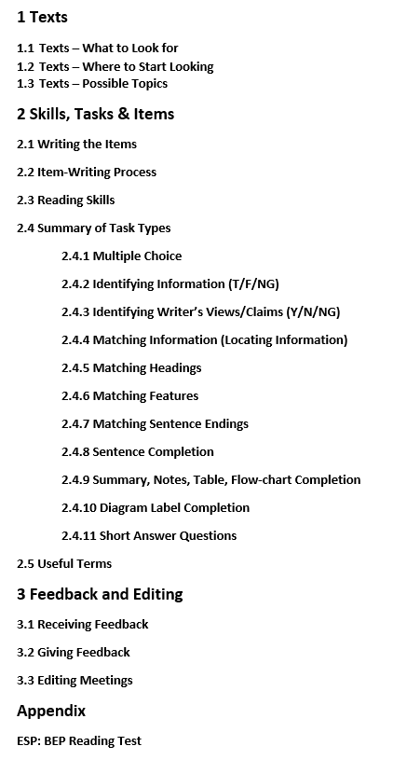
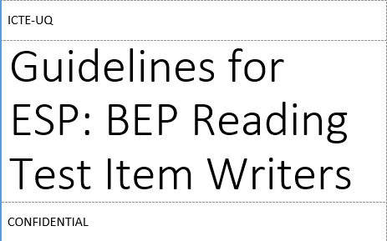
Training

Slide 17

An Expert’s View
Writing reliable test materials requires both science and art. The science comes from the technical aspects and, as you say, the need for standardisation. It takes years to learn and hone the skills to be able to produce test materials that are fair, valid, and reliable. The art (and perhaps the issue that is least understood) comes from the fact that the specifications and guidelines which item writers are given, are not a set of instructions or some sort of recipe that can easily be replicated with just a few variations. They are closer to a theory of how testing works that then needs to be applied in a skilful way to create something new each time. There is an art to that. We are repurposing texts, but to be able to do that, you need to be able to see the possibility within the original as well as the ‘shape’ of what you can create from it.
Yucel, M, Interview with Pauline Cullen, Language Assessment Matters, Issue 8, October 2017

Slide 18
Development cycle

Slide 19
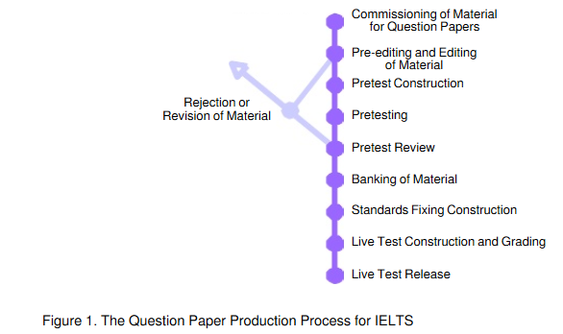
Insights from the Literature
Green, A and Hawkey, R (2012) Re-fitting for a different purpose: A case study of item writer practices in adapting source texts for a test of academic reading, Language Testing, Vol 29, Issue 1, pp. 109 - 129
Green, A and Hawkey, R (2012) An empirical investigation of the process of writing academic reading test items for the international English language testing system, IELTS Research Reports, Volume 11, 2012, pp. 273-374
Taylor, L and Weir, C (2012) Introduction, IELTS Collected Papers 2: Research in Reading and Listening Assessment, Cambridge: CUP, pp. 1-31

Slide 20
BEP Reading Test Development Model

Slide 21
Text and task selection

Slide 22
Texts: Where to look
Newspapers | The Guardian The Observer The New York Times The Australian | The Age Sydney Morning Herald Wall Street Journal International Herald Tribune
Magazines | The New Yorker Australian Geographic New Scientist Scientific American Psychology Today | History Today The Economist The Atlantic Magazine The Monthly Meanjin Archaeology
Websites/Apps | Longreads Pocket The Atlantic | Wired The Conversation

Slide 23
Topics
Agriculture Animals – biology, behaviour Architecture Archaeology Art Astronomy Business Culture Diet and Exercise Education Economics Employment Environment | Geography History Innovations Lifestyles Music Plants Psychology, Neuroscience Science Society Technology Tourism Traditions (etc.)

Slide 24
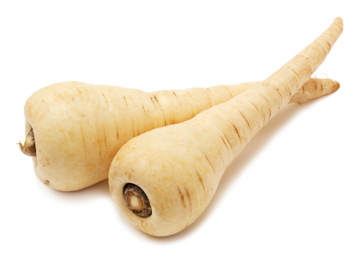
P A R S N I P S
Pork, Politics
Alcohol
Religion
Sex
Narcotics
Isms

Slide 25
Rejected Texts
Let’s Stop this Mindless Tree Planting
Global Health Report Card
Michael Moss and the profits of fat, sugar and salt
This is more of a list of countries and how they are doing in terms of health so is quite repetitive.
Texts that are good reading test sources need to contain a variety of different ideas otherwise the items will all be too similar and you will end up just testing one point over and over.
I also tend to steer away from texts that name countries and nationalities and present them in a negative light.
This text definitely has potential but needs too much work to make it a useable text for our purposes. Paragraph 1 is essentially a list of foods and their origins. Paragraphs 2 to 5 are definitely useable with lots of facts and opinions to test on but from there the flow is lost and it reads more like an interview. You would need to work on this to make a more cohesive text. You can see by the layout of the paragraphs that this text becomes less discursive as it progresses.
It favours anyone who knows about trees with some technical vocab (chalara fraxinea; the loss of this welter; coppice stools and pollards; casts its propagules.) It also basically makes one point that is then reinforced throughout the text: that there is a need for diversification of trees in the UK.

Slide 26
Advice on texts
Texts should be well written.
Work with one self-contained text.
It’s better to have a text that is too long that you can cut than one that is too short.
When you look at a text, can you find approximately 15 different items? Be wary of texts that make the same point over and over again.
Ask for a second opinion on any text before you start working on it. You don’t want to spend a lot of time on a text that just isn’t going to work.
Specialised vocabulary? Add a gloss (a brief definition in the text the first time the word is used) or insert a footnote.
Consider: What tasks does the text lend itself to?

Slide 27
Writing the items

Slide 28
Reading skills and tasks
Skills
Task types
reading for gist
reading for main ideas
reading for specific information
reading for detail
inferring meaning
understanding relations within sentences
understanding relations across sentences and paragraphs.
Type 1 – Multiple choice
Type 2 – Identifying information (T/F/NG)
Type 3 – Identifying writer’s views/ claims (Y/N/NG)
Type 4 – Matching information (Locating information)
Type 5 – Matching headings
Type 6 – Matching features
Type 7 – Matching sentence endings
Type 8 – Sentence completion
Type 9 – Summary, notes, table, flow-chart completion
Type 10 – Diagram label completion
Type 11 – Short answer questions

Slide 29
Item-Writing Process
Source your text | → | Write your items | → | Submit text + items for editing | → | Participate in editing meeting | → | Make suggested changes | → | Submit edited version for piloting
↑
Seek feedback/advice from assessment team colleagues

Slide 30
Advice on writing items
Think about the most appropriate task types for your text. Try a few different ones to see what works. Ask for a second opinion.
Remember that this is a test of reading comprehension – the ability to read and comprehend a text. You are not trying to ‘trick’ candidates.
Some tasks are aimed at reading for main ideas, some are aimed at reading for specific information, and others are aimed at reading intensively. As a general rule, try to target key ideas, not inconsequential details.
Students should be required to read the text in order to answer the questions. Don’t test general knowledge.

Slide 31
Advice on writing items
Aim to use clear straightforward language that is at a similar level to the text in terms of lexis or syntax.
The item should be a paraphrase of the point in the text that you are trying to test. Candidates should have to read and process the information and ideas in the text in order to answer the question. If the wording is too similar this processing does not occur.
Items should not overlap in any way. Bear this in mind if you have two or three tasks, because you can only target a particular point in the text once.
Each item should be independent. Getting the answer right for one question should not help you to get the answer right for the next question.

Slide 32
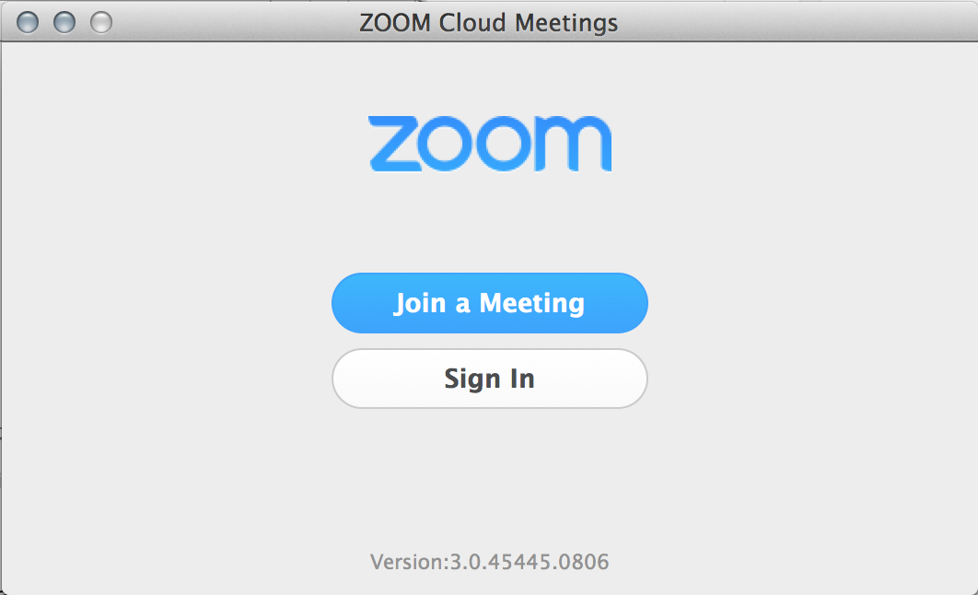
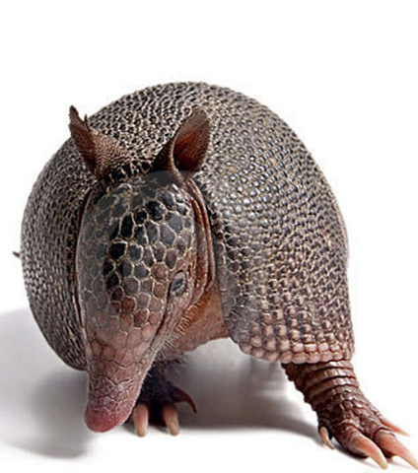
Editing

Slide 33
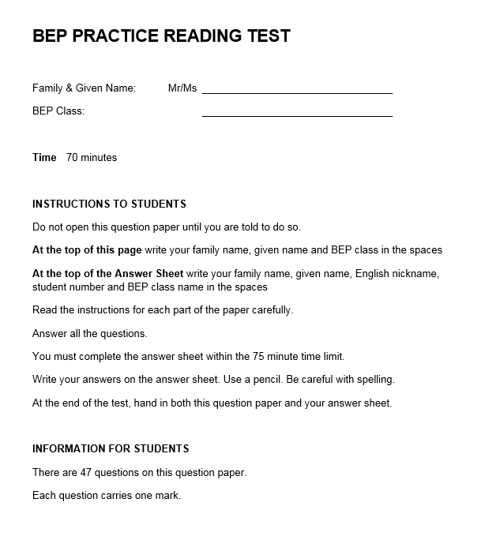
Trialling

Slide 34
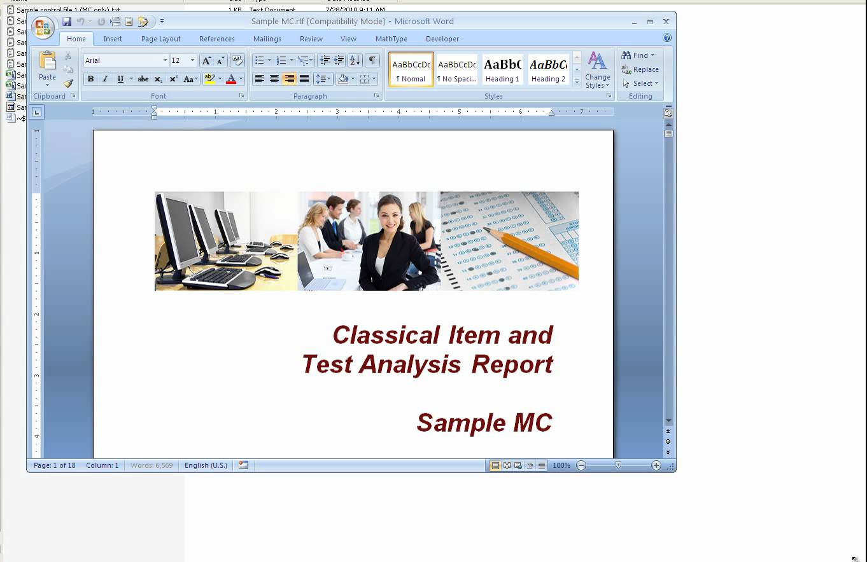
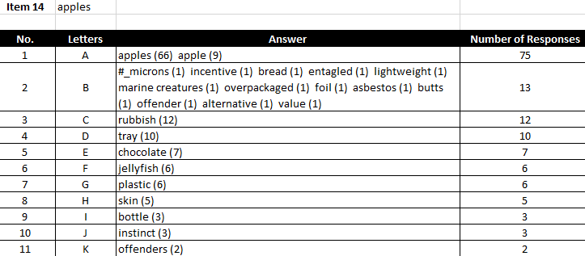
Data Entry & Item Analysis

Slide 35
BEP Reading Test Development Model

Slide 36


Slide 37
Thank you
Megan Yucel, Senior Teacher: Assessment
E: m.yucel@icte.uq.edu.au
T: (07) 3346 6770

